Slide 1
Microsoft Dynamics GP2010 Pre-Launch

Slide 2
Agenda
Dynamics GP Statement of Direction
GP 2010 Improvement Summary
What’s New in Dynamics GP 2010
Licensing in Dynamics GP 2010
Next Steps

Slide 3
Microsoft Dynamics GP Roadmap
GP “14”
GP “12”
Continued innovation targeted at mid-market with particular focus on:
Next Gen UI
Contextual Role Tailored Workflow
Microsoft technology
GP 2010
Continued innovation targeted at mid-market with particular focus on:
Simplicity
Productivity
Dynamics User Experience Leadership
Contextual BI
Time-to-Value
GP 10 SP4
Deep Functionality
Role Tailored BI
Next level of Office integration and Workflow
Corporate Performance Management
Extender Functionality
Microsoft Dynamics CRM Adapter for Microsoft Dynamics GP
MAJOR RELEASES
2009
2010
2012-2013
2015-2016
SERVICE PACKS/MINOR RELEASES
GP 10.0 SP4 Aug
GP 2010 May
Notes:
For mid-sized companies that struggle with a lack of functionality or that are overwhelmed by and overly complex system—Microsoft Dynamics® GP delivers a comprehensive ERP solution that goes beyond basic business management and reporting to meet your unique needs. Unlike many ERP systems, Microsoft Dynamics GP is easy to implement and use, enables all your people to work with information in ways that are familiar to them, and delivers innovation now and into the future.
Microsoft Dynamics GP has a strong product roadmap with GP “11” nearing release with GP “12” research and spec design underway. This consistent roadmap give confidence in the product future.

Slide 4
Breaking down the wall…
Front Office
Document Approvals
Back Office
Remote Workers
Payroll
Receivables
Budgeting
Payables
Receiving
Purchasing
Sales Staff
Financial Reporting
Executives
Accounting Staff
Time Entry
IT Staff
Customers
Vendors
Notes:
Historically, there has been a considerable wall around the core Back Office people and tasks that many ERP applications have served. People, processes, and information in the back office have been separated from the rest of the organization by means of closed ERP applications available only to those who had an actual login to use the system.
BUILD 1: What surrounds that wall are all of the other people and processes that make up the rest of the organization. In fact, the overwhelming majority of processes and need for information lies outside of this wall, where everything from Executives to Customers and Vendors to processes like Time Entry or Document Approvals have lived. These people have had to rely on those inside of the wall to get them the information they need to be effective, and the processes they require to be productive in their jobs have been supported by a series of disconnected systems or manual procedures that lead to many inefficiencies throughout an organization. This wall made it difficult for an organization to operate at their full potential, and made decision making a guessing game in many cases.
BUILD 2:
When using Microsoft Dynamics GP 10.0 along with the Microsoft Office and SharePoint products, customers can break down that wall and enable everyone throughout the organization to have access to the information and processes required to do their jobs. They can get more information with less confusion. More collaboration and less isolation. More productivity and less manual workarounds.
The ability to Extend the Reach of ERP is the type of power and flexibility customers are beginning to demand more and more from Microsoft products and partners.

Slide 5
Microsoft Dynamics GP 2010
Enhance Insight
Make It Easier
Extend Connections
Notes:
Three Launch Themes:
Microsoft Dynamics GP 2010 extends the reach of insight, productivity, and collaboration across your entire business, helping ensure that people—and the different ways they work—are your most powerful asset. New capabilities deliver faster access to personalized business intelligence, enhanced ways to streamline business processes, and built-in tools that speed deployment and customization. Equally important, Microsoft Dynamics GP 2010 takes full advantage of Web-based innovation, community, and collaboration to connect the entire enterprise—employees, customers, and vendors. We keep it simple, but we deliver the new way to do business.
Enhance insight
Bring personalized business insight to key roles in your organization and extend access to information to everyone in your company.
Make it easier
Automate business processes with rich new features that make it easier to work faster and smarter.
Extend connections
Dissolve traditional boundaries with solutions and services that connect people and systems and make it easier to strengthen business relationships.

Slide 6
Microsoft Dynamics GP 2010
Enhance Insight
Make It Easier
Extend Connections
Delivers Role-Tailored Insight
Streamlines Access to Information
Enables Advanced BI Capabilities
Increases Productivity
Automates Business Processes
Simplifies Personalization
Builds Better Relationships
Connects People and Systems
More Visibility
Less Effort
More Collaboration
Notes:
With the upcoming release, Microsoft Dynamics GP 2010 extends the reach of insight, productivity, and collaboration across your entire business, helping ensure that people—and the different ways they work—are your most powerful asset. Microsoft Dynamics GP 2010 gives people fast, access to personalized business intelligence, new ways to streamline business processes and build better relationships. Microsoft Dynamics GP 2010—The New Way To Do Business.
The three launch themes include:
Enhance Insight
Bring personalized business insight to key roles in your organization and extend access to information to everyone in your company. Microsoft Dynamics GP 2010:
Delivers role-tailored insight
Streamlines access information
Enables advanced business intelligence capabilities
Make It Easier
Increase productivity and automate business processes with rich new features that make it easier to do more with less. Microsoft Dynamics GP 2010:
Increases productivity
Automates business processes
Simplifies personalization
Remove Barriers
Dissolve traditional boundaries to build better business relationships that connect people, information, and processes across applications and systems. Microsoft Dynamics GP 2010:
Builds better relationships
Connects people and systems

Slide 7
Agenda
Dynamics GP Statement of Direction
GP 2010 Improvement Summary
What’s New in Dynamics GP 2010
Licensing in Dynamics GP 2010
Next Steps

Slide 8
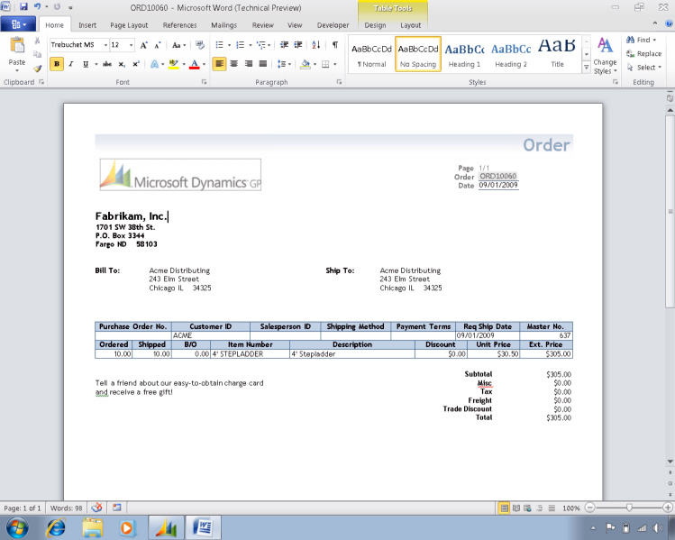
20
Business Intelligence Features
15
Field Service Features
22
Word Forms

Slide 9
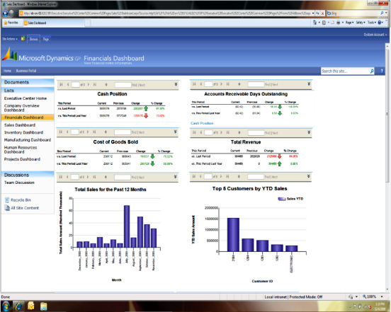
119
New Charts and KPI’s
20
New SRS Reports
11
New Excel Reports

Slide 10
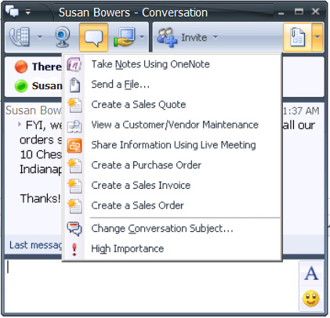
83
New Web Services
11
System Features
25
Financials Features

Slide 11
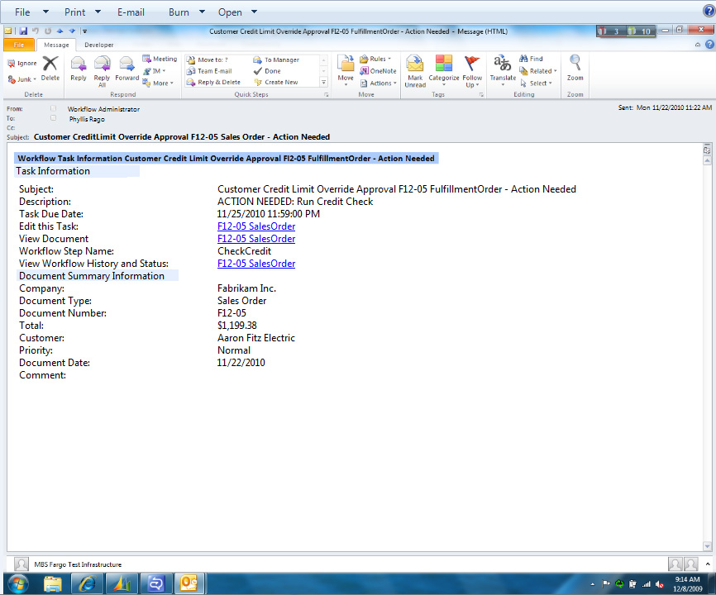
3
New Workflows
12
Distribution Features
20
Human Resources/ Payroll Features

Slide 12
22
Word Forms
25
Financials Features
119
New Charts and KPI’s
12
Distribution Features
20
New SRS Reports
20
Human Resources/ Payroll Features
11
New Excel Reports
15
Field Service Features
83
New Web Services
11
System Features
3
New Workflows
20
Business Intelligence Features

Slide 13
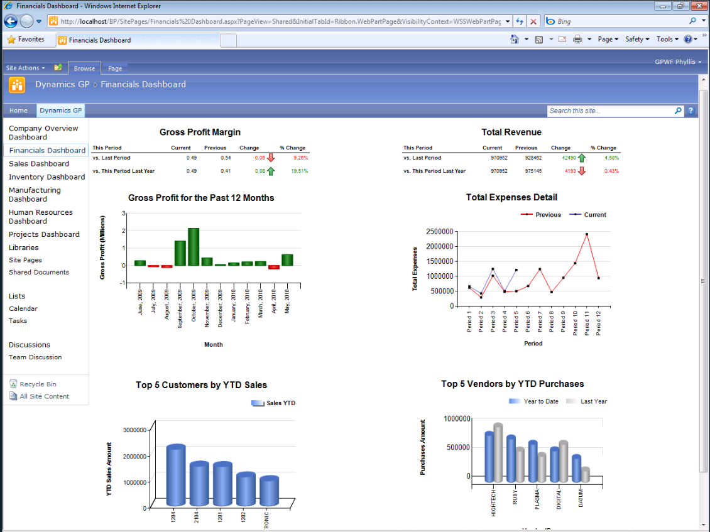
Enhance Insight – Charts and Graphs
Enhance Insight
Make It Easier
Extend Connections

Slide 14
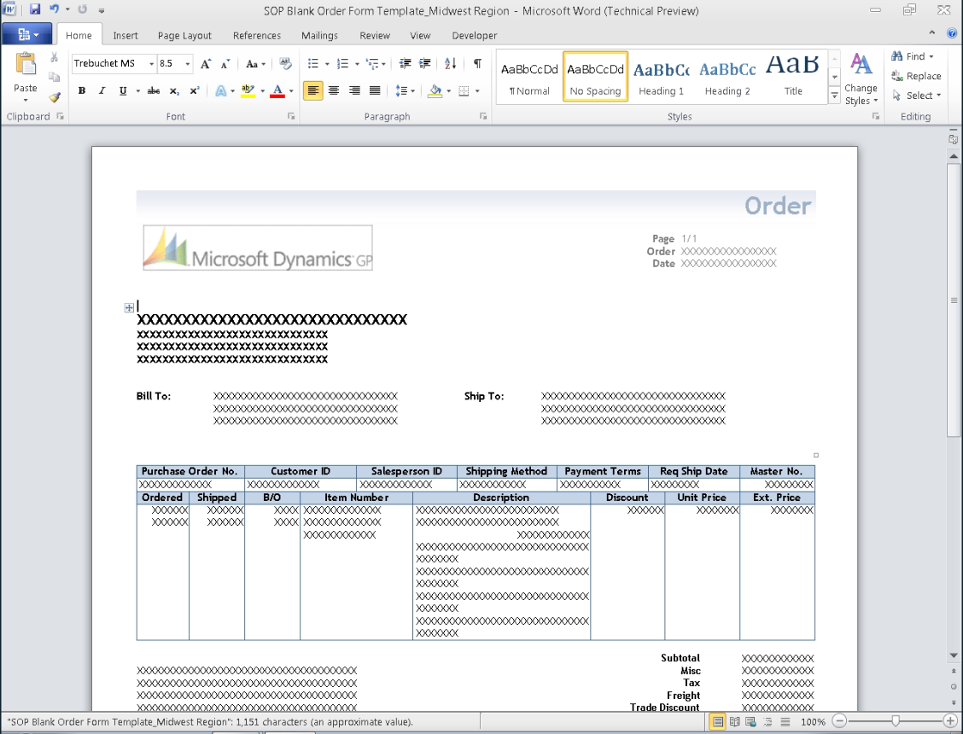
Make It Easier – Word Forms
Enhance Insight
Make It Easier
Extend Connections

Slide 15
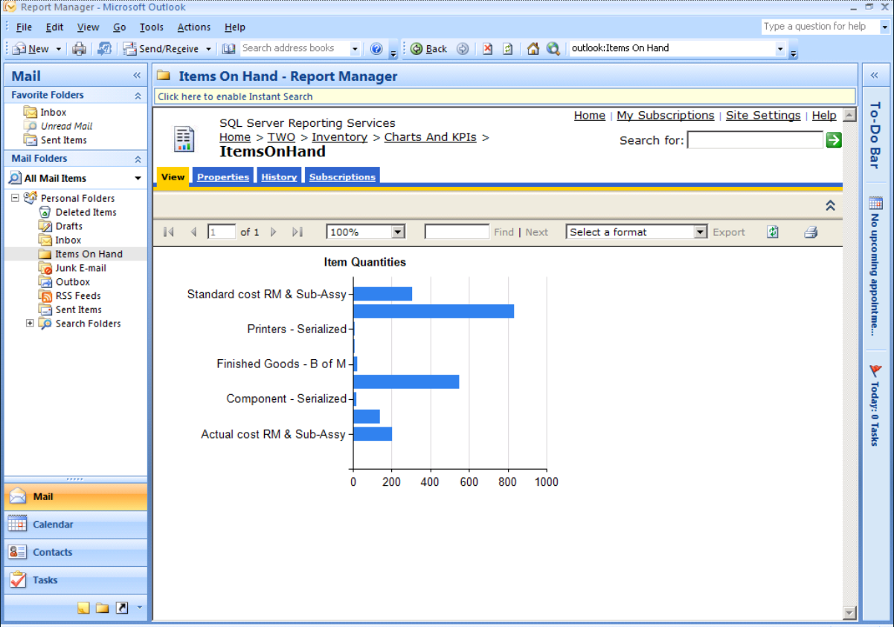
Extend Connections – SRS Extended to Outlook
Enhance Insight
Make It Easier
Extend Connections

Slide 16
Agenda
Dynamics GP Statement of Direction
GP 2010 Improvement Summary
What’s New in Dynamics GP 2010
Licensing in Dynamics GP 2010
Next Steps

Slide 17
What’s New in . . .System and Workflow

Slide 18
System Manager
Home Page Cues
Dynamics Connect Part
Unified Communication Integration
Registration Navigation Pane
Remember User and Company
Security Setup Sorting
Copy User Security
Context Menu (right click) support
E-mail Forms
Notes:
Cues – checkbox on reminders window
Dynamics Connect Part – will display customer source information specific to the company and role, will cycle through the slides
UC Integration – messenger address on customer/vendor/employee address record → internet information, once added, presence will display, can left click on the presence icon and start a conversation with the contact. In inquiry as well.
Registration Navigation Pane
Business Essentials and Advanced Management install multiple modules. In prior versions if a module was installed the Navigation Pane was available regardless if the customer would use it.
Allows administrators control over which Navigation Panes are available to users
Remember User and Company
Allows the user the ability to login without typing a password reducing the time needed to log into the system
Allows the user the ability to save their most used company reducing the time needed to log into the system
With both User and Company saved the user auto-magically is logged into Dynamics GP
Security Sorting
Allows the Security Administrator to view only selected:
Operations assigned to tasks
Tasks assigned to roles
Roles assigned to users
Increases efficiency for the Security Administrator
User Copy
Provides the ability to copy all security access from one user to another
Copies all operations, tasks, roles and company access
Increases efficiency for the Security Administrator
E-mail
send customer/vendor facing docs to assigned e-mail address automatically, assign diff docs to diff e-mails, attach multiple docs to single e-mail, customize e-mail message, send to multiple e-mail addresses

Slide 19
Workflow
Support for Microsoft SharePoint Foundation
Action Step Workflow
Vendor Approval Workflow
Employee Onboarding Workflow
Personnel Maintenance Workflow
Notes:
Microsoft SharePoint Foundation support for GP 11. Supports Versions 3.0 and 4.0. New customers will get SharePoint Foundation. Existing GP 10 customers that are upgrading to 11, can continue to stay on MOSS. MOSS is not available for new customers on GP 11.
Action Step Workflow- Ability to define an action that needs to be completed as part of the workflow process. Example: A step in the Credit Limit Override process might be ‘Check customers credit score and average days to pay’.
Vendor Approval Workflow-Route New vendors for approval, and route changes to existing vendors for approval.
Employee Onboarding- Integrated into Personnel Maintenance and HR Hire, when adding a new employee can be routed for approval or steps
Personnel Maintenance- - Integrated into personnel maint when make a change to an employee, route for step or approval

Slide 20
What’s New in . . . Access to Information and BI
Notes:
Improved access to information
Microsoft Dynamics GP 2010 features that will make finding and navigating to information more efficient for end users
What’s new in Business Intelligence
Microsoft Dynamics GP 2010 Business Intelligence features that enable you to personalize and visualize your data.
Extending report deployment & publishing

Slide 21
Improved Access to Information
Enhanced Integration to non-native Dynamics GP Reports
Default Views for Advanced Lookups
Drill-Through Support
Navigation List Builder
Add Extender as Table Type:
Smart List Builder
Excel Report Builder
Extender – Disable/Hide Fields on Forms and Windows
Notes:
Enhanced integration – Excel reports can be displayed in the series reports now, i.e. sales excel reports shows under sales nav button
Advanced lookups – save a default view, by user, customers, vendors, items, salespeople and employees
Drill through support – protocol handler allows you to drill back into GP from outside the app, i.e. from a metric or a SRS report, 23 fields available for drill back, the user can go into the SQL views and add them to other reports (e-one piece did not get done) there are 5 reports that have drill back enabled
E-one
Nav List Builder – will be part of smart list builder. Works off existing nav lists and lets them build custom lists by adding custom actions and fields using any GP. Can help perf by adding restrictions directly to the list which may speed up the access to the data. Will be a price increase if want to buy after May 1

Slide 22
What’s new in Business Intelligence
Dynamics GP Word Templates
Home Page Metrics
Business Portal Dashboards
Business Portal KPIs
Excel Report Builder
Pivot Table Support
Totals on Reports
Notes:
Word templates – focused on top 22 external facing documents customers use, to modify the templates need Office 2007. No office dependency to view the reports. This will support the modified documents they’ve already got. Enabled by default. Go to SOP → Enter invoice → Print invoice → Print destination window will display template → will open the form in word
New options are under reports menu --> Configuration → allows you to turn word forms on/off by form → and lets you define an image for the company (allows you to use a single template and pull the image from the company you are in.)
Template maintenance – allows you to say which templates to assign to the RW report, there will be at least one template, it shows with the asterisk to create a new template click new → mark existing checkbox → can modify which opens word → go to the developer tab to show the Dynamics GP add-in → shows field list and xml source to let you change/add/modify the fields on the report → save it will commit the template changes → click the add button in template maintenance to allow you to use this template in GP
can assign templates to specific customer/vendor or class
Home Page metrics – took existing home page metrics, duplicated in SQL reporting services, 2008 dependency, over 150 additional reports built on the portal side, then create own KPI’s and metrics and show them on the home page, drill back from the home page metric → to srs report → to detail information → back to GP transaction
BP KPI’s are redone in SQL 2008
Excel Report builder – can now select a pivot table as an option in the builder (traditional option is list)
- Totals on reports saves the option for totals

Slide 23
Report Deployment & Publishing
Support for SharePoint Server Deployment
Charts & KPI Deployment
Remove ‘sa’ Requirement to Publish Excel Reports
Save Settings when Publishing Excel Reports
Notes:
Option to deploy reports to Sharepoint
New option in deployment wizard for Charts and KPIs

Slide 24
What’s New in . . . Financials
Notes:
GP11 install – all mods
SmartList builder installed
Analytical Acct installed
Collections Manager installed
Office Communicator installed
email pdf needs Word installed and word forms turned on
HRP Suite installed
SRS 2008 Report Services installed (sharepoint or native mode)
SRS Reports deployed
Lesson company data
Enable Reporting Ledgers in GL Setup

Slide 25
General Ledger
Budget Transactions
Consolidate Multiple Budgets
Reporting Ledger Functionality
Clear Amounts in GL Recurring Batches
Notes:
Budget transactions – Add GL Budget Trx Batch, enter transactions and show how can view edit list and post
Consolidate budgets – can copy from one budget to another, same accounts will combine amounts, can remove copied budget when complete, option in budget maintenance
Reporting Ledger – option in GL setup, show checkbox in GL Journal to assign a journal entry to a specific reporting ledger. Sub ledgers automatically assign to base, can stop in GL and modify if desire, show inquiry where can view summary for one, two or all 3 reporting ledgers. Can setup Excel Reports to restrict by reporting ledger, will be integrated with MR and FRx
To help make IFRS reporting easier
Base ledger is automatic for all sub ledger transactions
GL Journal transactions can be assigned to 1 of the 3 ledgers, so enter the fixed asset using IFRS rules as IFRS and enter the same trx using local GAAP as Local Ledger. Then, when inquire or report, you can choose which reporting ledgers to combine to choose the amounts on the report

Slide 26
Receivables Management
E-mail Receivables Documents (not statements)
Updates to RM EFT
Recurring Cash Receipt Batches
Lockbox Enhancement
Negative Cash Receipt
Notes:
RM EFT
Financials → EFT format,
Financials → Checkbook → setup the checkbook with EFT bank information for RM
customer Address ID → EFT Bank information
When you enter a cash receipt sale
E-mail – do not e-mail statements with this, continues to function as it does today for email statements

Slide 27
Collections Management
Display Unposted Cash on Collections Main
Display Collections Reminders on Home Page
Print Collections Letters by Address ID
Collections Note Display on Navigation Lists
Reply to E-mail Address Option
Use E-mail Address from Customer Address ID
Collections Go-To Options in RM/SOP SmartLists
Open Note or Create New from Inquiries
Notes:
Collections Letters by Address ID – option on Collection Letters, a customer could now receive multiple letters, each letter will display the invoices grouped for that address ID
Reply to – Option in Collections Setup – Current Workstation, Current Agent, Customers Credit Manager
Use E-mail from Customer – if one exists on the Address ID for e-mail address, use it, otherwise, function as it does today

Slide 28
Payables Management
E-mail Vendor Remittances
Select Checks Enhancements
Additional Restrictions Functionality
Restrict Invoices by Expired Discount Date
Vendor Workflow
Notes:
Select Checks Enhancements
Show setup option for discount date
Show select checks window, choose restriction and insert into selection window

Slide 29
Other Financials
Analytical Accounting
Security for user creating dimension code on the fly
Integration with US Payroll
Not For Profit
Control Account Management for Receivables
Encumbrance Options for Workflow/PO Approvals
Notes:
NFP
Encumbrance options – allows you to set how the encumbrance will happen once a PO has been approved. It’s in encumbrance setup, lets you choose to encumber right away when PO is approved (same as GP10), encumber if under budget or never encumber. Never encumber would need to go through Mass encumbrance and can validate budget amounts.

Slide 30
Expense Management Update
An Updated Integration will be Available for the New Concur Travel & Expense Service
$1,000 for the Integration
Price does NOT include Concur Setup Services (a change from the previous eExpense pricing)
Available in Late Spring 2010
Available to Pro, AM, and BE customers
NEW - availability to BE customers
Existing eExpense Pro Customers – No Charge for Integration

Slide 31
Management Reporter

Slide 32
Benefits of Management Reporter for Users
Easy Transition from FRx
Dimension Flexibility
Formatting Enhancements
Logos & Images in Headers and Footers
Page Breaks in Columns
Organization
Folders for Storing Templates
Report Library for Generated Reports and External Files
Report Viewer
Undo
XBRL
Notes:
Transition
Since Management Reporter is built using the same concepts as FRx, it will be an easy transition for customers.
Undo
Seems small, but makes the app more consistent with other msft applications.
Dimension flexibility
Allows for more flexibility when creating reports. The structured rules of regarding segments in FRx are no longer a limitation. By allowing larger and variable length masks, Management Reporter scales better to larger customers. By having the same functionality in columns and trees as rows, customers can use individual dimensions, ranges of dimensions, wildcard any dimension or subtract any dimension. They can go crazy!
Formatting
Board room quality reports are a given and by adding logos/images to headers and footers, reports become even more customized. Allowing for page breaks to be specified in columns, users can control what data is displayed on what page. If the columns contain departments, they can specify the departments they want printed on each page by using the column page breaks.
Organization
By creating folders, users can organize and easily find the building blocks they are looking for, which increases productivity.
Report Viewer
Again, by creating folders in the report library, reports can be found easily and put into folders that make sense to everyone in the organization. Security can also be applied to these folders to make sure only those individuals that should have access to certain folders or items have access. Also, any supporting documents to the financials can be added to the report library. All of the information users need are all in one place.
When viewing report data, the same great drill down functionality is available to get to the information users need, but can either use a tree to navigate or drill through as they are used to in FRx. And, it doesn’t open a new view each time you drill. Users can see where they are it the report and can easily get back to summary information.
XBRL
Management Reporters supports XBRL 2.1 and Dimension 1.0 specifications. Tagging of financial data is done at design time which allows the tagging to be re-used. A new instance document can be created by simply changing the report date. This is unique in the field as most XBRL applications tag financial information in Excel after the report has been generated.

Slide 33
Benefits of Management Reporter for IT
New Code Base and Architecture
64-Bit
C# and .NET
SQL Server
IIS
Report Processing on Server (not local machines)
Improved Multi-User Environment
Active Directory
Notes:
New code base and architecture
64-bit support
Many companies are upgrading their systems to 64-bit. Management Reporter was built using in 64-bit environments. The IT department won’t need to maintain a separate machine just for Management Reporter as they may need to do for FRx.
More stable
FRx code base was close to 20 years old and the design experience was closely tied to generating. Fixing bugs was risky because it resulted in breaking things in other areas. Management Reporter is much more stable. Each area of the application (designing, processing, viewing) is isolated which makes it easier to identify exactly where issues are.
Improved performance
Processing takes place on the server, not the client. This frees up the client to continue designing reports instead of locking it up until the report has finished generating.
SQL Server
No more Microsoft Access databases! This means no more corrupted spec files, no need to rebuild indexes to ensure new accounts are picked up. This results in less calls to IT or the partner to “fix” the issue. End users are much more productive.
Improved multi-user environment
With the switch to IIS and SQL Server, there is no need create shares for the sysdata and io_data. All of the building block, company information and generated reports are in a SQL database. Administrators can see all reports that are being generated at any given time since all processing is done on the server.
Active directory
Once users are added to Management Reporter, any changes made to passwords, etc by users are automatically rolled forward. There is no need to “manage” users in Management Reporter unless a user needs to be disabled or given a new security role. This also means the only login screen users see is the company login which logs them into GP.

Slide 34
Overcoming the Gaps
Currency Translation - GP 2010 Feature Pack
Forecaster Integration - Transfer tool to move Forecaster data into the GL
Row linking
Use dimension sets to handle exceptions that cannot be accommodated by using ranges and wildcards.
Create multiple dimension links in a single row format. This method works for consolidations and situations in which row definitions are similar and dimension codes are different.
WebPort
Report Library
Export reports to Microsoft Excel and upload to SharePoint Library
Email – Export reports to Microsoft Excel and attach files to email
Report Manager - Report Library with folder structure and external files
Notes:
Currency translation
Moving the functionality back into the GL allows the data to be done at the source and Management Reporter reports off of converted data as any other data in the GL.
Forecaster integration
Many customers want to have their budget data back in the GL for historical purposed. By providing them a way to move data from Forecaster back into the GL, the data is where they want it to be and they can create budget to actual reports in Management Reporter with no extra setup.
Row Linking
Not a large number of customers use row linking, but those that do tend to use it extensively. There are multiple workarounds to accomplish the same goal. In the next release of Management Reporter, we are evaluating a new way to handle the scenarios where row linking is used.
WebPort
The Report Library can be used to secure and share reports. Or, reports can be exported to Excel and uploaded to Sharepoint. In the future, the right solution is integrate directly with SharePoint. This is being planned for the next release of Management Reporter.
Email
Reports can be exported to Excel and the files can be sent to users via email. Again, the solution for the future is to use SharePoint and notification services to notify users of reports ready for review.
Report Manager
The report library, with it’s ability to create folders and upload external files, can be used to group items. Reports and files can be manually printed and included in a report book. In the next release of Management Reporter, we are evaluating the ability to select files, folders and reports and print them all at once.

Slide 35
What’s New in . . . Distribution

Slide 36
Distribution
Inventory Auto Number Lot Numbers
Sales Order Processing
E-mail SOP Documents
Print Backordered Items on Picking Ticket
Purchase Order
E-mail Purchase Order
Line Item Date Roll – down
Auto-Receive In-Transit Items
PO Returns Enhancements
Replace Returned Goods
Invoice Expected for Returned Goods
Notes:
Inventory Auto Number Lot
Allows users to setup a pre-defined lot mask for designated items
Provides the ability split receipts into multiple lots
Similar user experience to the Auto S/N feature requiring short learning curve
SOP
E-mail is turned on by default, but the documents are not defined to e-mail
Setup → Company E-mail setup (don’t need word to create Docx), docx uses word forms, html uses Report writer report, pdf/xps do require word installed
Enable – series, can setup messages and enable which docs you want to e-mail
Customer setup in enable – lets you say which customers you want to turn on documents and format type for the customers. This opens the customer navigation list, or can edit individually on the customer card
Sales trx Entry →enter document for an e-mail customer → Click e-mail expansion button next to customer ID, will display how the e-mail is going to be sent out
PO Returns - Replace returned goods, will reopen line item or PO if still current. If completed and removed, will create a new PO, will update encumbrance

Slide 37
What’s New in . . . HR and Payroll

Slide 38
Human Resources / Payroll
US Payroll Integration to AA
Post with Detail Option
Multiple W2 Boxes for Deduction/Benefits
Secondary Employee Status Code
Additional Payroll and HR Reports
Check Inquiry Reprint
Garnishment Single Maximum Option
Multi Build Functionality
Notes:
Posting → AA Dimension Defaults – you can define default dimension distributions for Payroll transactions, show transaction entry → dimensions window, also show Payroll Posting Edit List window (I built and calculated checks just for salary employees)
Post with Detail option – cool because gives additional detail in the general ledger, is available for customers who are not using AA, but is required for AA-PR
Multiple W2 boxes, up to 4 for each deduction and benefit. This will enable the amounts to print in multiple places on the w2 itself. Will also display in the edit W2 window
Secondary emp status code – additional way to group employees. For example, if an employee is inactive, you may want to see who is inactive because they are military deployed or who is on maternity leave
Additional Payroll and HR Excel reports – based on some of the feedback from Convergence last year, took 5 additional reports and incorporated them into the GP11 release
Check Inquiry Reprint – go to Check inquiry → select an employee, mark the checkbox on the right for a check and select to recreate pay stub
Garnishment single Maximum – in some cases, we’ve had the request to have a maximum garnishment that runs in sequence to give a minimum pay for an employee. As an option in garnishment maximum setup, choose to include previously sequenced garnishments

Slide 39
Human Resources / Payroll
Workflow
Employee Onboarding
Personnel Maintenance
Fiscal Year
Track Payroll Information
Apply Benefit/Deduction Maximum
Position Control Phase II
Budget
Reports
Notes:
Fiscal Year Payroll Tracking – show setup option, show benefit/deduction maximums for Fiscal year

Slide 40
Human Resources / Payroll
Certification Licensing Excel Reports
Payroll Extensions Report Preferences
HRP Suite Security Task Integration
PTO Manager – UI Refresh
Benefit Self Service
Benefit Confirmation Statement
Benefit Enrollment Summary
Notes:
HRP Suite Slide
6 Certification Licensing reports – 3 current, 3 history
Payroll Extensions, reports display in with posting accounts reports, so can set defaults for outputs when installed
Security tasks and roles have been created for all the HRP suite modules. Making it easier to grant access for individual users.
BSS – confirmation statement, now a user can print out the selections they’ve made for BSS in a friendly easy format
Enrollment summary – a HR manager can see the status of the benefit enrollment, how many users have submitted their selections, how many have not

Slide 41
What’s New in . . . Web Services

Slide 42
Web Services
A new, straightforward integration platform based on Web Services technology connects applications to/from Microsoft Dynamics GP, and enables internal or external developers to create independent integration adapters.
Take full advantage of innovation with a new Web Services architecture that offers better performance and easier integrations.
Benefit from more flexible integrations by using Web Services to create two-way connections that are not dependent on IIS.

Slide 43
Agenda
Dynamics GP Statement of Direction
GP 2010 Improvement Summary
What’s New in Dynamics GP 2010
Licensing in Dynamics GP 2010
Next Steps

Slide 44
Pricing and Licensing Update

Slide 45
Pricing and Licensing Overview
Module Consolidation into Suites
Module Moves
Module Additions
DCO (Dynamics Client for Office)
What is DCO?
How is it Changing?
New Pricing Waterfall

Slide 46
Module Consolidations into Suites
Notes:
Several suites are being created for Business Ready Licensing on Microsoft Dynamics GP 2010. Existing Customers must upgrade to take advantage of the suites. Their list price will remain the same.
Module Based Customers have the opportunity to license model transfer if it makes financial sense. If they already own one of the modules, then the transition they will automatically get the suite. Or they can purchase one module now and if they transition anytime in the future, they will receive the suite.
This is a huge opportunity customers can take advantage of by May 1, 2010.

Slide 47
Consolidate Risk, Integration & Customization Suites
Available to Advanced Management ALC and BUSINESS ESSENTIALS ALC
Risk Management Suite
Module | Old List | Old Total | New Total
Audit Trails | $5,000.00 | $9,000.00 | $5,000.00
Electronic Signatures | $4,000.00
Integration Suite
Module | Old List | Old Total | New Total
Integration Manager (All) | $5,000.00 | $8,000.00 | $5,000.00
eConnect / Web Services | $3,000.00
Customization Suite
Module | Old List | Old Total | New Total
Developer Toolkit | $3,000.00 | $10,500.00 | $5,000.00
Dexterity | $7,500.00
*Suites are ONLY available with Dynamics GP2010
Notes:
Existing Customers can buy one component module before May 1, and get the full suite when they upgrade to GP 2010. Which is a huge opportunity.
These are available on Ala Carte for Advanced Management and Business Essentials (NEW) May 1st.

Slide 48
Consolidate Manufacturing & Distribution
Available to Advanced Management ALC
Manufacturing Suite
Module | Old List | Old Total | New Total
Capacity Requirements Planning | $4,000.00 | $21,000.00 | $6,500.00
Engineering Change Management | $3,000.00
Job Costing | $4,000.00
Quality Assurance | $3,000.00
Sales Configurator | $4,000.00
Sales Forecasting | $3,000.00
Distribution Suite
Module | Old List | Old Total | New Total
Advanced Distribution | $6,500.00 | $10,000.00 | $6,000.00
Advanced Picking | $3,500.00
*Suites are ONLY available with Dynamics GP2010
Notes:
Existing Customers can buy one component module before May 1, and get the full suite when they upgrade to GP 2010. Which is a huge opportunity.
These are available on Ala Carte for Advanced Management only.

Slide 49
Module Changes

Slide 50
Modules Moves
Add to Business Essentials Foundation Pack
Field Level Security
Account Level Security
Electronic Banking Suite
Electronic Bank Management (UK)
Add to Business Essentials A La Carte
Modifier at a Reduced Price, $3000 US
Dynamics Client for Office (DCO)
Notes:
Field Level Security and Account Level Security came from Advanced Management
Electronic Banking Suite and Electronic Bank Management (UK) came from Business Essentials Ala Carte.
Modifier at reduced $3K price and Dynamics Client for Office (DCO) came from Advanced Management ALC.

Slide 51
License Transition from FRx to Management Reporter
 | Average BE 5 Full Users |  | Average AM 8 Full Users
FRx Designer (All Concurrent) | Before | After | Before | After
FRx Desktop or Report Designers | 5 | 10 | 8 | 16
Total |  | 10 |  | 16
FRx Viewers
FRx Drilldown Viewer (Named) | 7 | 7 | 14 | 14
FRx WebPort (Concurrent) |  |  | 4 | 8
FRx Report Launcher (Named) | 3 | 3 | 4 | 4
Total |  | 10 |  | 26
Notes:
Presenter Note: The 26 is the total # of DCOs they receive. We purposely omitted DCO until the DCO and Scenario section … immediately next.
Existing Customers will have their accounts simplified. For every user licensed that is named, they will received 1 named FRx Designer or FRx Viewer user. For every user licensed that is Concurrent they will receive 2 FRx Designer or FRx Viewers. Modules are folded into the product and not charge for additionally anymore.
Existing Customers will receive Management Reporter licenses as well which are Management Reporter Designers and Viewers. After consolidating FRx, then they will get the equal number of Management Reporter licensing.
FRx Report Manager is a module and does not have an equivalent, so no users will transfer to Management Reporter. Existing customers list price will be reduce for the value of this module.
New Customers who have an exception will be able to purchase FRx Designers and FRx viewers. The pricing will match the MR Designers and Viewers. MR users will come with the full user licenses and not FRx users.

Slide 52
DCO
Notes:
DCO opens up a wealth of familiar, easy-to-use, widely-used, and well tested tools that you can use with your Dynamics GP investment. These include a library of Excel-based Reports, a library of SQL Server Reporting Services Reports, a large collection of browser-based Employee Self-Service applications, Financial Report Viewing, and a library of SQL Analysis cubes. These tools open up endless possibilities to provide better insight and broader visibility into your Dynamics ERP information.
DCO encourages customers to stay current on their Dynamics ERP licensing. Customers on legacy licensing programs (also known as module-based licensing) do not have the option to license DCO.
DCO encourages customers to stay current on Dynamics and other Microsoft products. Many of the latest innovations can only be used when using the latest versions of Office, SharePoint, SQL, and Dynamics.
Microsoft, like our customers, is in business to make money. Cloud-computing and SAS are driving changes to the way that Microsoft must think about delivering value in on-premise licensing.
DCO leverages Microsoft’s economies of scale. A customer cannot build (or subsequently maintain) their own data access tool at near the per employee cost of a DCO investment.

Slide 53
Extend and Connect with DCO
Now Available for Business Essentials
SharePoint Portal
Business Intelligence
Database Access
Notes:
DCO is a license for people in your organization that do not have access to Microsoft Dynamics GP full client.
It contains a ton of functionality at a competitive cost. It contains functionality for portal solutions, reporting, and access the database.
03/24/2010 7:17 AM
53

Slide 54
Extend and Connect with DCO
Existing Customers get 1 DCO for Every Business Portal Licensed and 1 DCO for Every FRx Viewer Licensed
SharePoint Portal
Business Intelligence
Database Access
The New Executive Center Dashboards
External Lists with Write Back (SharePoint 2010)
Business Portal
Excel Reports
SRS Reports and Report Models
Graphs and KPI’s
Analysis Cubes
Management Reporter Viewer
Web Services Run-Time
eConnect Run-Time
Database Access License
Notes:
The value of DCO is organized into three buckets, Portal, Business Intelligence, and Database Access.
Portal includes our new executive dashboards, external lists that write back to the database and of business portal.
Business Intelligence includes the new Excel Reports, SRS reports, the SRS report models that make it really easy to create reports without a lot of Dynamics GP knowledge. It has over 190 charts and kpi’s with the ability to drilldown to deeper details. You can also take our out of the box, built in charts and graph and modify them, create different drilldowns, all without a developer and limited knowledge. Plus you get our analysis cubes for data warehouses, large datasets, and complex reporting. And you even get a Management Reporter view to view financial statements.
You get all of these things that are built in, plus database access and integration connections.
For Portal and Business Intelligence and Database Access, users get a huge amount of value for just $195 a user. To put into perspective, Management Reporter Viewers are $300 now $195. Web Port, now included in MR was $350 a user (minimum of 10). Report Launcher was $500 per user now in DCO. Analysis Cubes was 9,500 as a module, now in DCO. HRM Self Service Suite was $5000 plus $40 per user now in DCO. Focusing on portal and BI there is a huge amount of value.
03/24/2010 7:17 AM
54

Slide 55
DCO Waterfall Pricing Changes
DCO User Price Waterfall
From | To | Price | Discount
1 User | 24 Users | $195.00 | 0%
25 Users | 99 Users | $175.00 | 10%
100 Users | 249 Users | $150.00 | 23%
250 Users | Plus | $125.00 | 36%
Module Based Pricing (MBL)
No DCO License options available.
Business Portal Users are the equivalent of DCO
Business Portal for MBL price increases from $40 to $195
No Waterfall Price Breaks
Notes:
Exceptions for this pricing should be brought to the Business Desk.

Slide 56
Scenario #1
Existing Customer with a 3-User, BE
How Many DCOs?
3 (a result of the 3 FRx Viewers)
Notes:
FRx Concurrent License = x2
- Concurrent licenses are = WebPort
- Designers are not consider in the equation for DCO
FRx Named License = x1
- Named License are = Drill Down Viewers, Launchers

Slide 57
Scenario #2
Existing Customer with 8-User on AM & 20 BP Users
How Many DCOs?
20 (a result of the 20 BP)
8 (a result of the 8 FRx Viewers with AM)
28 (total)
Notes:
FRx Concurrent License = x2
- Concurrent licenses are = WebPort
- Designers are not consider in the equation for DCO
FRx Named License = x1
- Named License are = Drill Down Viewers, Launchers

Slide 58
Agenda
Dynamics GP Statement of Direction
GP 2010 Improvement Summary
What’s New in Dynamics GP 2010
Licensing in Dynamics GP 2010
Next Steps

Slide 59
Next Steps
Assess Your Benefit of Extending Connections to Dynamics Information within Your Organization
Contact Boyer & Associates for More Information
Purchase “DCO” Licenses before May 1st
Plan to attend Boyer Client Conference June 17th
Visit Boyer website for updates:
www.boyerassoc.com

Slide 60
Please fill out your survey for a chance to win a Zune!

Slide 61
Microsoft Dynamics GP 2010
Enhance Insight
Make It Easier
Extend Connections

