Slide 1

50 tips in 50 minutes for Dynamics GP

Slide 2
Keys to the 50 tips
This session is very fast.
Write down the numbers of good tips.
Follow up later with detail slides.
Relax and enjoy.

Slide 3
Agenda
Core Financials.
Distribution.
System and Integration.
Reporting.
Support, Administration and Security.

Slide 4
Core Financials

Slide 5
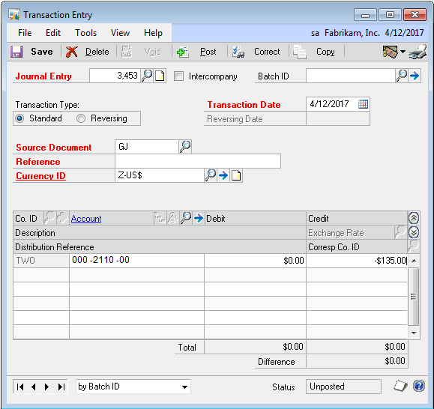
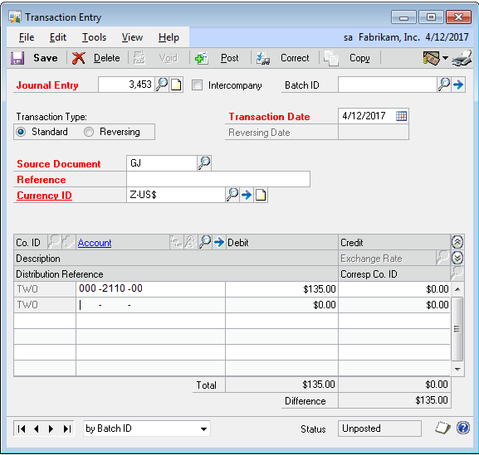
GL, AP, AR
1. Speed entry with negative debits.
1
Notes:
1. When entering account transaction data in Dynamics GP, the system tries to be helpful and puts the cursor in the debit or credit column based on the debit/credit setting in account setup. This is great until you want to debit an account with a default credit balance and vice versa.
You can obviously tab or shift-tab to get to the right field or you can move to the appropriate field with your mouse.
Or…
You can stay where you are and enter the item as a negative.
If you enter a negative debit Dynamics GP automatically enters it as a credit. Negative credits become debits.

Slide 6
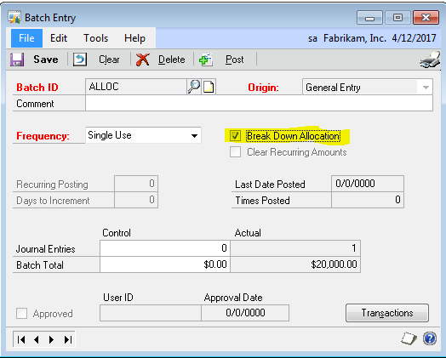
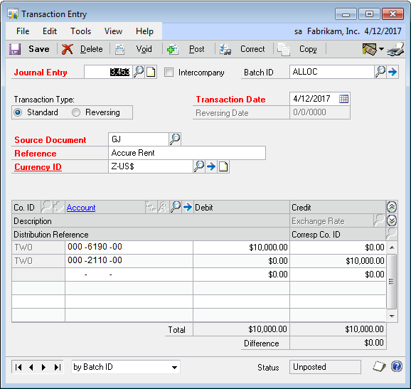
GL, AP, AR
2. Show allocations with breakdown
allocation accounts.
1
Notes:
2. Check the ‘Breakdown Allocation’ box on batches to show destination account for allocations
3

Slide 7
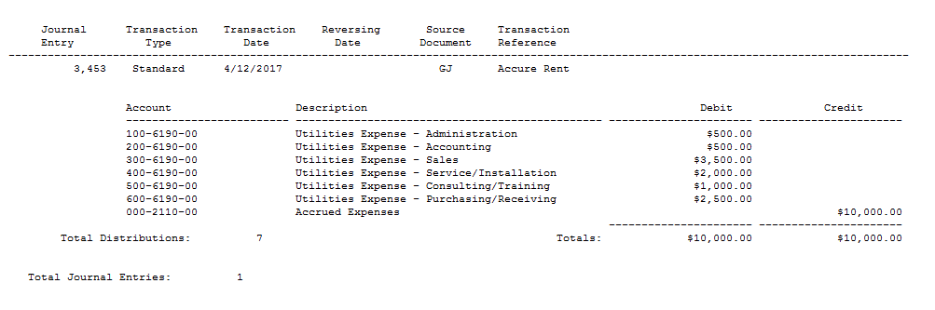
GL, AP, AR
2. Show allocations with breakdown
allocation accounts.
1
Notes:
2. Check the ‘Breakdown Allocation’ box on batches to show destination account for allocations

Slide 8
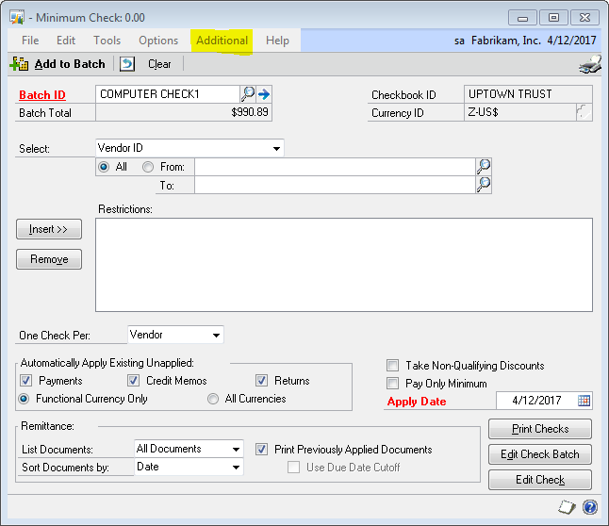
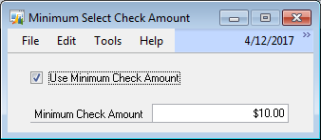
GL, AP, AR
3. Reduce payments with minimum
check amounts.
1
Notes:
3. Sometimes you don’t want to cut a check if it’s not at least a minimum amount. A common scenario for this is affiliate programs like Amazon’s Associates program. They won’t send you a payment until the amount they owe you equals $10.00.
In another example, when my college scholarship finished they sent me a check for a leftover $0.25. It cost the college more to mail the check and then I had this tiny little check that I had to go deposit.
In Dynamics GP we can control this and only cut checks when they are over a certain amount. Contrary to your first thought, this is not the Minimum Check line in vendor setup. That is used for when a minimum payment is due to a vendor, like a credit card minimum payment.
To only cut checks over a minimum amount, you need a free tool from the Professional Services Tool Library.
First, download and install the Professional Services Tool Library. Contact Boyer if you need help. Then check the box next to PM Minimum Check.
Now when you go into Select Checks to build a batch of AP checks, pick Additional>Set Minimum Check Amount from the menu.
In the box, make sure that Use Minimum Check Amount is marked and set a minimum check amount.
Back to our Amazon.com example. If you want to pay a group of vendors only when they are above the minimum but not worry about it for everyone else, the simplest solution is to put those vendors in a class. Then, process an AP check run for that class and set the minimum amount. For other check runs, simply remove the minimum amount and process normally

Slide 9
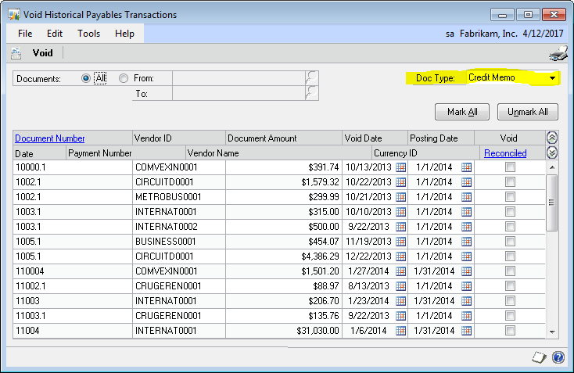
GL, AP, AR
4. Adjust payable applications by voiding
credit memos.
Notes:
4. Let’s say that you let AP checks automatically apply credit memos and a credit memo is a applied to a wrong invoice. Maybe it should have been on hold, it’s being disputed, whatever.
Voiding the check won’t unapply the credit memo application. Frankly if you had painstakingly applied a bunch of credit memos by hand and then had to void them because of a check printing error you’d be pretty upset that they had been unapplied.
So how to you unapply this credit memo since it completely paid off the invoice? You simply void the credit memo the same way that you would void a check, with Void Historical Transactions under Purchasing.
To make it even easier, change “All” selection in the upper right to “Credit Memo”. You’ll have to re-enter and reapply the credit memo but it’s still a pretty easy fix.

Slide 10
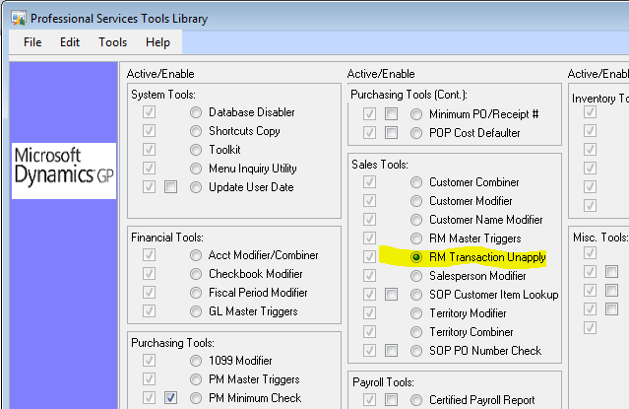
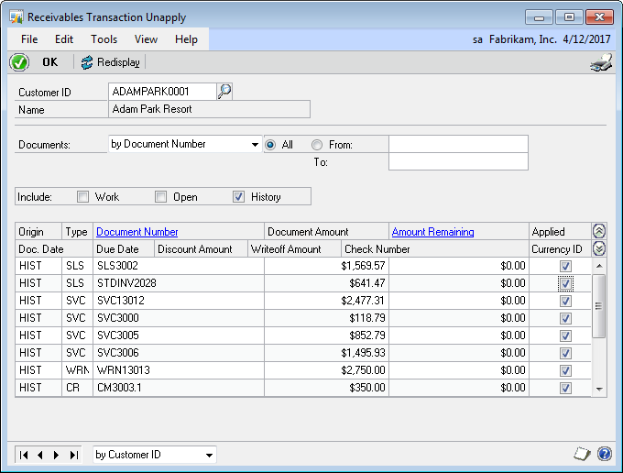
GL, AP, AR
5. Improve cash application with
receivables unapplied.
Notes:
5. For years now we’ve been recommending the use of Paid Transaction Removal for AR to move paid items to history and improve both AR and Collections management performance. One of the problems with this approach is that it it's difficult to unapply a payment after Paid Transaction. Now that the Professional Services Tools Library is free, this gets to be a whole lot easier.
PSTL includes a Receivables Management Unapply tool designed to unapply payments from the history table and allow user to apply them to other transactions.
The tool is really easy to use, simply run the Receivables Management Unapply tool, enter the Customer, find the item to unapply and an uncheck the box. The system will ask if you really want to unapply or just see a report. Indicate that you want to unapply and that's it.
A report does print with specifics. There are a few caveats and specifics around discounts, writeoffs and Multi-currency so be sure to read the help file included with PSTL.

Slide 11
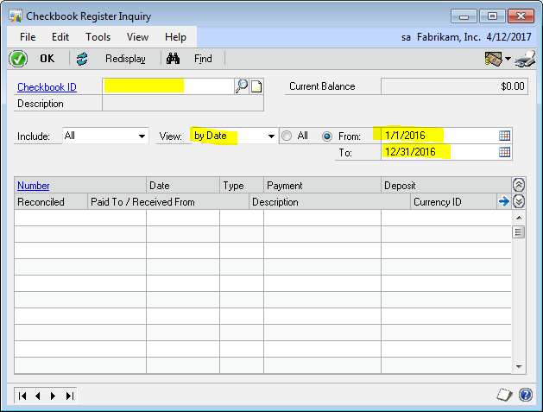
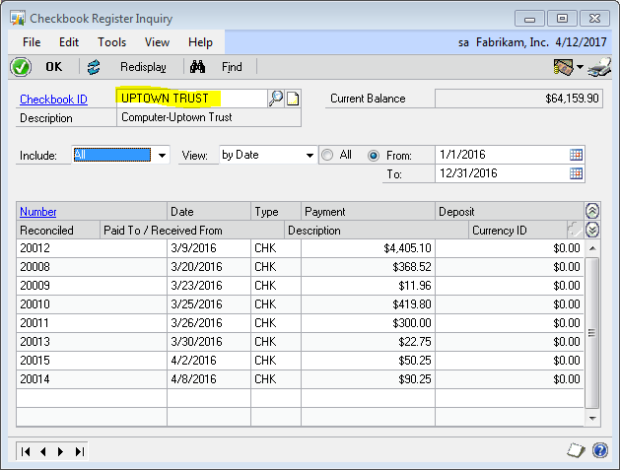
Banking and Fixed Assets
6. Speed checkbook inquiry with this tip.
Notes:
Pick Checkbook Dates Before the ID
The Checkbook register can be slow returning large amounts of data. A way to deal with that is to set the data range you want FIRST then pick the Checkbook ID.

Slide 12
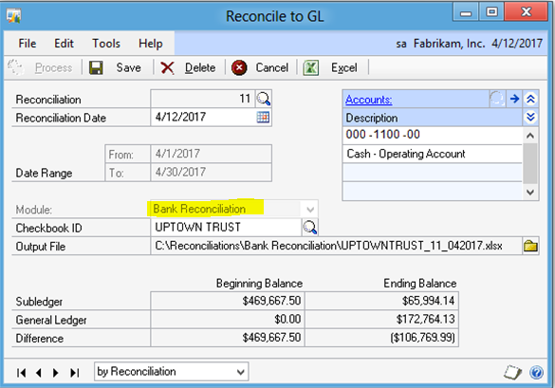
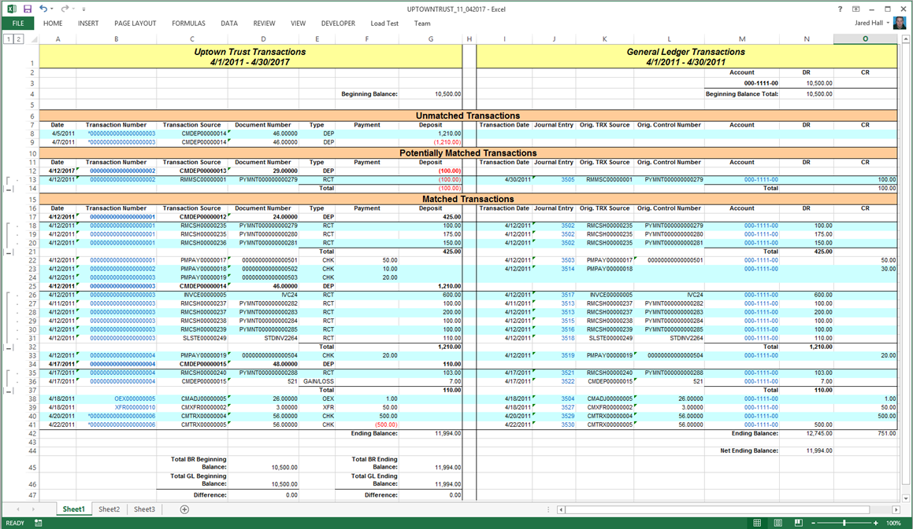
Banking and Fixed Assets
7. Reconcile checkbook to GL with
Microsoft Dynamics GP 2013.
Notes:
Reconcile checkbook to GL
(Financial >> Routines >> Financial >> Reconcile to GL)
A common challenge for Microsoft Dynamics GP users is reconciling difference between sub-ledgers balances and the balance for the associated GL accounts. The reconcile to GL routine, added in GP 10 , automated much of the work required to reconcile differences for Receivables Management and Payables Management. In GP 2013 they have added the Bank Reconciliation module to the Reconcile to GL routine, helping user analyze difference between the checkbook balances in Checkbook Balance Inquiry window and the associated General Ledger cas account for the checkbook. Each reconciliation is specific to a defined checkbook.

Slide 13
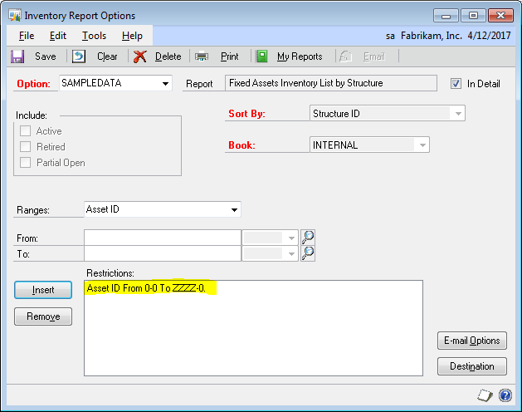
Banking and Fixed Assets
8. Don't leave off assets beginning with 'Z.‘
Notes:
Asset ID’s Beginning With “Z” Don’t Appear on Some Reports
We found a bug the other day that I swear I’ve seen reported somewhere but I can’t find it so I’m noting here for everyone. I have reported this to MS via PartnerSource and MS Connect.
For Dynamics GP 10 SP 5 and GP 2010 SP 1 at least, if the Fixed Asset ID begins with the letter “Z” the asset will not appear on at least some reports. I haven’t test this with R2 yet. To duplicate in Fabrikam, create a new fixed assets starting with the letter Z like Z1234 and assign it to structure 100. Create a second asset starting with the letter Y like Y1234 and assign it to structure 100.
Run the Inventory by Structure ID report using structure 100 as the only limiting criteria. Item Y1234 will appear on the report, item Z1234 will not.
Microsoft has indicated that this is a known bug reported in KB 863264 but the KB seems to be unavailable. No wonder I couldn’t find it. MS is working to update the KB to ensure that it’s available. There are no plans to fix this issue. If you want it fixed, vote for it on MS Connect.
You’ve two options to deal with this:
1) Add a Fixed Asset ID end range of “ZZZZZZZZ” to reports
2) Change the Fixed Asset ID via SQL. Fortunately, FA uses asset indexes, not the ID to link assets in various tables so the change only needs to happen in one table. However, some ISV solutions use the Fixed Asset ID (like Multi-Entity Management from Binary Stream) so you’ll need to check those too.

Slide 14
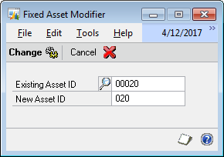
Banking and Fixed Assets
9. Clean up asset IDs by renumbering
fixed assets.
Notes:
Renumber Fixed Assets
Over time fixed asset numbering can get kind of messy, especially if you’re trying to keep some kind of logic to it. May you want your FA numbers to all be 5 digits and someone keys the asset with 4 digits. Well, the Fixed Asset Modifier, part of the now free Professional Service Tools, will let you rename an asset with minimal fuss.
It’s about a straightforward as you can get, enter or lookup the old number, key in the new number. The system retains the suffix which could be a challenge if you’re trying to cluster multiple assets based on an asset ID but it’s better than nothing.

Slide 15
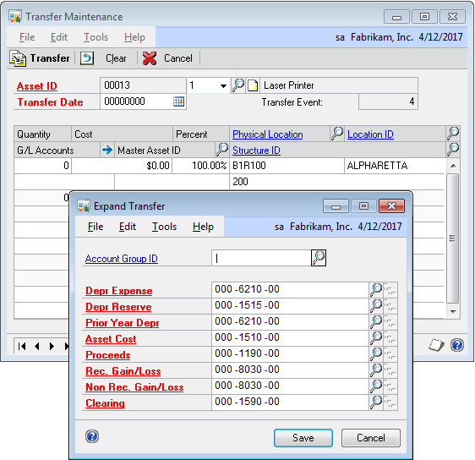
Banking and Fixed Assets
10. Keep assets in balance with GL
by transferring accounts.
Notes:
Fixed Asset GL Account Transfer
A lot people don't use Fixed Asset transfers because they think in terms of the physical movement of assets but transfers can be used for more than that. For example, if an asset has been going to a wrong account or if you decide to reorganize fixed assets and change accounts a fixed asset transfer can be used to move the GL accounts.
To transfer GL accounts for Fixed Assets in GP open the Financial Area Page. Under Fixed Assets pick Transfer. Select an asset and transfer date. Click the blue arrow next to G/L Accounts. Change the accounts that need adjustment and click transfer.

Slide 16
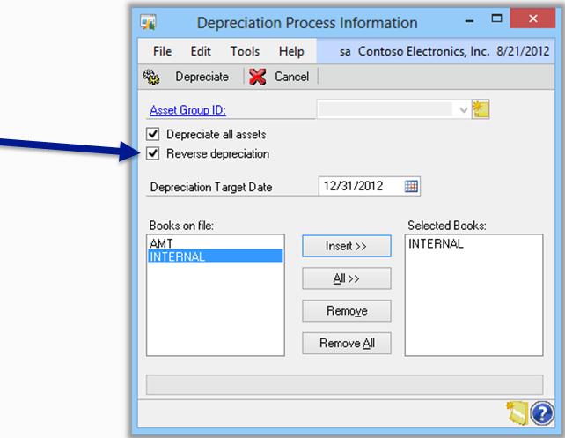
Banking and Fixed Assets
11. Fix errors with mass undo of depreciation.
(Microsoft Dynamics GP 2013)
Notes:
Fix Errors with Mass Undo
Financial >> Routines >> Fixed Assets >> Depreciate
This feature provides users with the ability to back out depreciation for all, or a group, of assets. The system currently has the functionality to reverse depreciation one asset at a time, which can be time consuming when the need arises to back out depreciation for a large number of assets. This new functionality saves a significant amount of time for users by allowing depreciation to be backed out for large groups of assets with a single process.

Slide 17
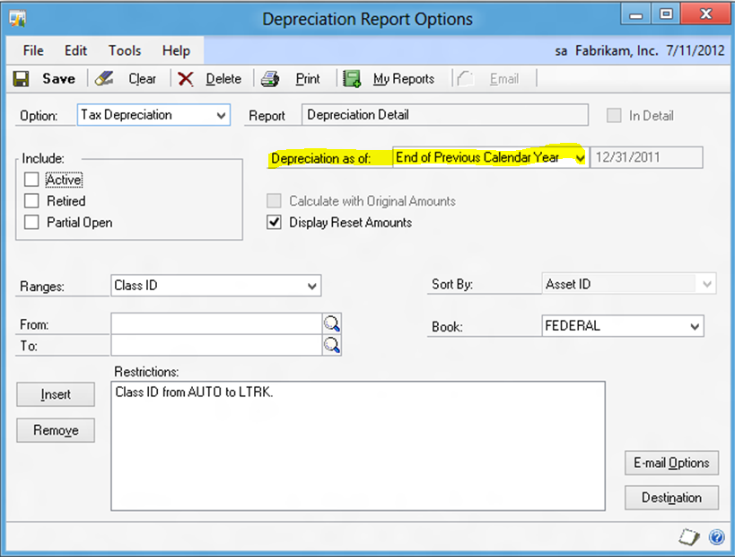
Banking and Fixed Assets
12. Improve reporting with fixed asset
historical reporting. (Microsoft Dynamics GP 2013)
Notes:
Fixed Asset Historical Reporting
Financial >> Reports >> Fixed Assets >> Depreciation >> New
New report option allow you to run “Depreciation as of” a specific date.
This feature is a top requested feature of Fixed Assets. In GP 2013 you have the option of reporting on historical depreciation amounts, adding a “depreciation as of” date to the report options. The depreciation of the report is then calculated as of the defined date giving you greater flexibility in depreciation reporting.

Slide 18

© 2013 Microsoft Corporation. All rights reserved. Microsoft, Windows, Windows Vista and other product names are or may be registered trademarks and/or trademarks in the U.S. and/or other countries.
The information herein is for informational purposes only and represents the current view of Microsoft Corporation as of the date of this presentation. Because Microsoft must respond to changing market conditions, it should not be interpreted to be a commitment on the part of Microsoft, and Microsoft cannot guarantee the accuracy of any information provided after the date of this presentation. MICROSOFT MAKES NO WARRANTIES, EXPRESS, IMPLIED OR STATUTORY, AS TO THE INFORMATION IN THIS PRESENTATION.

