Slide 1
What’s new in Microsoft Dynamics® GP 2013

Slide 2
System Manager

Slide 3
System Manager New Features
Area Page Changes
Default Sort on Lookups
Web Client
Print SQL Reports from Maintenance Windows

Slide 4
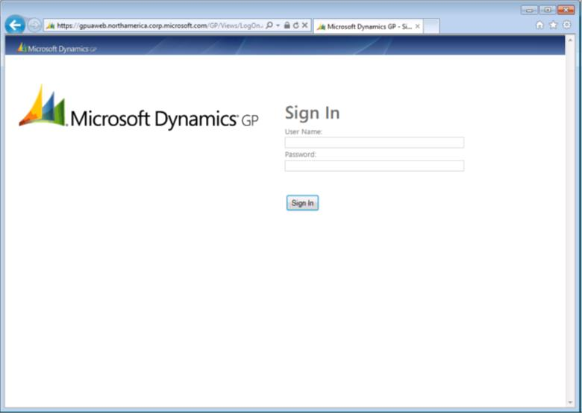

Slide 5
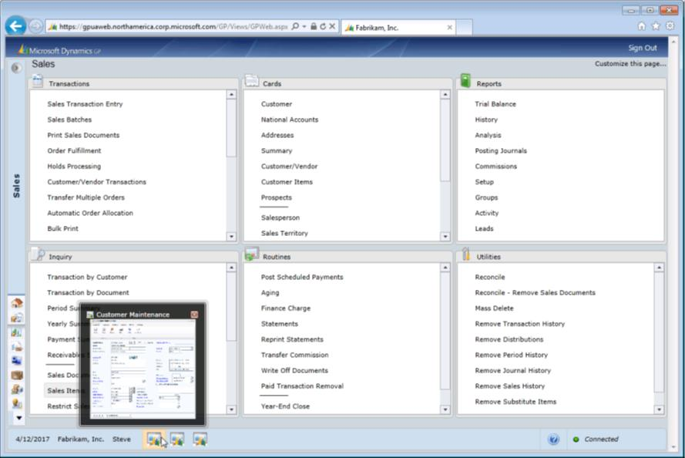

Slide 6
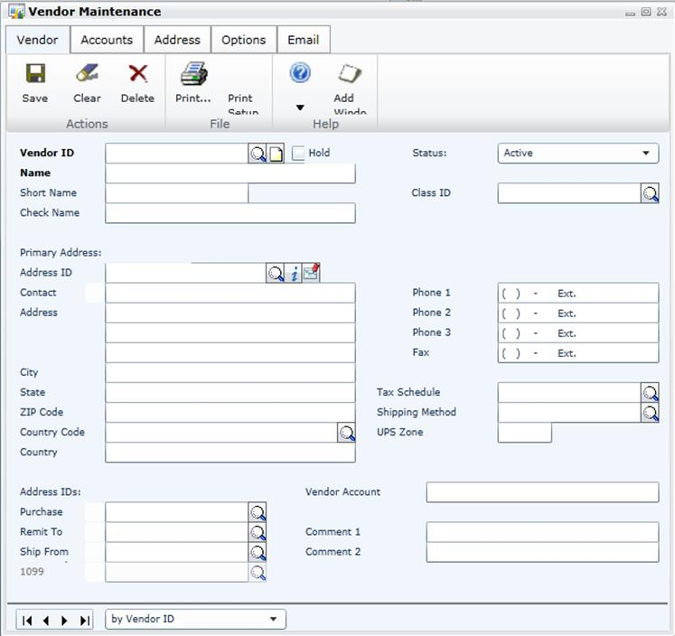

Slide 7
What’s new in Microsoft Dynamics® GP 2013: Financials

Slide 8
General Ledger New Features
Historical Journal Entry Inquiry
Clear Unit Account Balances at Year-End
Reconcile Options
Batch Approval Fields

Slide 9
Fixed Assets New Features
Historical Depreciation Reports
Reset History in Detail
Restrict Displaying Reset Transactions
Lock Fixed Assets Year
Process Progress Bars
Analytical Accounting Integration with Fixed Assets
Independent Fixed Assets Calendars
Define Short/Long Calendar Years
Autogenerate Next Asset ID
Intercompany Asset Transfer
Fixed Assets Transactions Batches / Post in Detail to GL
Mass Depreciation Reversal

Slide 10
Receivables Management
New Features
Rename User Defined fields for Customer Address
Multi-Currency apply in Cash Receipts Entry
Email RM Statements using Microsoft® Word® Templates
Save default sort order for Customer Lookups

Slide 11
Payables Management New Features
Void Check returns applied credit documents
Vendor’s Credit Card Invoice automatically voided when credit card payment voided
Settlement Date added to EFT payment
EFT Length and Delimitation Options
Edit Remit to Address
Save default sort order for Vendor Lookups
Change non-1099 Vendor and transactions
Edit 1099 Transactions
Print1096 Form
Email Indicators on Navigation Lists
PM Reprint Checks and Remittance Forms

Slide 12
What’s new in Microsoft Dynamics® GP 2013: Distributions

Slide 13
Microsoft Dynamics GP 2013
Purchase Order Processing
new features
Prepayment on PO
PO Tolerance
Tracking Serial/Lot Numbers
Prevent Purchase Order Close

Slide 14
Microsoft Dynamics GP 2013
Sales Order Processing
new features
Ship-to Address with a different company name
Consolidating POs from drop-ship Sales Orders
Combined Invoice
Suggested Selling
New Word Templates

Slide 15
Microsoft Dynamics GP 2013
Inventory Control
new features
Inactivate Items
Inactivate Sites
Bin Transfer History
Reason Codes
Multi-select Serial Numbers

Slide 16
What’s new in Microsoft Dynamics® GP 2013: HR and Payroll

Slide 17
Microsoft Dynamics GP 2013
HR and Payroll
Code Modifier
Build Exception Report
Disable Alignment Printing
Duplicate Checks
FICA TSA Deductions

Slide 18
Questions?

Slide 19
© 2013 Microsoft Corporation. All rights reserved. Microsoft, Windows, Windows Vista and other product names are or may be registered trademarks and/or trademarks in the U.S. and/or other countries.
The information herein is for informational purposes only and represents the current view of Microsoft Corporation as of the date of this presentation. Because Microsoft must respond to changing market conditions, it should not be interpreted to be a commitment on the part of Microsoft, and Microsoft cannot guarantee the accuracy of any information provided after the date of this presentation. MICROSOFT MAKES NO WARRANTIES, EXPRESS, IMPLIED OR STATUTORY, AS TO THE INFORMATION IN THIS PRESENTATION.

