Slide 1
30 tips for Management Reporter

Slide 2
Management Reporter (MR)
What is it?
Management Reporter is a real-time financial reporting application designed to empower information workers to quickly and easily create, generate, secure, and publish financial statements, such as Profit and Loss (P&L) statements, balance sheets, and cash flow reports.

Slide 3
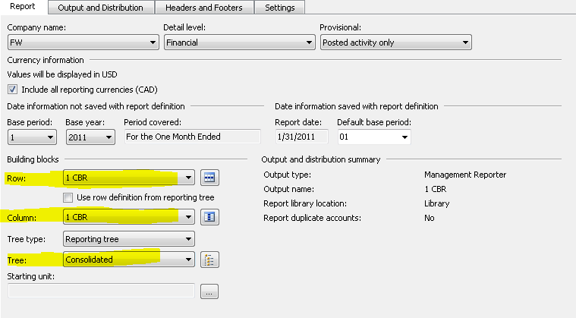
Management Reporter (MR)
Two basic comments are required for creating a report, the third is optional.
Row Definition
Column Definition
Tree Definition

Slide 4
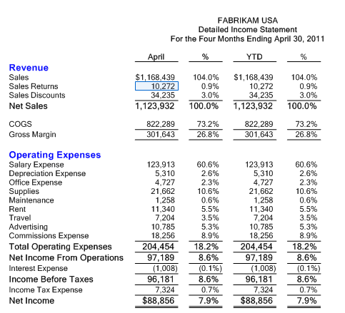
Management Reporter (MR)
Column Definition set to Month, YTD, and % calculation
Row Definition set to specific
GL accounts and simple
Calculations.

Slide 5
30 Tips Outline
Calculations | Columns | Rows | Organization | Web Viewer | Customization | Headers and Footers | Speed | Format | Other
CBR | Start/End | Prevent Drilldown | Related Rows | Go To | Default Fonts | Logos | Default Reports | Shading | MR Versions
Periods | Rolling 12 | Departments | Suppress Blank Row | Show Summary | Default Library | Additional Text | Find and Replace | Indenting | Long Date
Ratios | Dynamic Header | Column Break | Delete Blank | Other Currencies | Alt F1 | Rounding | Insert Rows | Box | Resources

Slide 6
Calculations
CBR (Change Base Row)
Allows the report to calculate a percentage of net sales or another row.
Row Definitions:

Slide 7
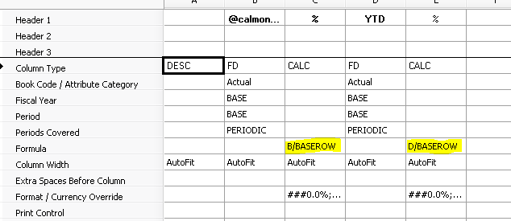
Calculations
Multiple CBR calculations:
Column Definition:

Slide 8
Calculations
Result:

Slide 9
Calculations
PERIODS
Calculates the average of periods calculated for the report.
Column Definition:

Slide 10
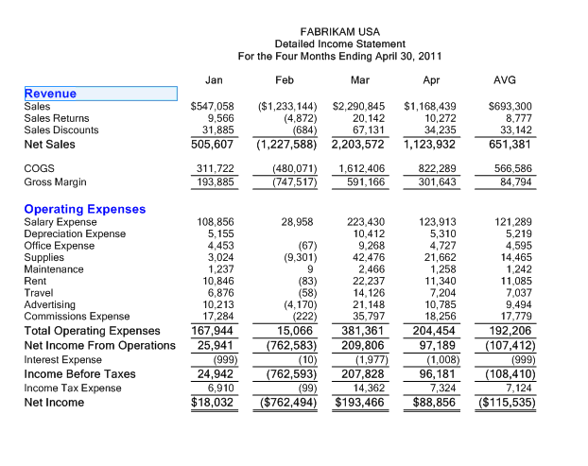
Calculations
This report was run for period 4, the last column sums the displayed columns and divides by the base period.
Result:

Slide 11
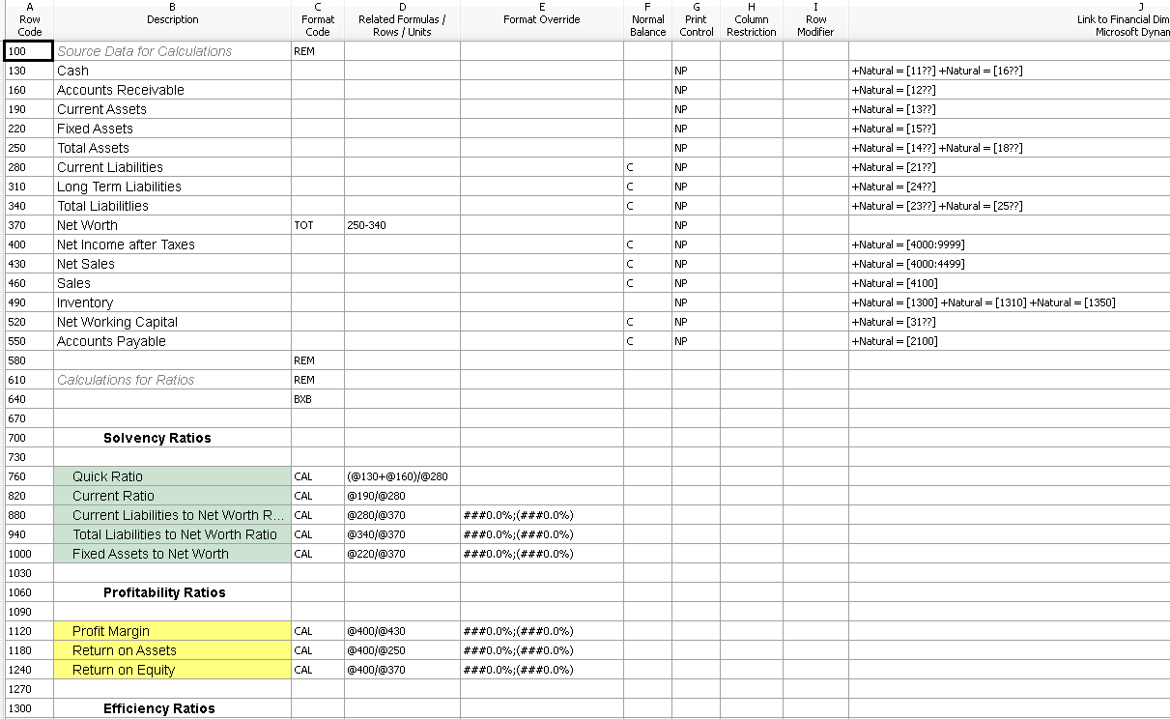
Calculations
Ratios
Use other rows to calculate ratios and other formulas eliminating the need to export to Excel.
Row Definition:

Slide 12
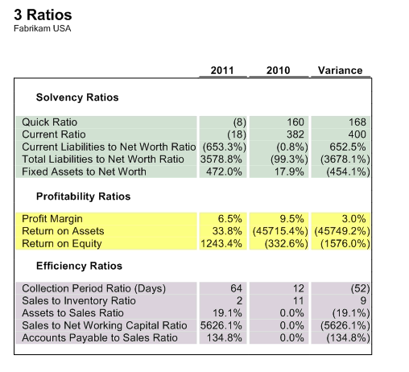
Calculations
Result:

Slide 13
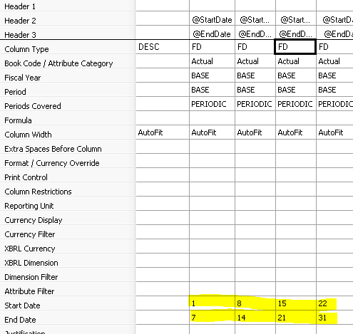
Columns
Start/End Dates
Use the starting and ending dates to create a weekly (daily) sales report.
Column Definition:
Result:

Slide 14
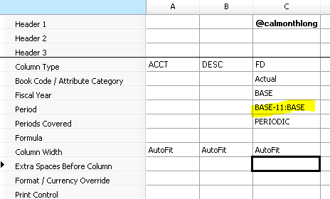
Columns
Rolling 12 Months
Use this to show a rolling number of periods dynamically. This example is a12 month rolling, Base plus 11 periods in the past.
Column Definition:

Slide 15
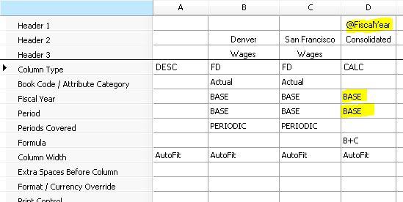
Columns
Dynamic Headers with CALC
If you want the auto text to populate in the column header for a calculated column you will need to define the Fiscal Year and the Period.
Column Definition:

Slide 16
Rows
Prevent Drill Down
To hide confidential information, yet allow details in the report, use the XD under the print control. This prevents the drill down feature when viewing the reports.
Row Definition:

Slide 17
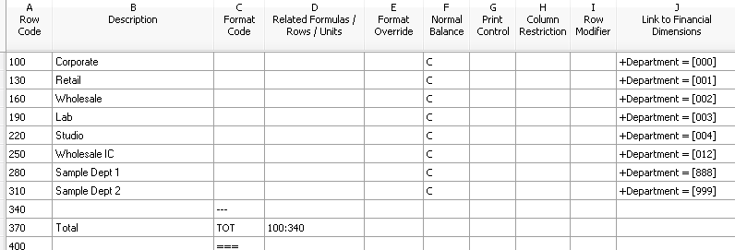
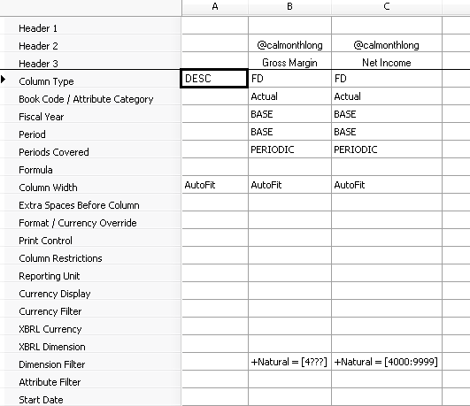
Rows
Departments on Rows
Flip the traditional report layout to have departments in the row or separate a row to show the different departments without having to drill down.
Row Definition:
Column Definition:

Slide 18
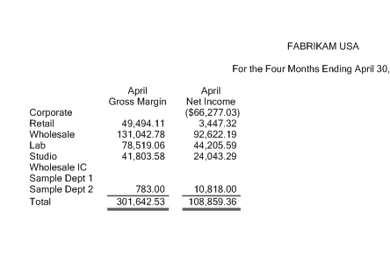
Rows
Result:

Slide 19
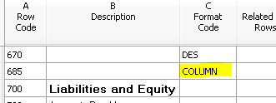
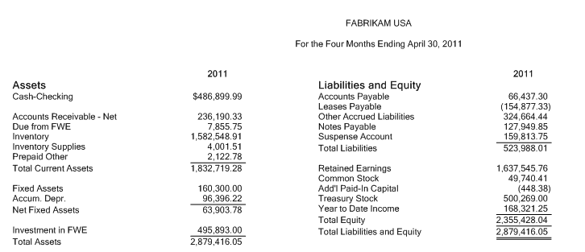
Rows
Column Format Code
This format is used to generate a side by side report.
Row Definition:
Result:

Slide 20
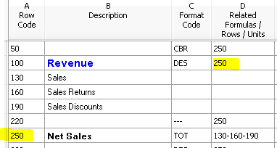
Organization
Related Rows
Clean up those consolidated reports with Related Rows.
Before:
Row Definition:
After:

Slide 21
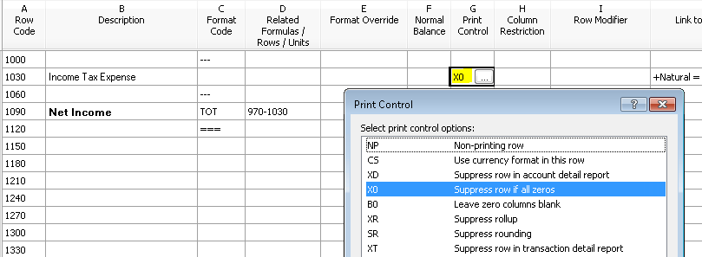
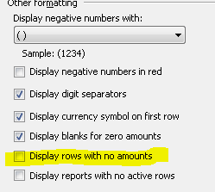
Organization
Suppressing Blank Rows
Have rows showing up with no amounts? Suppress them!
Row Definition: X0
or Report Definition:

Slide 22
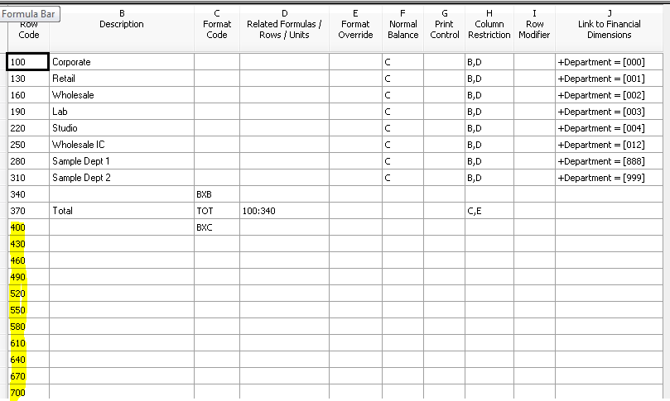
Organization
Delete Blank Rows
Wonder why that report generates an extra blank page?
Row Definition: Make sure to delete the blank rows on the bottom of your row definition.

Slide 23
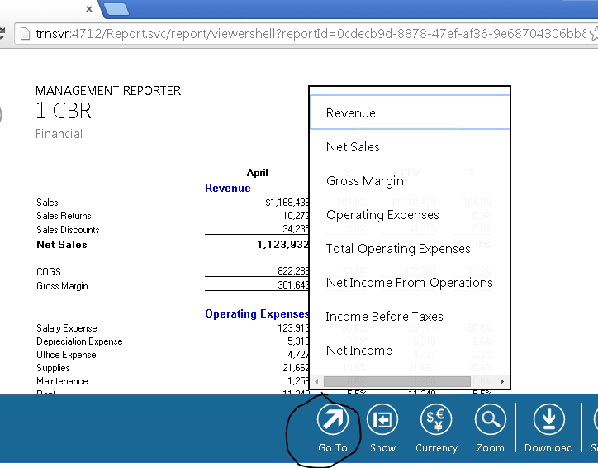
Web Viewer
Go To Option
Very helpful with long reports. Brings you right to that section of the report.

Slide 24
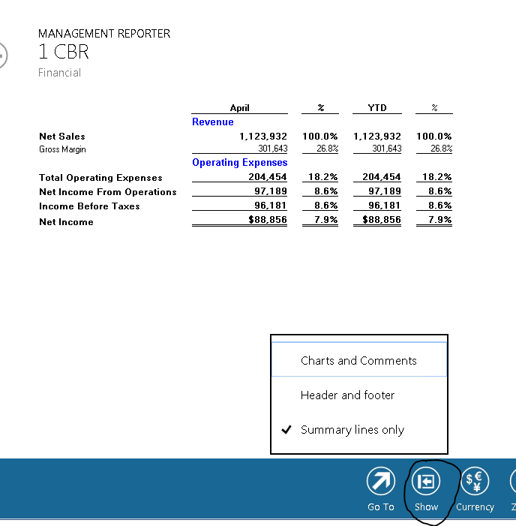
Web Viewer
Show Summary Information
Another helpful option when viewing large reports. Displays only the summary lines.

Slide 25
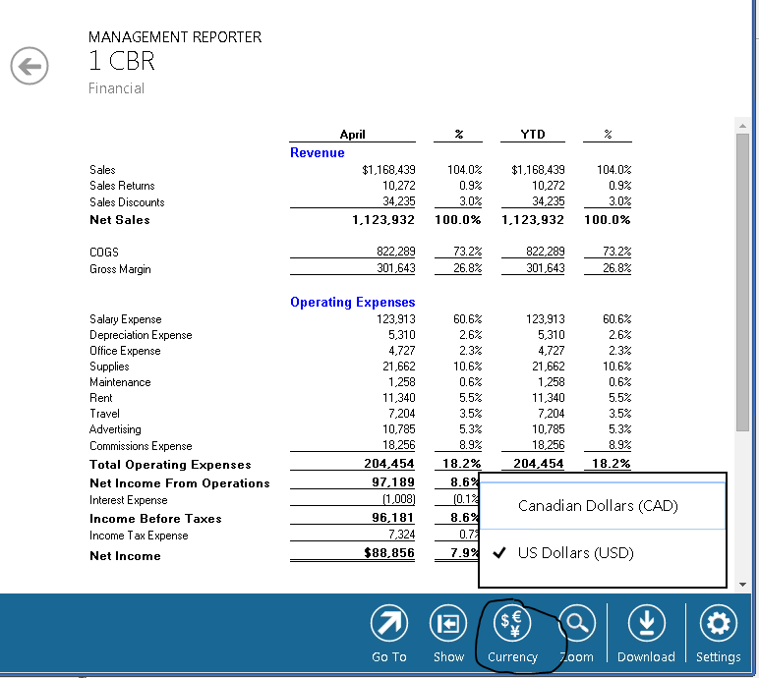
Web Viewer
Show Other Currencies
When using multiple currencies you can change the view to show a specific currency.

Slide 26
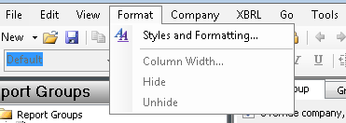
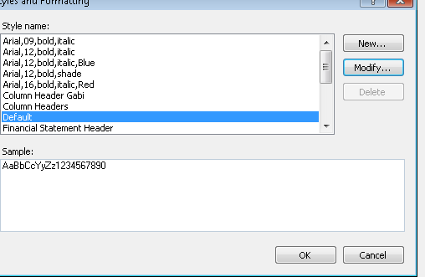
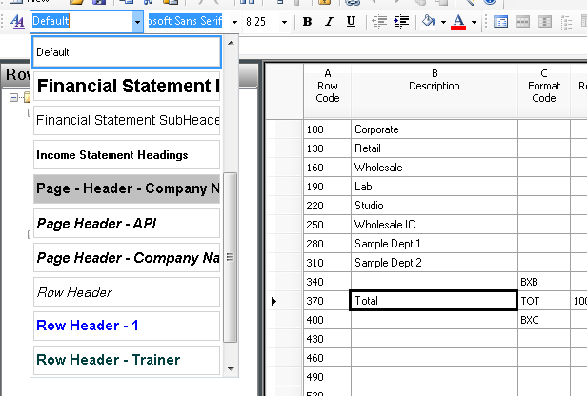
Customization
Default Fonts
Use this to set up a default font and size so all the reports are consistent.

Slide 27
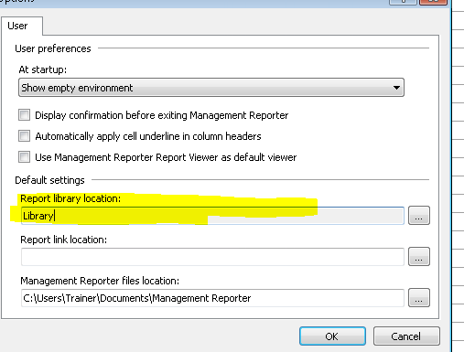
Customization
Default Report Library
When developing reports you can change the default library where reports will be generated. This way you can keep them separated from other reports. Tools/Options

Slide 28
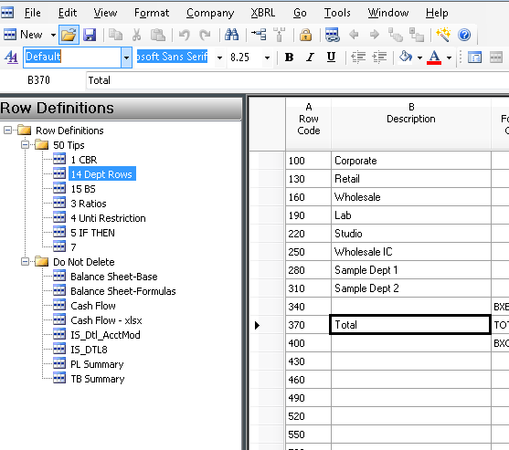
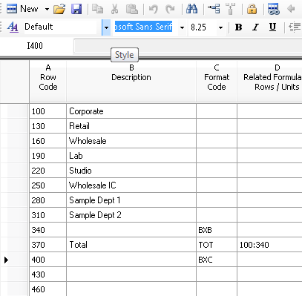
Customization
Alt F1
Gives you more screen space when developing definitions. Hides the definition views.

Slide 29
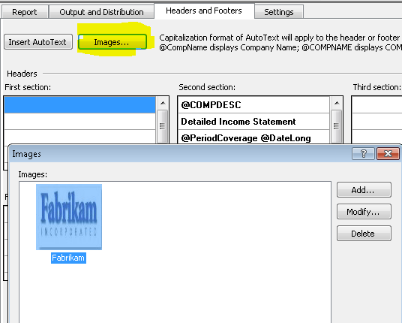
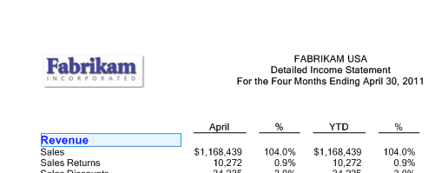
Headers and footers
Logos
Insert logos on the report.
Report Definition:
Result:

Slide 30
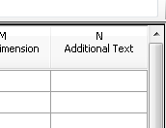
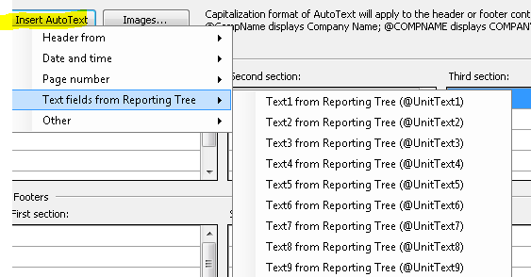
Headers and footers
Additional Text in the Tree
Add additional information to the header or footer from the tree definition.
Tree Definition:
Report Definition:

Slide 31
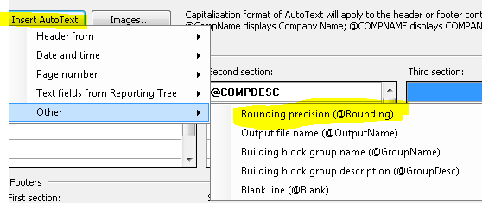
Headers and footers
Rounding Defined
Add the rounding precision to the report header.
Report Definition:
Result:

Slide 32
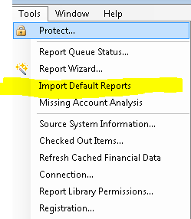
Speed
Default Report Definitions
Use the default report definitions to create reports faster (CU7 and greater).
As of version CU8 there are 16 report definitions with supporting rows and columns.

Slide 33
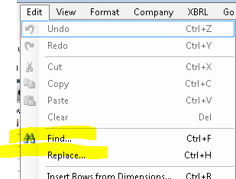
Speed
Find and Replace
While in a row definition you can find specific items or replace multiple items to speed up modifying reports. Works just like Excel.

Slide 34
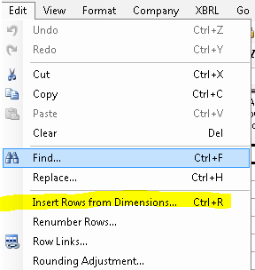
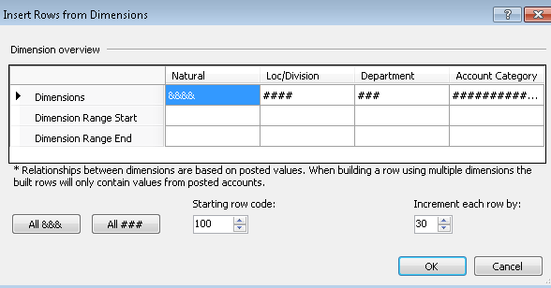
Speed
Insert rows from dimensions
Rather then typing all the accounts, depts., etc., use the insert Rows from Dimensions. This will also work in tree definitions Insert Units from Dimension. Pulls the data from your specific chart of accounts.

Slide 35
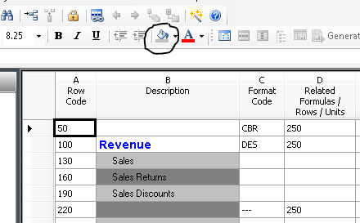
Formatting
Shading
Create a more appealing report with shading.
Row Definition:
Result:

Slide 36
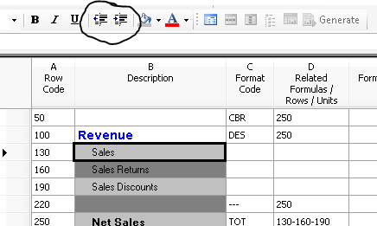
Formatting
Indenting
Use the indent button instead of spaces.
Row Definition:
Result:

Slide 37
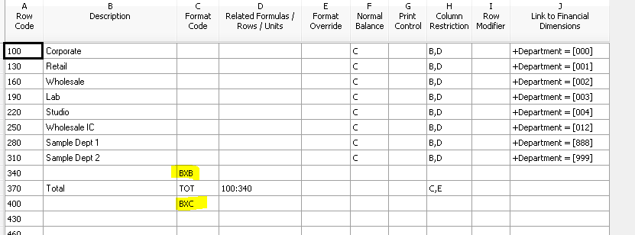
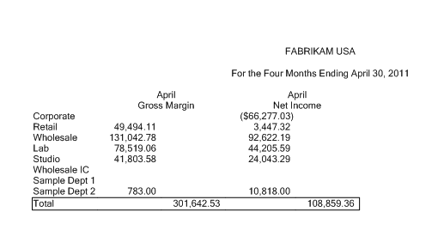
Formatting
Box
Create boxes to highlight data or separate sections.
Row Definition:
Result:

Slide 38
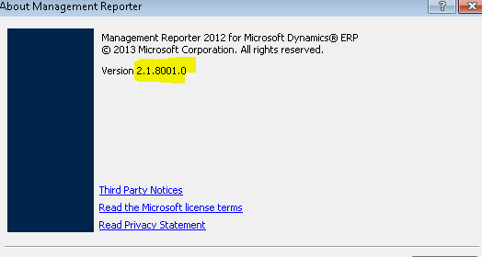
Other
MR Version
If you are wondering what version of MR you are running.

Slide 39
Other
Long Date Format
Remove the day from your report headers.
Change the date format on the system.
Correct way for no day

Slide 40
Other
Training/Resources
Online Training and Guides
https://dynamics.microsoftelearning.com
Local Training Class
http://www.boyerassoc.com/events/category/all-events
Helpful tips and issues
http://community.dynamics.com

Slide 41
Questions
Paul James
pjames@boyerassoc.com
Boyer & Associates
3525 Plymouth Blvd, Suite 107
Plymouth, MN 55447
Direct: 763 412-4336 |Fax:763 412-4301 |Office: 763 412-4300

