Slide 1
GP NOW
What’s New from Release to GP2013 R2

Slide 2
Agenda
Web client and architecture
Microsoft Dynamics GP 2013 RTM features
Microsoft Dynamics GP 2013 SP1/SP2 features
Microsoft Dynamics GP 2013 R2 features
Q and A

Slide 3
Microsoft Dynamics GP Roadmap
2012
2013 (H1)
2013 (H2)
2014 (H1)
2014 (H2)
2015
2016+
GP 2013
GP 2013 SP1
GP 2013 SP2
GP 2013 R2
GP 2015
GP “Next”
Web Client
Functionality
Management
Tools
Hosting
Business Analyzer
Web Client Wave Releases
Functionality
RapidStart
BA Off Domain
On Azure
Web Client Wave Releases
Functionality
GP App for Office365
BA Update
Functionality
Requisitions
Workflow
Identity Management
Companion Apps
Functionality
Workflow 2.0
Identity Management 2.0
Service Based Architecture
Functionality and
Technology releases
every six months
Microsoft Dynamics GP R2 is now available!
Notes:
2 mins
The Dynamics GP Roadmap is an exciting and rapid release roadmap. We’ve shifted our cadence on releasing functionality to the marketplace and have adopted a half year release strategy. As you can see from this slide, we have already released two updates (SP1 and SP2) with additional feature functionality to the marketplace in the past year. We have a release coming in the first half of 2014 with another set of features that are directly in response to customer suggestions. This release will bring to market 40 additional features. All of this before the next “major” version has even hit the street!
We are getting great feedback on this strategy and will continue this half year cadence as we move into and beyond the GP 2015 release.

Slide 4
Microsoft Dynamics GP
Web client and architecture

Slide 5

Microsoft Dynamics GP 2013 web client
Microsoft Dynamics GP in a browser
Works like you expect
Look and feel is the same
Phased release of modules
Available where you are!

Slide 6
Phased release schedule
Quality assured
Financials
Distribution
PHASE 1 - RTM
Project Series
HR
Payroll
Financials
Distribution
PHASE 3
Field Service
Project Series
HR
Payroll
Financials
Distribution
PHASE 4
Manufacturing
Field Service
Project Series
HR
Payroll
Financials
Distribution
PHASE 5
Quality assured
Financials
Distribution
PHASE 1 - RTM
HR
Payroll
Financials
Distribution
PHASE 2
Project Series
HR
Payroll
Financials
Distribution
PHASE 3
Field Service
Project Series
HR
Payroll
Financials
Distribution
PHASE 4
Manufacturing
Field Service
Project Series
HR
Payroll
Financials
Distribution
PHASE 5
HR
Payroll
Financials
Distribution
PHASE 2
All planned phases are released!
Fully supported
Fully supported

Slide 7

Features
Deployment
    Use on-premise or hosted
    Using a web browser connection
    Can replace terminal services implementations
Secure
    All communication fully encrypted by https
Features and functionality
    Familiar interface as the Desktop client
    Recovery of Session
Secure
Recoverable
Scalable
Familiar

Slide 8
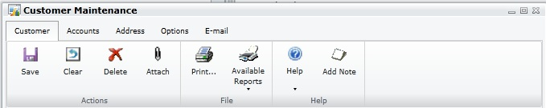
Changes specific to web client
Navigation
    Menus removed, Home Pages/Area Pages main areas for Navigation
Window Ribbons
    Common across majority of windows
Window Groups
    Tabs on certain main forms to group related windows
Performance
    Comparable to Terminal Services

Slide 9
Named system database
For use in hosted environment
    Allows multiple hosted companies in the same Microsoft SQL Server each with their own system database
For use in on-premise environment
    A single Microsoft Dynamics GP customer may have several unrelated business entities. These can now have their own system databases
    Test environments
Advantages
    Companies are kept entirely separate and don’t share any system data
    System data can now be entirely different from one company to another
    May reduce the number of SQL instances needed
    Performance

Slide 10
Named system database
Sample architectures
Microsoft Dynamics
GP 2010
Microsoft Dynamics
GP 2013
SQL
Server 1
SQL
Server 2
SQL
Server 3
SQL Server
Company A
Company B
Company A
DYNAMICS
DYNAMICS
DYNAMICS
DYN01
DYN02
DYN03
TWO
TWO
TWO
TWO01
TWO02
TWO03
COM_A
COM_B
COM_C
COM_A
COM_B
COM_C

Slide 11
Named system database
How it works
    System Database name set during install
    System Database name cannot be changed in Microsoft Dynamics GP Utilities
Lesson Data Impact
    Lesson Database name defaults to TWO, then increments (i.e., TWO01, TWO02…)
    Only create Lesson Users for TWO Database name
Other areas impacted
    User accounts cannot be duplicated on a SQL Server
    Company database IDs cannot be duplicated on a SQL Server
    Naming databases will help determine the hierarchy when view in SQL
    Multi-company reports

Slide 12
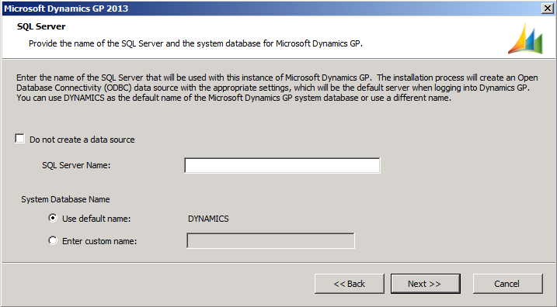
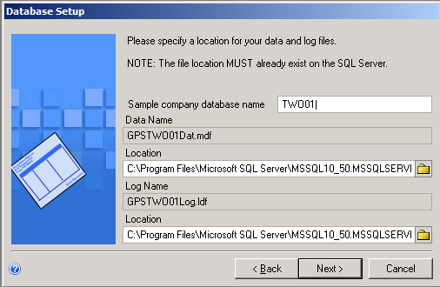
Named system database
Install and Microsoft Dynamics Utilities windows

Slide 13
Multi-tenant
Targeted for Hosting Environment
    Host multiple (separate) tenants on a single instance of the application
Features and Functionality
    Deployment of multi-tenant applications
    Configuration of the tenants
  Supported Applications
    Microsoft Dynamics GP Web Client
    Microsoft Dynamics GP Web Services
    Integration Manager

Slide 14
Microsoft Dynamics GP 2013
RTM features

Slide 15
Multi-tenant
Database multi-tenancy (named system database)
Application multi-tenancy
Report deployment and retrieval for multi-tenant
Multi-tenant applications - tenant service
Multi-tenant Integration Manager
Multi-tenant web service

Slide 16
System
Home page changes
General Journal batch history
Select printer at time of print
Support for Http:// report destination
Print SSRS reports from forms
Excel export using open XML
Document attachment
Inactive users
Lesson users
Enhance the AltMod windows with a mark all and unmark all functionality

Slide 17
Email enhancements
64-bit Outlook supported
Email indicators on navigation lists
Password protection on Word documents
Word templates for Receivables Management (RM) Statements
Email additional Word templates for Sales Order Processing (SOP)

Slide 18
Business intelligence
Business Analyzer on the home page
Printing SSRS reports from forms
Excel report deployment to Office 365
Word templates for SOP back orders
Word templates for SOP picking tickets
Business Analyzer for Windows 8

Slide 19
General Ledger
  Journal Entry Inquiry for History
  Reconcile Bank Reconciliation
  Reconcile Inventory
  Year End Close options
  Currency Translation Average Exchange Rate calculation

Slide 20
Fixed Assets
  Historical Depreciation Reports
  Reset History in Detail
  Restrict Displaying Reset Transactions
  Lock Fixed Assets Year
  Process Progress Bars
  Mass Depreciation Reversal
  Independent Fixed Assets Calendars
  Define Short/Long Calendar Years
  Autogenerate Next Asset ID
  Intercompany Asset Transfer
  Fixed Assets Transactions Batches
  Post in Detail to General Ledger
  Analytical Accounting Integration with Fixed Assets
  Documentation Updates for MACRS

Slide 21
Other financials
eReconcile
  Add BAI format support
Encumbrance management
  Integrate Encumbrance with GL Journal Entry
  Assign Multiple GL Budgets for Encumbrance validation
  Receipt Cost Difference Notification

Slide 22
Payables Management
Reprint Payables Checks and Remittance Forms
Print 1096 Form
Save default sort order for Vendor Lookups
Edit 1099 Transactions
Edit Payables Transactions:
  Remit to Address
  1099 Information
Void Check or credit card payment
Returns applied credits
Vendor’s Credit Card Invoice
Enter EFT Settlement Date
EFT Length and Delimitation Options
Change non-1099 Vendor and transactions
Document Attach

Slide 23
Inventory
Item Standard Cost adjustment post to GL
Multi-Serial Number select
Inactivate Item
Inactivate a Site
Inactivate an Item/Site combination
Reason Codes for stock movements/adjustments
Bin Transfer History
Document Attach

Slide 24
Sales Order processing/manufacturing
Additional Word templates for SOP
Print Button on Pick List Shortage Inquiry (Manufacturing)
Ship to Address has different Company Name
Link Items for suggestions on Sales
Consolidated invoicing
Integrate AA with Copier Series
Document Attach

Slide 25
Purchase Order processing
Document Attach
Tolerance Handling
Track Serial Numbers for Drop Ship items
Track Lot Numbers for Drop Ship items
Prepayments on a PO
Prevent PO close prior to Invoice Match
Integrate AA with Copier Series
Restrict Sales Documents to Purchase

Slide 26
Payroll, PTO Manager, and Human Resources
Check Build Exception Report
Stop Duplicate Checks
Pay Code History Edits
Pay Code, Deduction and Benefit Modifier
FICA and TSA Deductions
Human Resource Calendar
Negative Carryover
PTO Detail and History
PTO Manual Checks
Year End PTO
Life Insurance enhancements
Requisition Navigation Lists
Mandatory Arrears Templates
Mandatory Arrears Tasks
Deduction in Arrears Reporting
Payroll Integration to Payables (PIP) Voucher Description
PIP Document Numbers
PIP Voucher Consolidation
Advanced HR Warning Notice
Advanced HR Delete History Records
Custom Fields for Advanced HR

Slide 27
DEMO
Microsoft Dynamics GP 2013
RTM features

Slide 28
Microsoft Dynamics GP 2013
SP1 features

Slide 29
Web client modules and features
Human Resources
US Payroll
Returns Management
Contract Management
Inventory Bill of Materials
Excel Based Budgeting
Field Level Security
ADP Integration
Autocomplete
BA Navigation Lists
Notes:
A lot of work was put into GP2013 SP1 to update modules with ribbons, tabs and verify functionality on the WC.
We also continued bringing more modules into the Web Client. The first of these is the Human Resources solution.
Moving onto US Payroll users can now add new employees, update employee info and print payroll checks along with all of the other features from the US Payroll module.
Two Field Services modules were added for SP1: Returns Management and Contract Management.
The inventory module has been rounded out on the WC with the addition of core BOM.
We’ve solved some of our technical challenges and were able to ship Excel Based Budgeting for the Web Client.
You now have the same Field Level Security functionality that was available to you on the Desktop client is also available on the Web Client.
If you’re using ADP, General Ledger transactions can now be imported into Dynamics GP directly from the Web Client.
In SP1 we added the ability for web client to “remember” entries into select fields and then provide them as choices to facilitate faster data entry just like the feature in desktop client. It also remembers anything selected from a lookup in lookup enabled fields.
List views have been a very popular feature within GP and with SP1 we’ve added the BA Graphs from the home page to lists on the WC.

Slide 30
Microsoft Dynamics GP 2013
SP2 features

Slide 31
Web client modules
Project Series
Field Service
Manufacturing
ISV Extensibility
Fixed Assets Enhancements
Bank Activity Statements
Payment Doc Management
Notes:
The same Project functionality that is currently in GP desktop client is now available for the Web Client.
With the SP2 release, all Field Service modules are now available on the Web Client.
Manufacturing customers now have full feature parity between the Desktop and Web Client versions of Dynamics GP with the SP2 release.
ISVs can convert existing .Net code to Silverlight using the VS Tools SDK Toolkit or create new integrations now available on the web client.
Two rendering models are available: 1) The most common controls are dynamically rendered and 2) The second model is called Custom Rendering and developers can create custom code for complex controls and manage the client side interactions themselves.
Fixed Assets Enhancements was new for GP2013 and incorporated specific requirements for Australia but these can be applicable elsewhere. We have now incorporated these requirements into the Web Client. Users can now setup and calculate depreciation for low value and low cost assets.
Bank Activity Statements (or BAS) functionality is a mandatory requirement for businesses in Australia. This functionality is now available in the Web client.
Payment Document Management (or PDM) allows you to enter sales and purchasing transactions using payment methods other than cash, check or credit card. This functionality is now available in the Web Client.

Slide 32
What’s NOT in Microsoft Dynamics GP web client?
Modules
Invoicing
Canadian Payroll
Grant Management
AFA
Tools
Integration Manager
Report Writer
Modifier/VBA
MR Designer
Forecaster
Notes:
We continue to evaluate the remaining functionality to determine if it’s needed for the Web Client. The modules listed above will be determined based on customer feedback.
The ADMIN experience for integration tools will not be part of the web client. They will work with the WC for data updates but the administration will remain in their current architecture.

Slide 33
SP2 Features
SmartList Designer
SmartList UI Enhancements
Document Attach 2.0
Email Attached
Flow Attachments
Attachment Status
Web Client Keyboard Shortcuts
Customer Combiner
Customer Modifier
Vendor Combiner
Vendor Modifier
Notes:
We continue to evaluate the remaining functionality to determine if it’s needed for the Web Client. The modules listed above will be determined based on customer feedback.
The ADMIN experience for integration tools will not be part of the web client. They will work with the WC for data updates but the administration will remain in their current architecture.

Slide 34
Financials and HR/Payroll
Financials
    Void Payables Enhancements
    Reconcile Bank without Marking Transactions
    Checkbook ID on Payment Inquiry
    AA Finance Charge Assessment
HR and Payroll
    Payroll Inquiry Check Date Sort
    Applicant E-mail Address
Notes:
In Dynamics GP2013 SP2, now you can more quickly find the transaction you need to Void. In Void Open Transactions and Void Historical Transactions, you can restrict the data by vendor ID, date range or document number range to quickly search through data.

Slide 35
Microsoft Dynamics GP 2013
R2 features

Slide 36
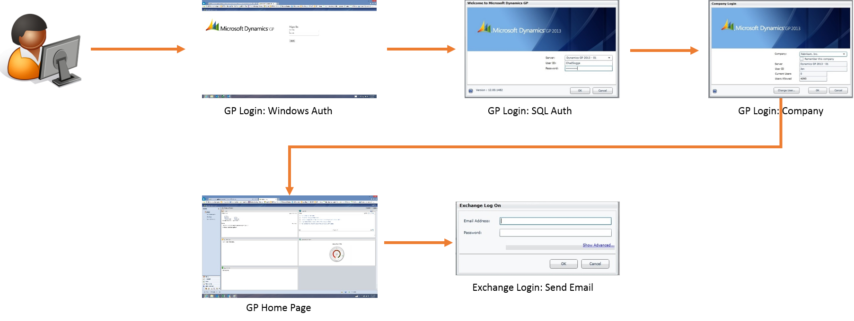

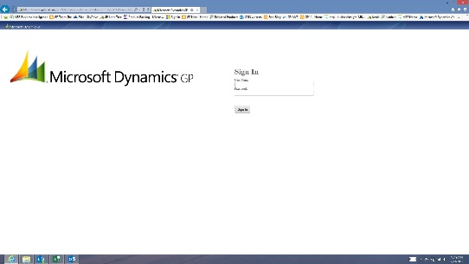
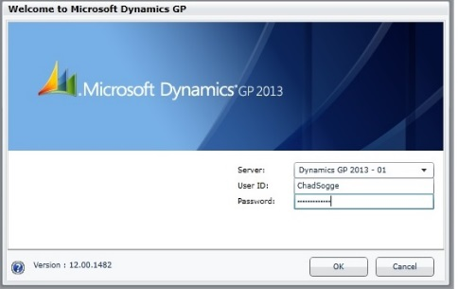
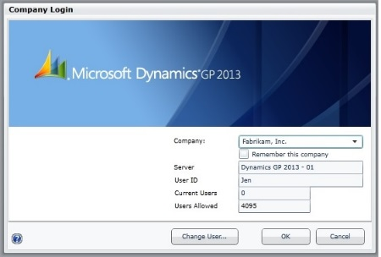
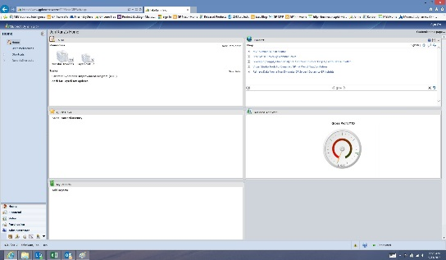
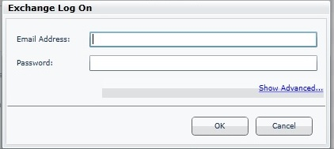
Identity management
Microsoft Dynamics GP 2013
Microsoft Dynamics GP 2013 R2
What is it?
  Simplify web client logins
  Reduce identity maintenance between apps
  Support companion app and service-based architecture scenarios
GP User: ON DOMAIN
GP Login: Windows Auth
GP Login: SQL Auth
GP Login: Company
Exchange Login: Send Email
GP Home Page
Notes:
The identity management feature for GP 2013 R2 has some addresses a couple of immediate needs with the web client but will also provide additional identity capabilities as we move into companion apps and a service based architecture. The immediate impact it will have is on the web client, where it will improve the user login experience. Currently a user logs into the web client by providing a Windows identity on the Logon.aspx page and then they provide their GP login (aka SQL Login) on the GP login window. The changes made for this feature will allow the user to log into Dynamics GP with their windows identity. A web client user will not require a SQL Login. Notice we talk about this for web client. That is because this functionality is only available in the web client, desktop client users will still require a GP/SQL login. Another change for R2 is that the user may choose to remember their Windows user name and password on the aspx login window, so subsequent logins to Dynamics GP from a trusted device will not prompt the user for credentials.
Improve the Dynamics GP Web Client login experience
Reduce identity maintenance between GP and peripheral applications
Maintain low deployment costs and proven GP security model
Support companion app and DexNext scenarios

Slide 37
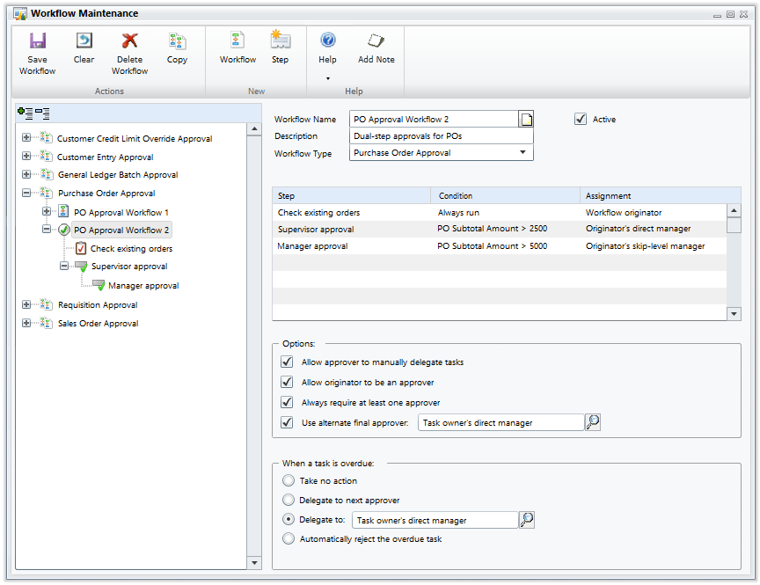
Workflow
Replace existing
workflow
Five workflow types
Dex-based
Email approval
Notes:
Workflow is being completely redesigned and rebuilt to be based in Dexterity rather than SharePoint. The first release of the new system will include five workflow types, and several methods for workflow approval.
GP2013 R2 Workflow Types:
Purchase Order Approval
Requisition Approval
Project Timesheet Approval
Project Expense Approval
Time and Attendance Approval

Slide 38
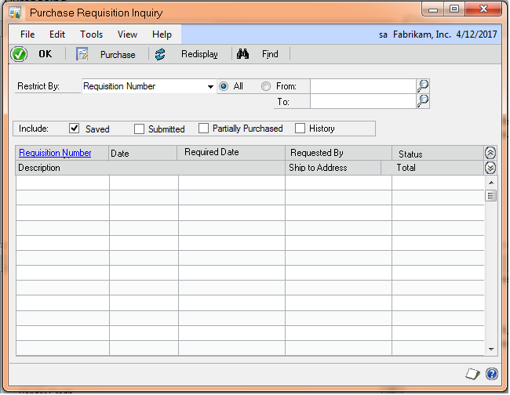
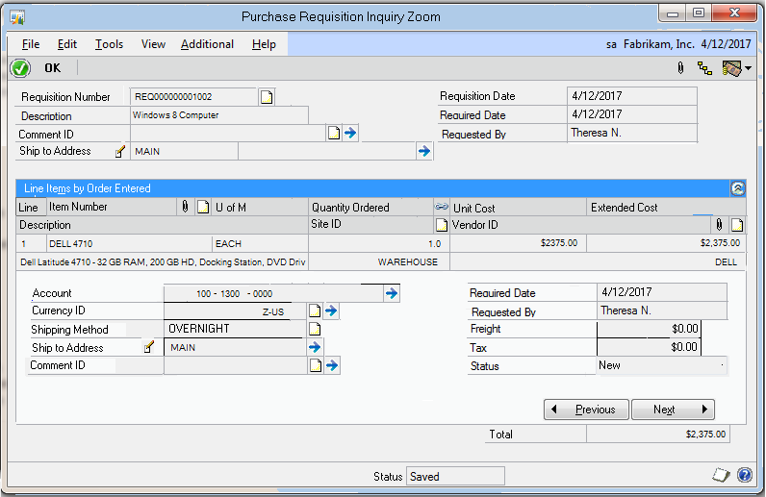
Requisition
Replace existing Req Management
Order items and goods
Combine requisitions to a single PO
Requisition workflow
Notes:
Purchasing Requisition functionality has been brought into the desktop side of the application with GP2013 R2. Leveraging the knowledge of the functionality in Req Management and the feedback from customers and partners, we’re building the requisition functionality from the start. The look and feel is like a transaction entry window in GP, but with fewer verified or required fields. If the user doesn’t know the vendor or cost of an item, they can still submit the requisition to the purchasing agent. With a tight tie-in to Workflow from the start, you can leverage Dynamics GP functionality to manage the business‘s goods request process.

Slide 39
System Wide
Print or E-mail any report with Word
E-mail address assigned by document type
Document attach 2.0
Integration with payables management
Ole notes
Scan and attach
SSRS reports on transaction windows
Ribbons on desktop windows
SmartList Designer 2.0
Create Go-To’s or use existing
Navigation
Take company offline
Send messages
Azure backups
Reverse GL year end close
Print and E-mail documents together
Notes:
In Dynamics GP2013 SP2, now you can more quickly find the transaction you need to Void. In Void Open Transactions and Void Historical Transactions, you can restrict the data by vendor ID, date range or document number range to quickly search through data.

Slide 40
Form changes
SSRS reports on transaction forms
Enables SSRS report rendering from transaction windows
Personalized SSRS reports based on your BI needs
Ribbons in the desktop client
Freshen desktop client UI
Include ribbons on all forms

Slide 41
Financials
Reverse Fiscal Year
Default Asset ID from Asset Class
Integration of Multicurrency Revaluation with AA
Copy and Paste from Excel to GL
Reprint Outstanding Transaction Report
Default Sort Order for Payables Checks
Notes:
In Dynamics GP2013 SP2, now you can more quickly find the transaction you need to Void. In Void Open Transactions and Void Historical Transactions, you can restrict the data by vendor ID, date range or document number range to quickly search through data.

Slide 42
Distribution
Suggested Item Enhancements
Assign Item to Multiple Sites
PO Prepayment Enhancements
SSRS Encumbrance Summary and Detail Reports
Notes:
In Dynamics GP2013 SP2, now you can more quickly find the transaction you need to Void. In Void Open Transactions and Void Historical Transactions, you can restrict the data by vendor ID, date range or document number range to quickly search through data.

Slide 43


Business Portal replacement strategy
Replace Business Portal with employee self-service functionality within Microsoft Dynamics GP web client
Business Portal
will not be released
for Microsoft Dynamics GP 2015
Web client
Apps
Limited User Role
Requisition Management
Employee Self-Service
Project Time
Project Expense
Augmented by apps such as:
  Business Analyzer
  Procurement
  Time Management
  Others (tbd)
Notes:
With the success of the Web Client we’ve began the process of replacing the Business Portal. The original intent of BP was to provide non GP Users a remote method of performing Employee Self Service tasks such as Requisitions, Attendance, Project Expense and general KPI analysis. The Web Client provides a platform for all of these tasks plus greater visibility of GP information through the Limited User Role.
Powerful Business Analyzer Metrics are available from within the Limited User Role as well as Enquiry access to all forms that the user is granted security to.
In order to complete the BP Replacement we are building several Self Service tasks into core GP including: Requisition Management, Employee Self Service, Project Time and Project Expense. Most of these solutions are on track for our R2 release with the remaining solutions coming with GP 2015.
Not only will customers have more functionality available with the Limited User Role in Web Client than today’s Business Portal, we are also building out Companion Apps for certain self service functions such as Procurement and Time Management. These cross platform apps will enable “on the go” users to use their favorite device to enter vacation or sick time directly from an iPad, Android tablet or Surface device! Current plans support three apps with additional research leading to other possible apps.
Our goal is to finish all of this work between R2 and GP 2015 and provide those solutions for a BP Replacement. We will NOT be releasing Business Portal with GP 2015.

Slide 44
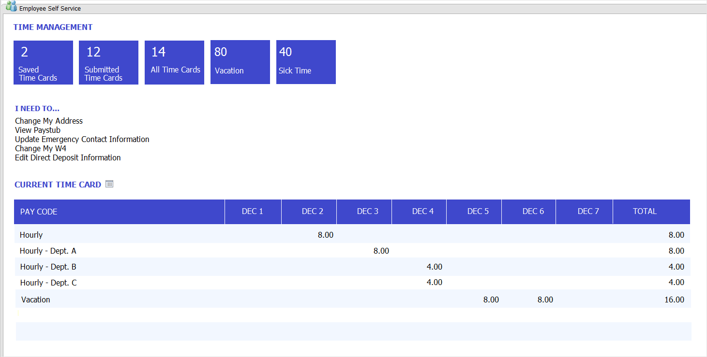
Self-service home page
New home page content page
Quick and simplified navigation
Preview important information
Notes:
Employee Self Service Content Pages will be added to the GP Home Page
3 new content pages will be added for Time Management, Requisitions, and Project Time & Expense
New Home Page role Self Service will be added
Intent is to limit the information and navigation the user will see. Self Service users will only enter to GP to do a single task, such as enter hours for payroll, and so we want to present a quick and easy navigation to those areas.
New content pages will work the same as the existing content pages on the home page. If they have security access other pages (home page parts) can be added.

Slide 45
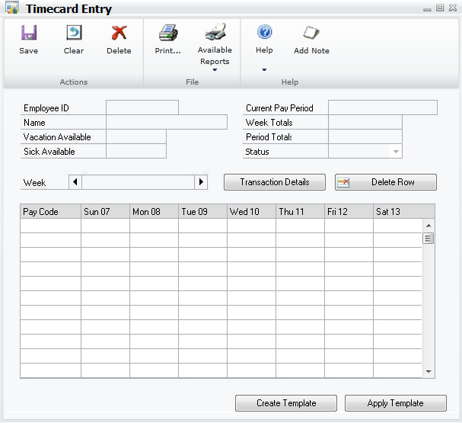
Employee self-service
Self-service user
Business Portal Time and Attendance Replacement
Allows entering ‘Time on Behalf Of’
Approval Workflow
Notes:
In Dynamics GP2013, you can enter timecards and enter time on behalf of a user directly in Dynamics GP. Deployed on either web client or desktop client and integrated with workflow, employees can submit a timecard or recall a previously submitted timecard.

Slide 46
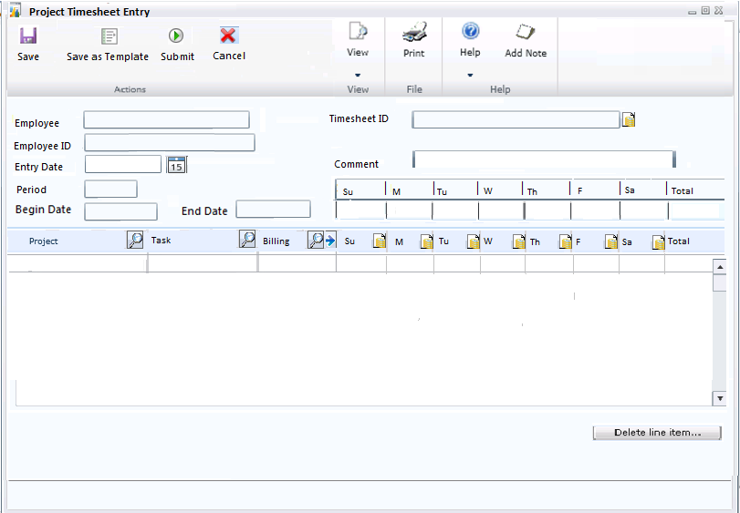
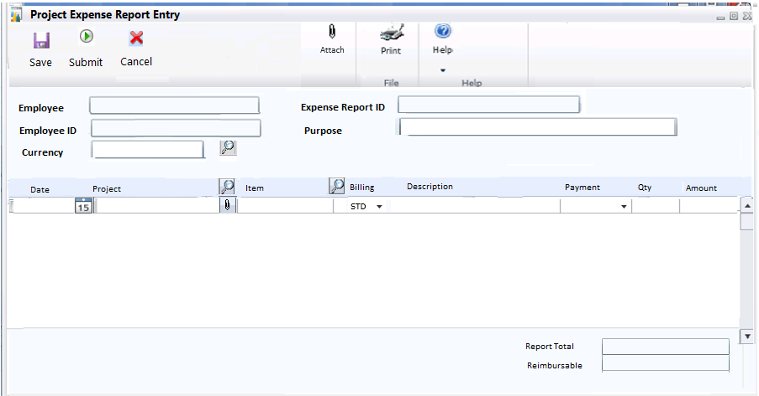
Project self-service
Self-service users
Project Time and Expense
Workflow
Notes:
Project Time and Expense (PTE) is a collective all the all the features from both Business Portal Project Time and Expense Entry and PDK. With PTE those features are elevated by incorporating full workflow functionality. Users will be able to view the timesheet and expense document as they flow through the approvals systems, and recall and edit them prior to approval completion.

Slide 47
DEMO
Microsoft Dynamics GP 2013 R2 features

Slide 48
Microsoft Dynamics App Roadmap (H1 2014)
NOV 2013
JAN 2014
MAR 2014
JUN 2014
JUL 2014
Business Analyzer R5
Business Analyzer WP8
Business Analyzer R6
Dynamics Workspace
Time Management
Business Analyzer R7
Procurement
HTML 5/JS
Azure support
Service-based architecture
Auto-selected role
Windows 8 Phone release
Support for SSRS report content
Off domain support
Actionable BI
Excel content support
App for Office
Excel Dashboards for Office 365
Sample Mode available
Submit Time Off
View Time Off Balances
View Time Cards
Cross-platform
MR content in Business Analyzer
Submit/View Requisitions
Inventory and non Inventory items support
Cross-platform
Notes:
First release of BA was January 2013 with XAML/C# code base.
Release 5 was major code change to HTML 5/JS. Changed code base to better align with other MSFT Apps in order to share common components.
Over 15,000 downloads since R1 Release
NOV 2013 – refactored to HTML 5/JS, Supports customer using Azure Service Bus but not a requirement. Can expose Companion App Service to internet traffic and connect directly to the service, the role and reports associated with that role are auto selected for you based on which reporting role (rpt_RoleName%) you are associated with in SQL
JAN 2014 – Windows 8 Phone release. This App is modeled after R4 of BA…C#/XAML. Support off domain users and provides actionable BI. Not the same as companion app BA because Windows 8 phone has a different SDK to build from.
MAR 2014 – Adding Excel content to BA from O365 or Network Share, releasing first App for Office (Dynamics Workspace) which will install with sample Excel dashboards (financial, sales, purchasing & inventory) that can be connected to live data. Can modify these dashboard or create your own.
JUN 2014 – Time & Attendance app will enable you to management your time off from outside of GP/BP. Will be supported on Windows 8, Android and iOS tablet devices (cross platform).
JULY 2014 – BA R7 will enable Management Reporter content and be cross platform. Procurement app will enable users to submit requisitions for inventory and non inventory items and will be cross platform.
App schedules may align with certain GP releases to ensure backend support for the app functionality but they are not tied to the same release dates as GP.

Slide 49
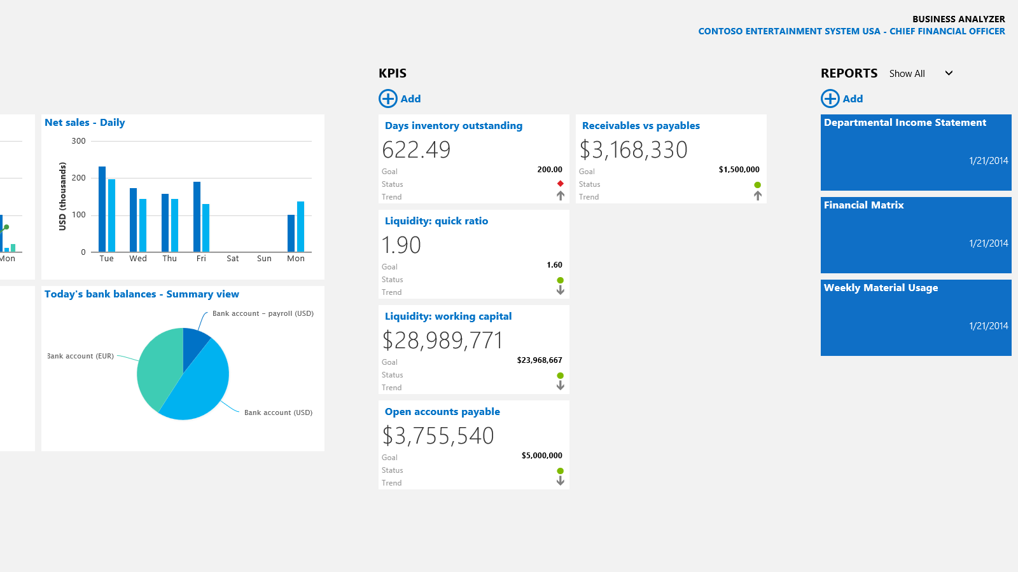
Business Analyzer R6
Supports Excel content within the app
Windows 8 design
Notes:
Key feature is the ability to see Excel content within the App.
Demonstrates the quick release cadence for apps and how new features can be added and releases as soon as they are completed.
No need to reinstall the app. Users will receive notification that an update is available.
GP Companion App services do need to be updated to map the location of you Excel files to the App Services
Supports Excel files stored on Network Share, SharePoint and O365

Slide 50
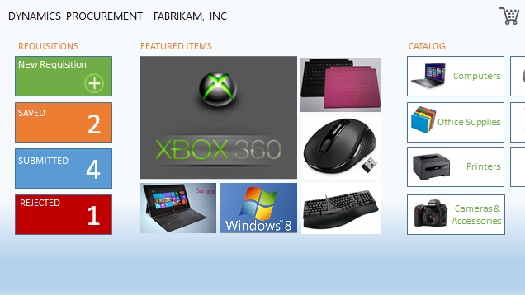
Procurement
Self-service user app
Request items
Windows 8 design
Tightly integrate with Microsoft Dynamics GP
Cross-platform

Slide 51
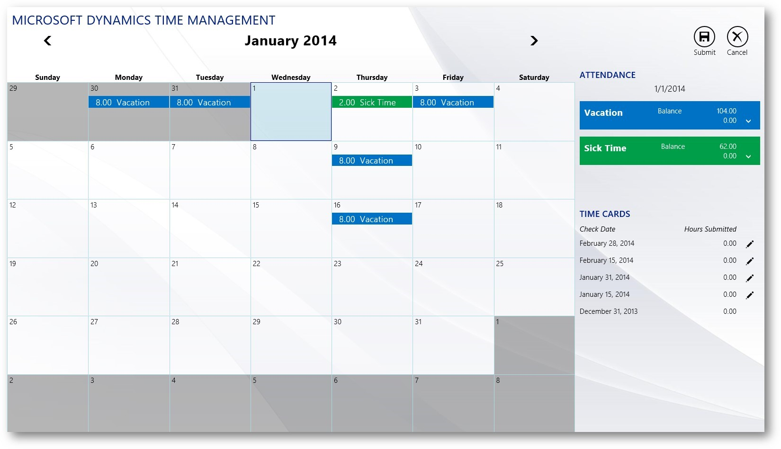
Time Management
Self-service user app
Enter time off
Windows 8 design
Cross-platform
Notes:
Cross Platform App (Windows, iOS, Android)
Designed for tablet
Connects back to GP using service
Enables user to enter time off (V1) and enter hours (V2)

Slide 52
Thank you!

Slide 53

© 2014 Microsoft Corporation. All rights reserved. Microsoft, Windows and other product names are or may be registered trademarks and/or trademarks in the U.S. and/or other countries.
The information herein is for informational purposes only and represents the current view of Microsoft Corporation as of the date of this presentation. Because Microsoft must respond to changing market conditions, it should not be interpreted to be a commitment on the part of Microsoft, and Microsoft cannot guarantee the accuracy of any information provided after the date of this presentation. MICROSOFT MAKES NO WARRANTIES, EXPRESS, IMPLIED OR STATUTORY, AS TO THE INFORMATION IN THIS PRESENTATION.

