Slide 1
Boyer Dynamics SL Client Event
Welcome!

Slide 2
Introductions
Boyer Team
Microsoft
Clients
Partners

Slide 3
Agenda
Time | Description | Presenter
9:00 | Welcome, Introductions, Agenda Review | Jack Boyer
9:10 | Microsoft Welcome | Jim Westerman
9:20 | What’s New in Dynamics SL 2015 | Jon Augdahl
10:20 | Break
10:30 | Customer Source – eLearning, Knowledge Base, Community Forums | Rich Studer
10:50 | Management Reporter – Focus on report distribution | Paul James
11:40 | Lunch
12:15 | Some of our favorite ISVs | Jon Augdahl
12:40 | Web Apps CU1 | Jon Augdahl and Jeff Larson
1:10 | Break
1:20 | SL Tips and Tricks | Paul James and Colleen McCoshen
1:50 | Closing | Jon Augdahl

Slide 4
SL 2015 and CU1
Presented By Jon Augdahl

Slide 5
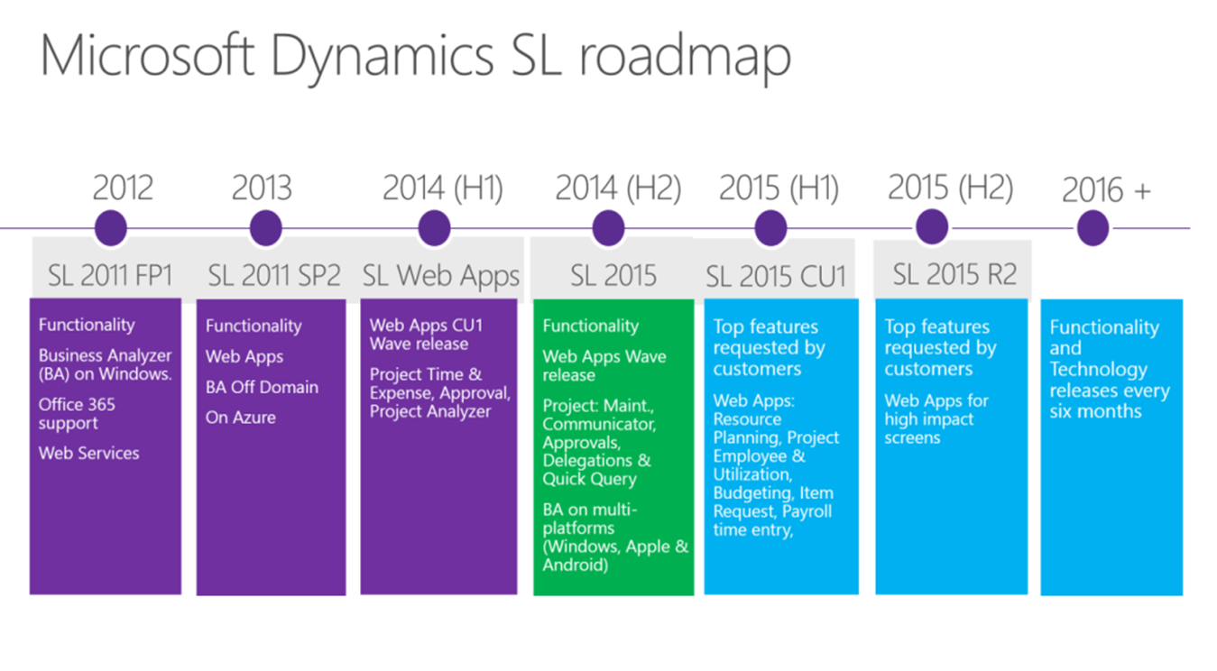
Roadmap

Slide 6
SL 2015 Highlights
General Changes
Crystal Reports 2013 runtime will be used for the generation of reports. 2008 designer is shipped with the software. The full version of Crystal 2013 can be purchased separately and used if wanted.
Visual Studio 2008 no longer supported. 2013, 2012, and 2010 are supported.
FRx will not work with Dynamics SL 2015
Business Portal is no longer available. Replaced by Web Apps
Microsoft Office 2013 is supported

Slide 7
SL 2015 Highlights
Administration and Foundation Changes:
Company Selection list limited to user’s access rights
Search Capability in Possible Values lists (DEMO)
New PV Functionality and export to Excel in Possible Values lists
Multiple Line (notes) on emails from Quick Send
Sorting and Selecting in ROI made easier (DEMO)
Email report directly from Print Preview

Slide 8
SL 2015 Highlights
Quick Query Exports
Copy to Table
Create Connection
Copy to table and create connection (Query Table)
Create Pivot Table with connection

Slide 9
SL 2015 Highlights
Accounts Payable Changes
Store Vendor Name on documents
Backup Withholding for eligible 1099 vendors
Ability to apply multiple pre-payments to a single voucher
Accounts Receivable Changes
Invoice Preview from Invoice and Memo screen and from Quick Query

Slide 10
SL 2015 Highlights
Project Accounting Changes
Multi-Company enabled
Multi-Currency enabled
Item Level Sales Taxes
Batch Numbers from Flexible Billings no longer overlap with AR (bug fix)

Slide 11
SL 2015 Highlights
Payroll Changes
Ability to reactivate earnings when voiding checks
Automatic recalculation of earnings subject to in Review / Edit Check screen.
Expanded Net Check functionality – automatically calculates the deductions for you
Audit of changes to pay, deduction, and tax tables

Slide 12
SL 2015 and CU1 Web Apps
Communicator
Employee Utilization
Inventory Lookup
Item Request
Payroll Time Entry
Approval Deferrals
Project Approvals
Expense Entry

Slide 13
SL 2015 and CU1 Web Apps
Project Maintenance
Project Time Entry
Quick Query
Resource Planning
Web Reports

