Slide 1
Dynamics NAV
NAV USER EVENT
5/28/2015

Slide 2
Dynamics NAV
Agenda
Welcome
Microsoft NAV path
NAV Standard Security
Easy Security Demo
Configuration Worksheets & Templates
NAV Cash Flow Management
Requisition Worksheet
Jet Reports (showcase Express)
Zeta Docs
Tips & Tricks

Slide 3
Dynamics NAV
Tips & Tricks
One Note
Word report creation and modifications
Document approval
Notifications
Linking file folders
Short Cuts
Navigation & Customization

Slide 4
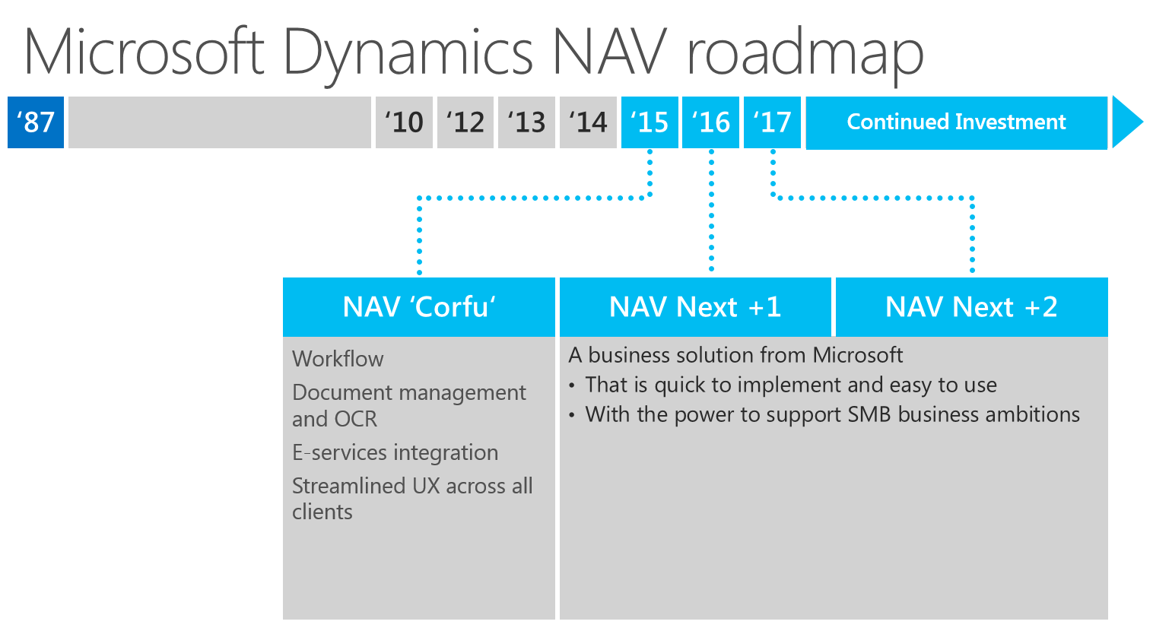
Dynamics NAV
NAV Support Goal
Assist you in becoming as independent & knowledgeable as possible, while holding down the cost of support.

Slide 5
NAV Roadmap

