Slide 1



Boyer Dynamics SL Client Event
ISV Showcase

Slide 2

Product Overview SL Add-ons
Product Portfolio – view at www.plumblineconsulting.com
Interfaces Seamlessly with SL
All products were developed using the same tools as Dynamics SL.
Access solutions through the Dynamics SL menu and navigation
Screens and functions similar to Dynamics SL (F3 lookup screens, etc.)
Standard Dynamics SL Security
Uses Crystal Reports
Solution Licensed, not by user count
PCL Products
2

Slide 3
Best Seller: Fixed Assets
Are you tracking assets outside of Dynamics SL ?
  Are you using Spreadsheets or external programs?
  Does this cause you to make duplicate data entry to get the information into SL?
  Are you using an outside agency to track your assets? This can cost you the loss of control as well as timeliness and money
  If you answered yes to any of these questions you need Fixed Assets for SL!!
PCL Products
3

Slide 4
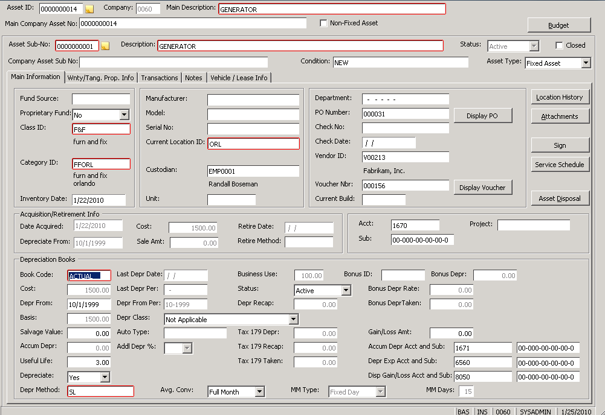
Fixed Assets
Track Assets within Dynamics SL – integrated solution
Pull Assets in from
  Payables
  General Ledger
  Project Controller
  Purchasing
Deprecation
  Deprecation calculation and forecasting
  SL, Sum of Years Digit, Declining Balance and IRS Tax Tables
  Depreciation posted to General Ledger
  Tax Reporting – Produce Reports within the system for
    4797
    4562
    Tangible Property Tax
PCL Products
4

Slide 5
Fixed Assets
Bonus Features
  Tracking Asset Locations
    - Where is my asset and where has it been?
  Asset Inventory
    - Bar Code Labels and Scanning
    - Automatic location updates
  Warranty Information
    - Tracking Expiration Dates and Warranty Providers
  Leased Equipment
  Vehicle information
    - Letters for Tag expiration
  File Attach included
  Rainbow Search with Pivot Tables included
  Optional Service Module
PCL Products
5

Slide 6
Fixed Assets
Common Questions
  Can we fix deprecation if we made an error?
    - Life to Date Option allows you to recalculate and post the correction in the current Period.
  Can we forecast for next year?
    - Yes. Forecast is provided Month by Month for Budgeting.
  How hard is it to tie to GL?
    - Trial Balance and Period Trial Balance
    - Rolling Report
    - GL Reconciliation Report
  How can I get my data in the system?
    - Transaction Import
    - Import Services
PCL Products
6

Slide 7

ISV Products for Dymamics SL that save time and money
Email: Vborak@plumblineconsulting.com sales@plumblineconsulting.com www.plumblineconsulting.com
Corporate Headquarters: 419-581-2300
PCL Products
20

Slide 8
SK Global Software
eBanking Suite
for
Microsoft Dynamics SL
eBanking Suite
for
Microsoft Dynamics SL
Notes:
***Presenter note: Be sure to turn the pointer on in GoToMeeting and tree the workflow slides like an actual demo, for example, you can use the pointer to press Begin Processesing and make it look like you’re actually pressing the button.
Hello and welcome to this presentation of the eBanking Suite for Dynamics SL
My name is Aynsley Keller, Marketing Coordinator for Sandler*Kahne
My presentation to you today will include a overview of the 5 modules in the eBanking suite as well as a short explanation of the other products Sandler Kahne offers and then I’ll go through a demonstration of the workflow for APEFT , Wire Transfer Plus and Positive Pay using some screen shots.
We’ll also leave time at the end for your questions
So let’s get started
First I’d like to tell you a bit about our company…
Rick:
Hello and welcome to this presentation of the eBanking Suite for Microsoft Dynamics SL
My name is Rick Sandler. I’m one of the founding partners of Sandler*Kahne Software.
This presentation will include a overview of the 5 modules in the eBanking suite, followed by a demonstration of the workflow for Accounts Payable Electronic Funds Transfer, Wire Transfer Plus and Positive Pay.
First I’d like to tell you a bit about our company…

Slide 9
SK Global Software
Developing high-quality software that extends the functionality of the
Microsoft Dynamics SL (Solomon)
product line since 1994.
Strategic Development Partner
Microsoft Partner Advisory Board
President’s Club (7 years running)
CfMD - Certified for Microsoft Dynamics SL
(eBanking Suite)
Notes:
We’ve been in business as SandlerKahne since 1994 but we’ve been in the SL channel since the 1980’s
Our goal is to develop software that extends your SL system.
We sell our products only through the reseller channel
(don’t read list…just mention below☺
Strategic Dev. Partner
we have a very close relationship with Microsoft at the development level so that they know what we’re up to and we know what they’re up to which gives a great opportunity to maximize the value of what gets delivered to you.
Since we’ve been around for quite sometime, as part of the Partner Advisory board, which gives us a chance to share what we know and what we hear from customers and partners with Microsoft as they are looking at adding new features and functionality to the SL product line.
Rick:
We’ve been in business as Sandler*Kahne Software since 1994 but we’ve been in the SL channel since the 1980’s
Our mission is to develop high-quality software that extends your SL system.
We sell our products exclusively through the Microsoft reseller channel.
As you can see from this list of credits, we enjoy an excellent standing with Microsoft and the Microsoft Dynamics community. Of particular note is our most recent achievement of being awarded Certified for Microsoft Dynamics SL logo status for our eBanking Suite. This means that the eBanking Suite has met or exceeded Microsoft’s requirements for high quality software.

Slide 10
The eBanking Trend
Search It: 3,650,000 results
It’s Here to Stay!
    Reduces expenses in processing
    Improves management of financials
    Reduces banking errors previously made by written communications.
    Fraud protection
Over 1200 SL Customers actively using SK Global Software’s eBanking!
Notes:
If you were to simply search the phrase Electronic Banking …you’d find well over 1 million results including page after page of product offerings, news reports and financial briefing on this growing trend.
One of the greatest benefits of electronic banking is the ability for organizations like yours to automate banking processes and reduce errors by simply reducing the amount of data entry.
Rick:
Make no mistake…eBanking is here to stay! If you were to simply search the phrase Electronic Banking …you’d find well over a million results including page after page of product offerings, news reports, financial briefings and so on.
One of the greatest benefits of electronic banking is the ability for organizations like yours to automate banking processes and reduce errors by simply reducing the amount of data entry.

Slide 11
Fraud Avoidance
Prevalence of Attempted Fraud in 2012
(Percent of organizations subject to attempted or actual payments fraud)
Payment Method | All Respond-ents | Revenues under $1B | Revenues over $1B | Mostly U.S. Transactions | Many Non-U.S. Trx
Checks | 87% | 87% | 91% | 92% | 87%
Corp/Commercial cards | 29 | 27 | 26 | 18 | 32
ACH Debits | 27 | 25 | 29 | 31 | 24
Wire Transfers | 11 | 7 | 12 | 8 | 10
ACH Credits | 8 | 9 | 6 | 5 | 7
AFP Survey:
http://www.afponline.org/pub/pdf/2013_AFP_Payments_
Fraud_and_Control_Survey_Introduction___Key_Findings.pdf
Notes:
If improving accuracy and reducing handling costs aren’t enough to cause you to consider ebanking, let’s talk about fraud avoidance! In 2008, a whopping 71% of companies surveyed found they were victim of attempted or actual payment fraud!
This chart, taken from a survey conducted in 2009 by the association of financial professionals shows some very interesting statistics.
As we can see, the overwhelming majority of attempts at payment fraud occur with paper checks. With today’s desktop publishing software, it’s not terribly difficult to doctor a check…or even completely forge one! This is why it’s so important for you to have some kind of Positive Pay protection and why more and more banks are requiring their corporate customers to have this protection. I’ll talk more about this shortly.
But there’s an even more compelling conclusion to be drawn from the information on this chart. The incidence of fraud attempts on payments being made electronically drops dramatically, as we see here for ACH debits. This means that electronic payments are far and away more safe than paper checks. Let’s be careful though to draw the distinction between making payments via ACH or wire transfer and making an online purchase on the internet.
So…while it’s common to make the decision to move to electronic payments based on cost savings and accuracy improvements, avoiding fraud could actually be the bigger reason for making this move!

Slide 12
Save Time & Money with these modules
eBanking Suite
  AP Electronic Funds Transfer
  AR Electronic Funds Transfer
  Positive Pay (aka Safe Pay)
  Lockbox Processing
  Wire Transfer Plus
Notes:
We’ll dive into a bit of detail with each of these 5 modules you see here and spend a few min. giving you a quick look at our other products.
Please keep in mind that each of the modules can be purchased independently of one another .
However, if you do purchase more than one at a time, we offer a multi-module discount.
Rick:
Now let’s take a few minutes to give you a high-level look at each of the modules in the eBanking Suite.
Please keep in mind that each of the modules can be purchased independently of one another .
However, if you do purchase more than one at the same time, we offer a multi-module discount.

Slide 13
Save Time & Money with these modules
eBanking Suite
  AP Electronic Funds Transfer
  AR Electronic Funds Transfer
  Positive Pay (aka Safe Pay)
  Lockbox Processing
  Wire Transfer Plus
Both Modules:
Electronically move funds from one account to another
Facilitated by National Automated Clearing House Association (NACHA)
Funds Guaranteed to clear within 48 hours
Notes:
The first 2 modules, the Accounts Payable Electronic Funds Module & the Accounts Receivable EFT module have some things in common to recognize:
(read List)
* NACHA is the organization that administers the ACH standard.
Rick:
The first 2 modules, Accounts Payable Electronic Funds Transfer (or APEFT) & Accounts Receivable EFT have some things in common to recognize:
They both move funds from one account to another
- Their function is facilitated by the National Automated Clearing House Association … or NACHA. This is where the term ACH comes from. It’s a standard that’s unique to the US and is used by all US banks.
- When using the ACH system, transactions must clear to completion within 48 hours

Slide 14
Save Time & Money with these modules
Accounts Payable EFT:
ACH Credit method (Push)
Employee Reimbursements
Vendor Trade Payments
Fed/State Tax Payments
IAT – International ACH
Email Remittance Advices
Payment method option by voucher
Account/Amount Approval
US-ACH only
  Other protocols addressed by Wire Transfer Plus
eBanking Suite
  AP Electronic Funds Transfer
  AR Electronic Funds Transfer
  Positive Pay (aka Safe Pay)
  Lockbox Processing
  Wire Transfer Plus
Both Modules:
Electronically move funds from one account to another
Facilitated by National Automated Clearing House Association (NACHA)
Funds Guaranteed to clear within 48 hours
Notes:
This first module in the suite, AP EFT, uses the ACH credit method or push method to pay vendors, reimburse employees , pay your taxes, etc. by PUSHING money from your account to the vendor account.
eMail remittance advises: so when you pay a voucher you can also send an email to that vendor notifying them that you put money in their account and note the invoices that were paid.
Payment method option by voucher: The new payment method in voucher entry allows you to set up your system to pay some folks by wire, others by ACH, and even others with a printed check and execute all that in 1 payment selection run.
Account/Amount Approval
Something that is important for you to understand. When you set up a vendor to pay them via ACH, you are entering their banking information in there. You want to be able to protect that so that en employee can’t go into the system and replace that information with their own account number and have the funds deposited to their account. We have security options that protect you against that. I’m spending some time on this b/c we just learned of a user that unfortunately did not implement that security feature and was taken for 45.000 dollars b/c an employee did just that. If they would have had the Account Approval feature turned on…they would have been protected. The security feature allows you to designate an approve0r who has to allow for changes to be made to vendor account information .
Amount Approval -
(we have security features built in to set levels of amount approval…for ex. Anything under 5,000 doesn’t require approval, between 5 and 10,000 requires one approval and anything over 10,000 requires 2 designated approvers)
APEFT is used when requiring US-ACH transactions only
All other transactions would be done through the Wire Transfer Plus product which we’ll talk about later.
* There are 2 levels of approval and each level can have up to 5 designated approvers.
Rick:
The first module in the suite, AP EFT … uses the ACH credit method to push money from your account into your payee’s account to pay vouchers for vendors, employee reimbursements and tax payments.
Additionally, in September of 2009, a new transaction type was mandated by NACHA called the International ACH Transaction or IAT. Brought about by terrorist activities in recent years, this transaction type is designed to allow a US company to pay vendors overseas using the ACH system. You can find out more about this new transaction type on our website. Your bank can also provide you with more education. The current version of APEFT fully supports IAT.
Other features of APEFT include:
support for email remittance advices, whereby an optional automatic email can be sent to your payee, itemizing what the payment is for.
the ability to control whether you want to pay electronically or by check on a voucher-by-voucher basis.
and account and amount approval to help protect you against embezzlement.
This is a concept important for you to understand…especially if you are already using this module. When you set up a vendor to pay them via ACH, you’re entering their banking information in their record. It’s important to be able to protect that information so an employee can’t go into the system and replace that information with their own account number and have the funds deposited to their account. Our security features protect you from that. I’m spending some time on this b/c we just learned of a user that unfortunately did not implement that security feature and was taken for 45.000 dollars b/c an employee did just that. If that company had had the Account Approval feature turned on…they would have been protected. The eBanking Suite allows you to designate an approver who authorizes any changes made to a vendor’s account information. That’s account approval.
When using amount approval, we allow you to set 2 levels of approval, each having up to 5 designated approvers from which to choose. For example, payments under $5000 don’t require an approval, between 5 and 10,000 requires one approver and anything over 10,000 requires 2 designated approvers.
Remember, APEFT uses the ACH system and is intended for use in the US only. If you’re a non-US company that needs similar functionality, you’ll want to look at Wire Transfer Plus…which we’ll be discussing shortly.

Slide 15
Save Time & Money with these modules
eBanking Suite
  AP Electronic Funds Transfer
  AR Electronic Funds Transfer
  Positive Pay (aka Safe Pay)
  Lockbox Processing
  Wire Transfer Plus
Accounts Receivable EFT:
ACH Debit method (Pull)
Email Payment Advices
Auto-application of Payments
Collect customer invoices
Recurring Payments
Subscriptions
Renewals
Both Modules:
Electronically move funds from one account to another
Facilitated by National Automated Clearing House Association (NACHA)
Funds Guaranteed to clear within 48 hours
Notes:
Let’s say you have built a good relationship with your customer. AR EFT allows you to reach into their account and pay the invoice that you sent them.
The idea is that when you create an invoice in the SL system it has a terms code on it that AR EFT picks up and creates a transaction inside the ACH batch to instruct the bank to pull funds from your customer’s accounts and credit your account.
This module is great if you set up recurring payments, subscriptions or renewals.
Rick:
AREFT uses the ACH debit method to pull money from your customer’s account and put it in yours. Obviously, this requires a pre-arranged agreement with your customer to do so. It’s a wonderful cash flow accelerator!
The idea is that when you create an invoice in the SL system it has a special terms code on it that causes AREFT to create a transaction inside the ACH batch. When the ACH transaction is completed, the funds wind up in your account and the payment is auto-applied to the related invoice.
This module’s great if you’re doing recurring payments, subscriptions, renewals or the like.

Slide 16
Save Time & Money with these modules
eBanking Suite
  AP Electronic Funds Transfer
  AR Electronic Funds Transfer
  Positive Pay (aka Safe Pay)
  Lockbox Processing
  Wire Transfer Plus
Features of both modules:
NACHA Standard (US)
Remittance/Payment advices by email
Multi-company / Multi-account
Pre-notification support
Communications support:
  Web
  FTP
  Custom (e.g. dialup, Hyperterminal)
Seamless integration with Dynamics SL financials
Notes:
To review the features of these modules:
both modules use the NACHA standards
They can also remit advices by email.
(bring up the email example)
The remittance email is optional and fully configurable and can also be sent as an attachment.
Here’s an example done through a hotmail address where you can summarize total payments or itemize details if you like.
(click again to return to features list)
Multi-Company and Multi-Account enabled
Pre-notes provide the opportunity to confirm account information with the bank before processing live transactions for a new eft vendor. They were required prior to 1997, but are now optional.
The flow of the software is such so you do your normal processing in SL and the EB software intercepts and creates the ACH file to generate to the Bank via FTP site, web, etc. all of those communications are built into the software.
Rick:
So, to review the features of these modules:
Both use the NACHA standards
They can also handle remittance and payment advices by email.
Here’s an example of a simple email remittance advice.
Email handling is optional and fully configurable, including the ability to attach files.
Both modules are Multi-Company and Multi-Account enabled
Pre-notes provide the opportunity to confirm account information with the bank before processing live transactions for a new eft vendor. They were required prior to 1997, but they’re now optional. That’s due the drastically increased volume of activity.
As you process your payments in SL, eBanking creates the ACH file to send to the Bank via the web (which is currently the most popular), FTP site, etc. All of these methods are supported.
Again, both modules are an extension of the functionality of the SL AP and AR modules. Your users won’t even know they’re using a third party program!

Slide 17
Save Time & Money with these modules
eBanking Suite
  AP Electronic Funds Transfer
  AR Electronic Funds Transfer
  Positive Pay (aka Safe Pay)
  Lockbox Processing
  Wire Transfer Plus
Overview:
Avoid check fraud!!
Also known as “Safe Pay”
File of distributed checks – bank checks against
Each bank has a different format
Notes:
The 3rd module is Positive Pay and that’s intended to help you avoid check fraud. Most of you know that check fraud has become quite an epidemic today..all you need to do is search the phrase and you see page after page of news and reports on the issue
As part of your normal check printing steps, a file is sent to the bank that lists those checks you’ve approved to pay and if someone presents a check to them that’s not on that list.. then they should not clear it. If they do, your are not held accountable for that error. The banks have begun to require corporate customers to have this kind of coverage.
Your bank may offer a software like this but it will probably require double-entry of information while Positive Pay does not b/c it is integrated with your AP check process. Therefore, there’s a seamless transfer of data
Rick:
The 3rd module in the eBanking suite is Positive Pay. As you saw earlier, payment fraud is rampant … most commonly involving paper checks. Positive Pay’s mission is to keep you safe from check fraud.
As part of your normal check printing steps, a file is sent to the bank that lists those checks you’ve just printed. The bank adds this to their master list of checks printed by your company. If a check is presented for payment that’s not on that list, then the bank should not clear it. If they do, you’re not held accountable for that error. More and more banks are requiring their corporate customers to have some kind of Positive Pay protection.
In all likelihood, your bank offers software like this but it will probably require double-entry of information while Positive Pay does not b/c it’s fully integrated with your AP check process, so there’s a seamless, automatic transfer of data. We’ll see more about that shortly.
Every bank has a different format. As you’ll see in a moment, we have that covered too.

Slide 18
Save Time & Money with these modules
eBanking Suite
  AP Electronic Funds Transfer
  AR Electronic Funds Transfer
  Positive Pay (aka Safe Pay)
  Lockbox Processing
  Wire Transfer Plus
Features:
A/P and Payroll checks
Multi-company, Multi-account
Communications like EFT
Numerous formats supported
Any format easily created
Overview:
Avoid check fraud!!
Also known as “Safe Pay”
File of distributed checks – bank checks against
Each bank has a different format
Notes:
We have a growing list of formats I’ll show you shortly. The file can be generated to protect AP and payroll checks and we create new formats all the time.
Rick:
Positive Pay protects AP checks and Payroll checks.
Like APEFT and AREFT, it’s multi-company and multi-account enabled.
It uses the same communication methods that are supported in those modules.

Slide 19
ABN Amro ALLFirst Bank ALLFirst Bank - 4DY Amegy Bank of Texas AmSouth Bank AmSouth Bank - 07 Associated Bank Associated Bank-ARP BancorpSouth - C Bank Atlantic Bank North Bank of America Bank of America - 100 Bank of America - 91 Bank of America - CA Bank of America - DC Bank of America - IMPACS Bank of America - MA Bank of America - Payee (PNV) Bank of America - Payee (PPV) Bank of Kansas City Bank of Montreal - Enhanced Bank of New York Bank of New York - Payee Bank of Texas Bank One Branch Banking & Trust Company (BB&T) Capital One Bank - TowerNet Charter One Bank Chemical Bank Chevy Chase Bank Citibank | Citibank - CDSA Citibank - Multi Citibank - PNA Citizens Bank City National Bank Colorado/Arizona Business Bank Comerica Bank Commerce Bank Commerce Bank (KC) Compass Bank Deutsche Bank Fifth Third Bank Fifth Third Bank - Payee First National Bank of Omaha First Tennessee Bank First Tennessee Bank - Payee FirstBank (Colorado) FirstMerit Bank Firstrust Bank Flagship Bank Fleet Bank - 2DY Fleet Bank - CT Fleet Maine National Association Harris Bank HSBC Bank Huntington Bank Huntington Bank – Payee IronStone Bank | JP Morgan Chase Bank JP Morgan Chase Bank - ARP JP Morgan Chase Bank - CDS JP Morgan Chase Bank - PVE JP Morgan Chase Bank - PVE-TX JP Morgan Chase Bank - PWS JP Morgan Chase Bank - TONCS Key Bank Key Bank - 220 Landmark Bank LaSalle Bank LaSalle Bank - 180 M & I Bank M & T Bank M & T Bank - Payee MB Financial Bank Mellon Bank Mellon Bank - Payee National Bank of South Carolina National City Bank Nordea Bank Northern Trust Bank Northern Trust Bank - 112 Northern Trust Bank - BP Pinnacle National Bank PNC Bank PNC Bank - ARP-80 PNC Bank - Payee PNC Bank - PINACLE-FIX | Regions Bank Royal Bank of Canada Royal Bank of Canada - Payee M ScotiaBank Security Bank of California Silicon Valley Bank-CSV-Payee SouthTrust Bank Standard Positive Pay SunTrust Bank SunTrust Bank - 07-03 SunTrust Bank - CPR SunTrust Bank - CPR-03 SunTrust Bank - Payee Toronto Dominion Bank Union Planters Bank United Bank United Commercial Bank-CSV US Bank US Bank - Payee US Bank - SPT Vectra Bank - CSV Wachovia Bank Wachovia Bank - 150 Wachovia Bank - CSV Wells Fargo Bank - ARP Register Wells Fargo Bank - National Wells Fargo Bank - Standard Wells Fargo Bank – Standard Whitney Bank
Notes:
If your bank is not on the list…the we’ll create
Rick:
Here’s a recent list of the formats included in Positive Pay. I’ll pause here for a moment so you can see if your bank is listed here.

Slide 20
Save Time & Money with these modules
eBanking Suite
  AP Electronic Funds Transfer
  AR Electronic Funds Transfer
  Positive Pay (aka Safe Pay)
  Lockbox Processing
  Wire Transfer Plus
New formats routinely added
Check our website for the latest list of supported banks
If yours isn’t here, we’ll add it!
Notes:
Again, we add new formats all the time so visit our website to get the most current listing. And remember, if you don’t see your bank listed…we’ll create your bank’s format for FREE!
WWW.SKSOFT.COM
Rick:
Didn’t see your bank listed? No worries…we add new formats all the time.
You can check our website for a current list.
If we don’t currently support your bank’s format, we’ll add it to Positive Pay at no extra charge.

Slide 21
Save Time & Money with these modules
eBanking Suite
  AP Electronic Funds Transfer
  AR Electronic Funds Transfer
  Positive Pay (aka Safe Pay)
  Lockbox Processing
  Wire Transfer Plus
Overview:
High-volume cash receipts
Bank supplies file of lockbox checks
Communications like EFT
Bank file mapped to Dynamics SL fields
Automates data entry
Workbench to finalize entries
Notes:
The fourth module in the eBanking Suite is Lockbox Processing for those of you using SL’s AR system and for folks that have high volume cash receipts.
You’ll have a lockbox agent or your bank or sometimes some inside your company that collects your checks. Here, all your checks come to one location and your agent gathers those checks, tabulates them, prepares the deposit and sends you a electronic file that lists those checks, amounts, check numbers, etc.
We then take that file and map that to your SL system and automatically apply the receipts to the invoices it was able to match. This can be a major time -saver
Anything that can’t automatically be matched up is put into a special workbench where we give you tools to help you zero in on what that check is for.
*The workbench is where the matching is made.
* The document lookup is how the matching is made.
Rick:
Lockbox Processing is next up. If you’re using SL’s AR module and you have high-volume cash receipts, you might want to take a look at this module.
The concept is really pretty simple. Your customers send their checks to a central location, which could be a PO box or your office. You’ll have a lockbox agent or your bank or even someone inside your company that collects your checks. This person gathers those checks, tabulates them, prepares the deposit and sends you a electronic file that lists those checks, amounts, check numbers, etc.
Lockbox then imports that file into your SL system and automatically applies the receipts to the invoices it was able to match. This is a major time-saver.
Anything that can’t automatically be matched up is put into a special workbench where we give you tools to help you zero in on what that check is for.

Slide 22
Save Time & Money with these modules
eBanking Suite
  AP Electronic Funds Transfer
  AR Electronic Funds Transfer
  Positive Pay (aka Safe Pay)
  Lockbox Processing
  Wire Transfer Plus
Features:
Custom mappings easily created
Auto-application when importing
Credit Memos / Discounts
Multi-Company / Multi-Account
Multi-Currency
Payment Application Workbench to research incomplete items
Powerful, graphical Customer/Document Lookup
Can be used without a Lockbox!
Overview:
High-volume cash receipts
Bank supplies file of lockbox checks
Communications like EFT
Bank file mapped to Solomon fields
Automates data entry
Workbench to finalize entries
Notes:
Rick:
As part of your module setup, we provide a tool for you to easily map your Lockbox file to your SL system. This is what facilitates the auto-application when the file is imported.
Lockbox Processing supports credit memos and discounts, and is multi-company, multi-account, and multi-currency enabled.
So, the auto-application of payments, coupled with the tools to help you with incoming payments that are hard to identify can really help you save time and reduce mistakes. That’s why we have folks who are using this module even though they don’t have an outside lockbox service!

Slide 23
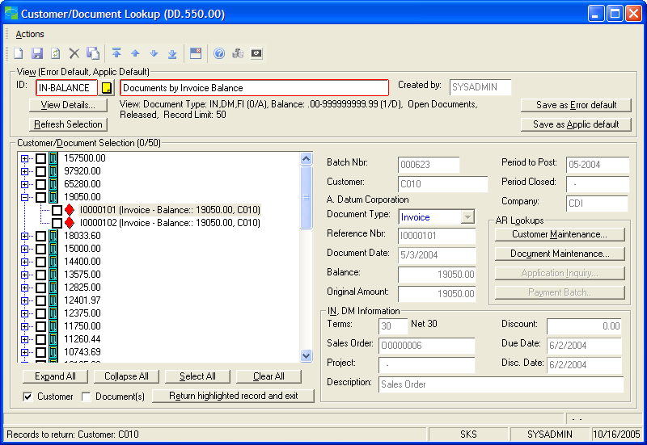
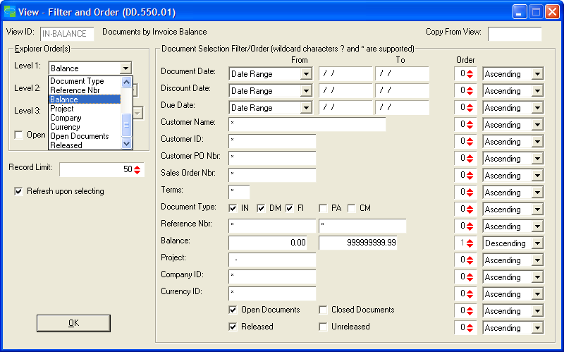
Save Time & Money with these modules
eBanking Suite
  AP Electronic Funds Transfer
  AR Electronic Funds Transfer
  Positive Pay (aka Safe Pay)
  Lockbox Processing ……… Lookup Examples………
  Wire Transfer Plus
Notes:
You can create as many views that you like…this is docs by invoice balance…and here we‘ve come across two invoices with this balance
If we were trying to track down a receipt with this amount then we’d see the invoices here that have that particular amount then by focusing on one of those …we could se all the relevant information to the right here. If that’s the one we want then we pull it into the workbench and process it.
(click for 2nd screen shot to come up)
This screen simply shows how easy it is to create different views by choosing various levels and setting up filters and saving for later use.
Rick:
Here’s an example of using the Customer and Document Lookup tool. You can create as many custom views as you like, then call up a saved view that suits your purpose when you need it.
This view is presenting open invoices by open balance in descending order. Let’s say we’re trying to match up a payment for nineteen thousand fifty dollars because the other information supplied with the payment was ambiguous. Here we‘ve come across two invoices with this balance. By highlighting one of the invoices, we can get the details that help us identify the proper invoice.
At that point we simply click the “return highlighted record” button to pass this record back to the workbench for payment application.
Creating or modifying a view is a simple point and click process. Notice that you can have up to 3 levels of presentation, with a filter and corresponding sort order for each field.

Slide 24
Save Time & Money with these modules
eBanking Suite
  AP Electronic Funds Transfer
  AR Electronic Funds Transfer
  Positive Pay (aka Safe Pay)
  Lockbox Processing
  Wire Transfer Plus
Overview:
Electronically move funds from one account to another
Facilitated by the Federal Reserve System (in the U.S.)
Funds guaranteed to clear within 6 hours (in the U.S.)
Both domestic and foreign payments
Notes:
Wire Transfer Plus, the final module in the Suite is designed also like the AP EFT module to move fund elect. from on account to another.
In the US, this module uses the Federal Reserve System… and payments are initiated in the US are guaranteed to clear funds in 6 hours.
With foreign banks, that will depend on their particular system.
Most typically, it’s used for domestic wires and paying vendors who are not domestic…. In all cases, each bank uses their own format - which must be specifically developed. I’ll be addressing this shortly!
*All cash manager questions to Tim Kahne
Rick:
Wire Transfer Plus, the final module in the eBanking Suite, is identical in flow and operation to the AP EFT module. The difference is that where the APEFT module uses the US ACH system, where Wire Transfer Plus uses a bank-specific format and transaction specification, because there is no standard.
In the US, wires are facilitated by the Federal Reserve System and payments are guaranteed to clear funds in 6 hours.
With foreign banks, that will depend on their particular system.
Most typically, it’s used for domestic wires and paying vendors who are in other countries…. In all cases, each bank uses their own format - which must be specifically developed. I’ll be addressing this shortly!

Slide 25
Save Time & Money with these modules
Features:
Electronically Wire:
  Vendor Trade Pay
  Domestic or Foreign Payments
Multiple formats – bank dependent (need to verify support for your bank)
Remittance advices via email
Payment method option by voucher
Multi-company, Multi-account
Account / Amount Approval
Flexible communications
eBanking Suite
  AP Electronic Funds Transfer
  AR Electronic Funds Transfer
  Positive Pay (aka Safe Pay)
  Lockbox Processing
  Wire Transfer Plus
Overview:
Electronically move funds from one account to another
Facilitated by the Federal Reserve System (in the U.S.)
Funds guaranteed to clear within 6 hours (in the U.S.)
Both domestic and foreign payments
Notes:
Rick:
As I said, the functionality of Wire Transfer Plus is the same as APEFT, as you can see from this list of features. It’s the lack of a standard makes Wire Transfer Plus different.
We have a growing list of bank formats and transaction types that we support, which you can view on our website. If we don’t presently support your bank’s format and transaction type, it’ll have to be developed and there’ll be a development charge for that that will vary depending on the complexity. Be sure to provide your reseller with a copy of your bank’s specs so we can give you a price for that format.
Once the format’s developed, it becomes part of Wire Transfer Plus and is supported accordingly.

Slide 26
MaxQ Products
For MICROSOFT DYNAMICS SL
John Pavain, President
(203) 748-0481 Ext 231
john.pavain@maxqtech.com
www.MaxQTech.com

Slide 27









Financial Management Series

Slide 28
Financial Management Series

Slide 29










Supply Chain Management Series

Slide 30





ADVANCED REVENUE MANAGEMENT
Featuring
Recurring Billing / Revenue Recognition

Slide 31
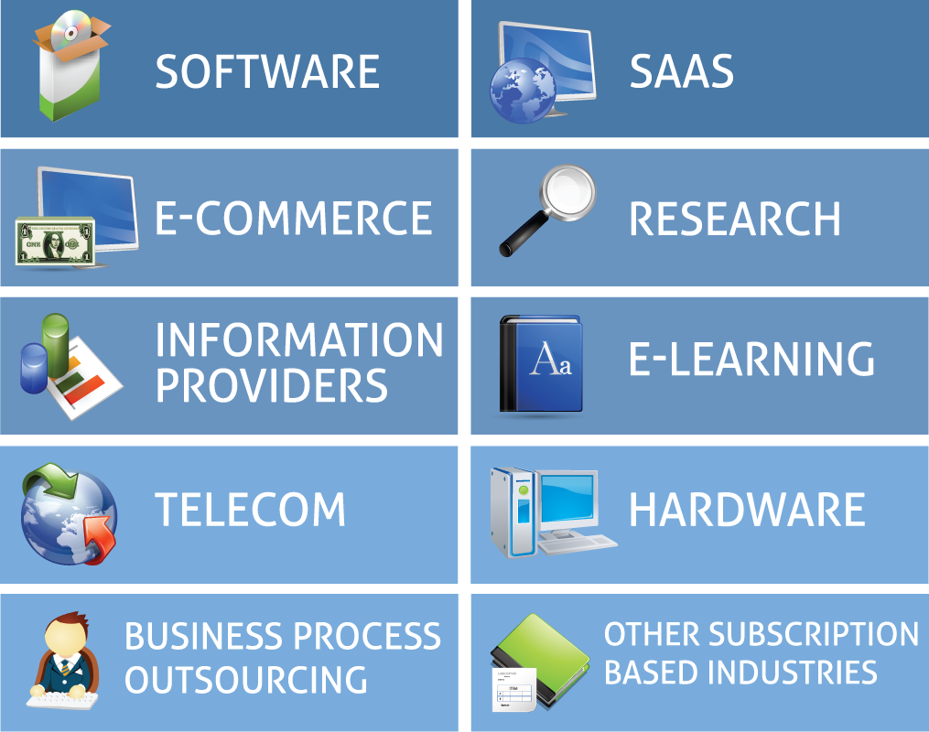
Adds Advanced Revenue Management Capabilities to Dynamics SL
Perfect for Businesses in:

Slide 32
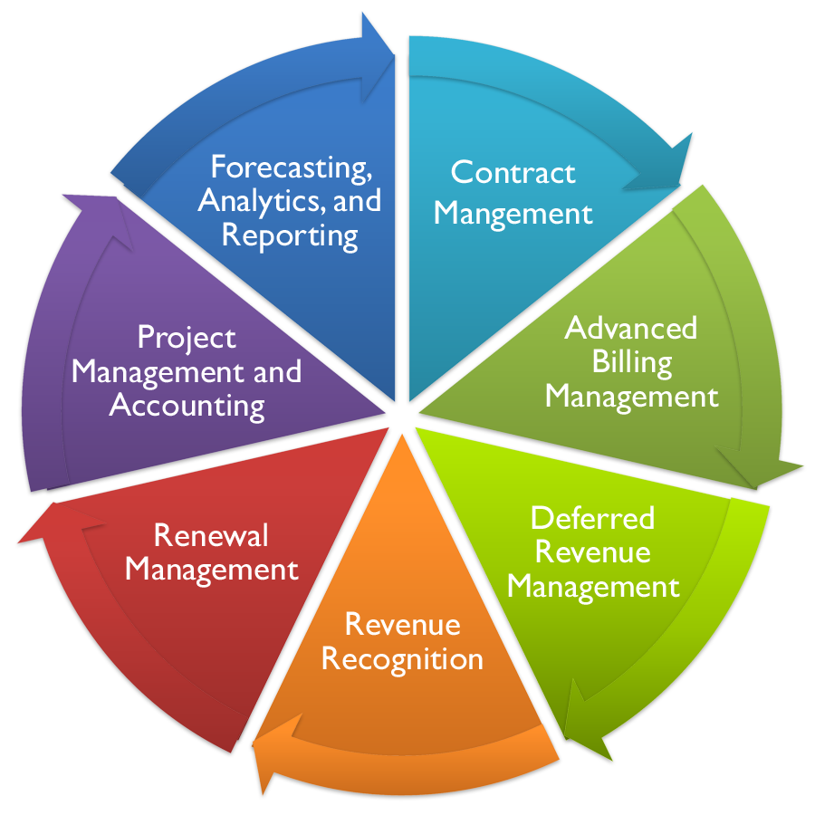
Advanced Revenue Management Suite

Slide 33
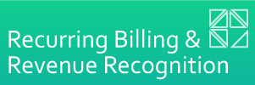


Components of Advanced Revenue Management
Advanced Revenue Management from MaxQ
Automated Credit Card Processing
Electronic Document Transmission
Advanced Billing and Contract Management
Automated Deposit Handling
Data Access and Exploration
ERP System

Slide 34
Complete Flexibility and Control
Gives complete control over complex billing needs
Accurate and automatic revenue recognition that complies with accepted accounting principals
Get out of spreadsheet hell
Increase renewal rates and control the entire contract life cycle
Easily integrate to external systems
Easily process credit cards and send electronic documents to your customers

Slide 35
How is the module used?
Accounts Receivable Invoices
Subscriptions to services billed in arrears or in advance
Memberships
Allows adjustments to bills to handle
one-time charges, credits, upgrades, etc.
Integration to B2B or B2C web services
Order Management Documents
Software Maintenance Agreements
Detailed billing for services which vary per period (e.g. ISP, storage charges, etc.)
All of AR benefits and more with use of non-stock inventory Items

Slide 36
Contracts
Determines billing schedule
Frequency (e.g. monthly, quarterly, user defined, etc.)
Starting/Ending date or Perpetual (open ended)
Generates AR Invoices or Order Management documents
  Multiple AR Invoice or OM Inventory item detail lines
  Link to Revenue Type if deferred income by contract and/or distribution line
Renewal Process
Provides for consolidation of multiple contracts to a single contract
Provides for the application of pricing increase/decreases
Track renewal/non-renewal status

Slide 37
Revenue Recognition
Create revenue schedules from Order Management and AR Documents
Default from Revenue Types
Revenue schedule per invoice line
Optional cost recognition schedules for OM
Option to automatically create billing contract
Auto-generate schedules
From Order Management Shippers
From Recurring Billing AR Invoices
Forecasts Revenue from schedules
Multiple formats

Slide 38

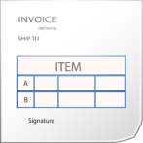

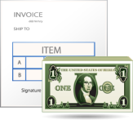

Three ways to Process Billing
Enter Recurring Billing Contract
Create AR Invoice
Create Revenue Recognition Schedules
or
Enter Recurring Billing Contract
Create Sales Orders And Invoice
Create Revenue Recognition Schedules
or
Enter Sales Order And Invoice
Create Revenue Recognition Schedules
Create Contracts For Renewals

Slide 39
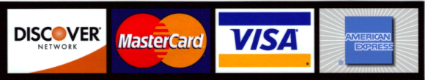
MaxQ Charge It!
Quick processing access from:
Sales Order Entry
Shippers
Invoice and Memo
Recurring Billing/Revenue Recognition

Slide 40
Integrated Processing and Control
Storage of credit card numbers or use Tokens
  All card numbers are encrypted
  Unlimited cards per customer
Charge a Sales Order / Invoice across multiple cards
Automatically place sales order on hold when a credit card is rejected
Support for backorders
  Funds are reserved when the order is entered
  Card is actually charged when order ships
Handles over/under shipments
  Automatically charge final invoice amount

Slide 41
Streamlined Flexibility
Automatically create credit card transaction for credit card invoices
Supports Address Verification Service (AVS) to confirm legitimacy of transactions
Level II transaction support
Automatic creation of all transactions to book fees, mark invoices as paid, book revenue and create receivables
Works with PayPal, Mercury and First Data (more to come)
MaxQ Charge It! Object Interfaces with your web site

Slide 42
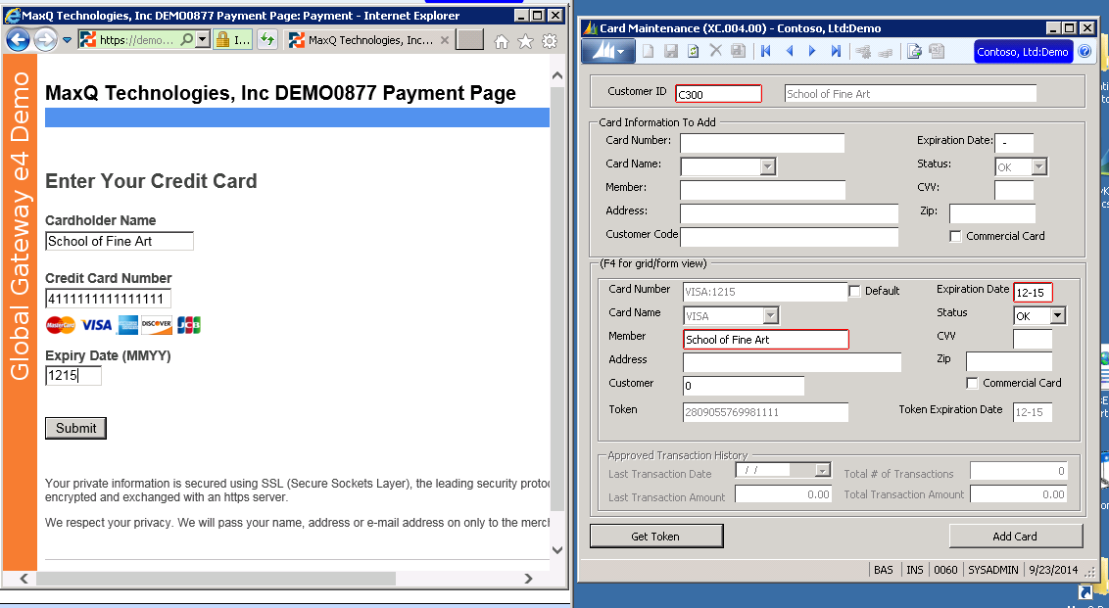
Credit Card Maintenance - Tokens

Slide 43

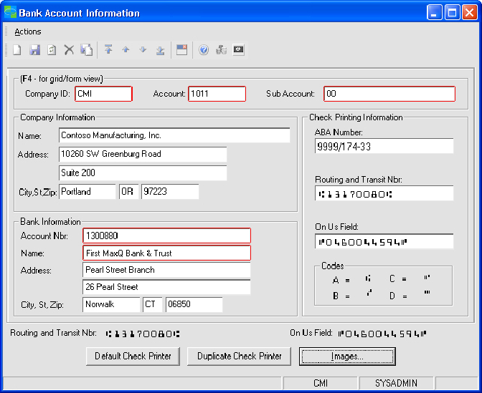
AP/PR Laser Checks
Produces custom laser checks including logos and digitized signatures for an unlimited number of companies and bank accounts on blank check stock; eliminating the need to purchase preprinted checks.

Slide 44
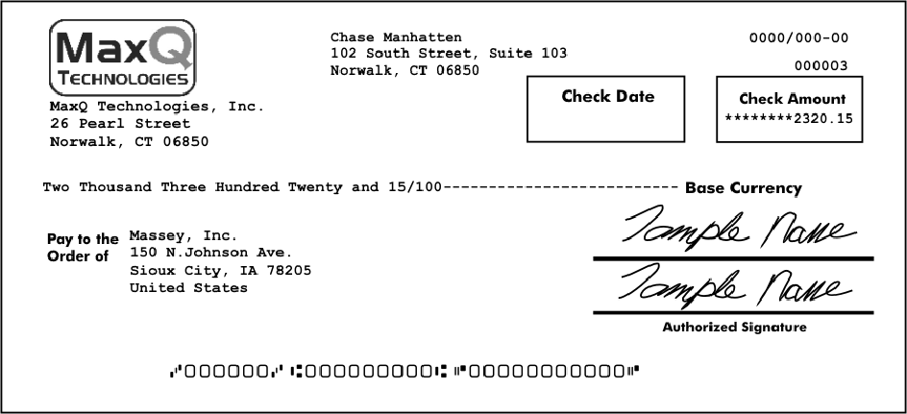
Sample Check

Slide 45

Questions?
Contact Information:
John.Pavain@maxqtech.com
(203) 748-0481 Ext 231
sales@maxqtech.com
www.maxqtech.com

Slide 46

KeyChange–enables you to safely change over 40 key fields in your Microsoft Dynamics SL database
Account Master–group, track, match, reconcile, and analyze financial activity in and across accounts
AP Voucher Import–converts your text or Microsoft Excel invoices into uploadable data for your Microsoft Dynamics SL system
GL Upload–lets you upload, correct, and map text and Microsoft Excel data to your Microsoft Dynamics database
Multi-Remit–facilitates the processing of vouchers and checks with multiple remittance addresses without creating multiple vendor ids
NexVue is award-winning Microsoft partner with a silver ERP competency.
Notes:
NexVue helps you get more value from your Microsoft Dynamics SL ERP with tools that automate processes, increase efficiency, and eliminate manual errors. Based on over 25 years of Dynamics SL experience implementing over 600 Dynamics SL installations, NexVue’s tools are used by more than 2500 customers around the globe.

Slide 47
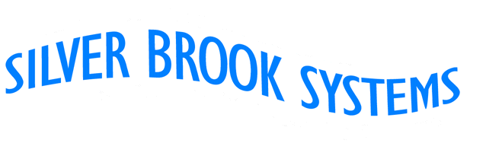
Silver Brook Human Resources
  Applicant Tracking
  New Hire and Termination Processing
  Salary and Job History
  Benefits Administration
  Credentials Management
  Training Management
  OSHA
  Workers Compensation, Compliance Reporting
  Health and Safety
  Property Management
  Applicant Self-Service
  Employee Self Service
Silver Brook Other Products
  Privacy Manager
  ACA Compliance

Slide 48

Order Central
  B2B
  B2C
  Multiple Storefronts
  Advanced Product Catalog
  Multi-Currency
  Shopping Cart
  Email Forms
  Tight, real time integration with Dynamics SL

Slide 49
Sales Central
Sales Central
Web based application for sales order management, customer maintenance, and order status.
Sales Central™ provides sales and customer service professionals the ability to create sales orders, maintain and create customer information, and provide customer service such as order status and information, with direct and seamless integration into Microsoft® Dynamics SL® Supply Chain Management system.

Slide 50
Account Central
Provides an easy way to offer web based statements, invoice detail, and online payments to your customers. Web based application for sales order management, customer maintenance, and order status.
With Account Central™ you can provide an easy way for customers to take care of their outstanding balances without creating accounting issues
More than just online payment, Account Central™ allows complete statement review, invoice detail review, and invoice history search. And because its integrated with Dynamics SL® you won’t have to worry about manually applying online payments to outstanding invoices because everything is automatic.

Slide 51

Managed Hosting Services

Slide 52
Common Business Cases which drive Hosting
Significant financial change
Purchased or sold division or entity
OPEX vs. CAPEX
Topic of Azure
Change at the “C” level or IT Management
Aging infrastructure

Slide 53

SLA’s 99.5%
Private Cloud
(GoIWx)
350 Colocation Thought Partnership with Level 3 Communication
Full IAAS with Managed Hosting Services
Physical Tours
Monitoring included
Redundancy included
Mature platform for ERP
Public Cloud
(Azure)
17 regions worldwide
IAAS ONLY
Premier Support Company – mandatory for support
SLA’s ONLY with Availability Sets
My opinion:
• OK – DEV & TEST
• Not OK – Critical Workloads,
(Production)
• Immature Platform for ERP
Cloud First Strategy
35% IaaS -
65% Managed Hosting Services

Slide 54

Contacts at GoIWx
Molly Stewart , Shared Services Manager
(952) 258-6329 - mstewart@goiwx.com

