Slide 1
Management Reporter 2012

Slide 2
Management Reporter 2012
Management Reporter is the replacement of FRx
Management Reporter 2012
User Benefits
IT Benefits
FRx Transition

Slide 3
Benefits of Management Reporter for Users
Easy Transition from FRx
Dimension Flexibility
Formatting Enhancements
Logos & Images in Headers and Footers
Page Breaks in Columns
Organization
Folders for Storing Templates
Report Library for Generated Reports & External Files
Report Viewer
Undo
XBRL
Management Reporter 2012
User Benefits
IT Benefits
FRx Transition
Notes:
Transition
Since Management Reporter is built using the same concepts as FRx, it will be an easy transition for customers.
Undo
Seems small, but makes the app more consistent with other msft applications.
Dimension flexibility
Allows for more flexibility when creating reports. The structured rules of regarding segments in FRx are no longer a limitation. By allowing larger and variable length masks, Management Reporter scales better to larger customers. By having the same functionality in columns and trees as rows, customers can use individual dimensions, ranges of dimensions, wildcard any dimension or subtract any dimension.
Formatting
Board room quality reports are a given and by adding logos/images to headers and footers, reports become even more customized. Allowing for page breaks to be specified in columns, users can control what data is displayed on what page. If the columns contain departments, they can specify the departments they want printed on each page by using the column page breaks.
Organization
By creating folders, users can organize and easily find the building blocks they are looking for, which increases productivity.
Report Viewer
Again, by creating folders in the report library, reports can be found easily and put into folders that make sense to everyone in the organization. Security can also be applied to these folders to make sure only those individuals that should have access to certain folders or items have access. Also, any supporting documents to the financials can be added to the report library. All of the information users need are all in one place.
When viewing report data, the same great drill down functionality is available to get to the information users need, but can either use a tree to navigate or drill through as they are used to in FRx. And, it doesn’t open a new view each time you drill. Users can see where they are it the report and can easily get back to summary information.
XBRL
Management Reporters supports XBRL 2.1 and Dimension 1.0 specifications. Tagging of financial data is done at design time which allows the tagging to be re-used. A new instance document can be created by simply changing the report date. This is unique in the field as most XBRL applications tag financial information in Excel after the report has been generated.

Slide 4
Benefits of Management Reporter for IT
New Code Base and Architecture
64-Bit
C# and .NET
SQL Server
Report Processing on Server (not local machines)
Improved Multi-User Environment
Active Directory
Management Reporter 2012
User Benefits
IT Benefits
FRx Transition
Notes:
New code base and architecture
64-bit support
Many companies are upgrading their systems to 64-bit. Management Reporter was built using in 64-bit environments. The IT department won’t need to maintain a separate machine just for Management Reporter as they may need to do for FRx.
More stable
FRx code base was close to 20 years old and the design experience was closely tied to generating. Fixing bugs was risky because it resulted in breaking things in other areas. Management Reporter is much more stable. Each area of the application (designing, processing, viewing) is isolated which makes it easier to identify exactly where issues are.
Improved performance
Processing takes place on the server, not the client. This frees up the client to continue designing reports instead of locking it up until the report has finished generating.
SQL Server
No more Microsoft Access databases! This means no more corrupted spec files, no need to rebuild indexes to ensure new accounts are picked up. This results in less calls to IT or the partner to “fix” the issue. End users are much more productive.
Improved multi-user environment
With the switch to IIS and SQL Server, there is no need create shares for the sysdata and io_data. All of the building block, company information and generated reports are in a SQL database. Administrators can see all reports that are being generated at any given time since all processing is done on the server.
Active directory
Once users are added to Management Reporter, any changes made to passwords, etc by users are automatically rolled forward. There is no need to “manage” users in Management Reporter unless a user needs to be disabled or given a new security role. This also means the only login screen users see is the company login which logs them into GP.

Slide 5
FRx to Management Reporter Transition
No more FRx Purchases
Modules
Users
New Clients
Named User Licenses
1 FRx User = 2 MR Designers
1 Dynamics User = 1 MR Generator/Viewer
Microsoft Ends FRx Support 7/8/14
Management Reporter 2012
User Benefits
IT Benefits
FRx Transition
Notes:
New code base and architecture
64-bit support
Many companies are upgrading their systems to 64-bit. Management Reporter was built using in 64-bit environments. The IT department won’t need to maintain a separate machine just for Management Reporter as they may need to do for FRx.
More stable
FRx code base was close to 20 years old and the design experience was closely tied to generating. Fixing bugs was risky because it resulted in breaking things in other areas. Management Reporter is much more stable. Each area of the application (designing, processing, viewing) is isolated which makes it easier to identify exactly where issues are.
Improved performance
Processing takes place on the server, not the client. This frees up the client to continue designing reports instead of locking it up until the report has finished generating.
SQL Server
No more Microsoft Access databases! This means no more corrupted spec files, no need to rebuild indexes to ensure new accounts are picked up. This results in less calls to IT or the partner to “fix” the issue. End users are much more productive.
Improved multi-user environment
With the switch to IIS and SQL Server, there is no need create shares for the sysdata and io_data. All of the building block, company information and generated reports are in a SQL database. Administrators can see all reports that are being generated at any given time since all processing is done on the server.
Active directory
Once users are added to Management Reporter, any changes made to passwords, etc by users are automatically rolled forward. There is no need to “manage” users in Management Reporter unless a user needs to be disabled or given a new security role. This also means the only login screen users see is the company login which logs them into GP.

Slide 6
Management Reporter 2012 for Microsoft Dynamics® ERP
Key Themes
Interactive Report Viewing
Deeper Dynamics ERP Integration
Report Collaboration
Design Flexibility

Slide 7
Management Reporter 2012
Interactive Report Viewing
Attach comments to important rows in a report version
Copy comments from one version of a report to another
Quickly create a chart based upon selected report rows and columns
Collaborate on a report by providing a link to current report and selected row when launching instant messenger client from within a report
Easily page within a report
Jump to key areas of report for fast analysis
Locate key features in Report Viewer with enhanced toolbar
Find a key value in a report, such as account value or description
Interactive Report Viewing
Deeper Dynamics ERP Integration
Report Collaboration
Design Flexibility

Slide 8
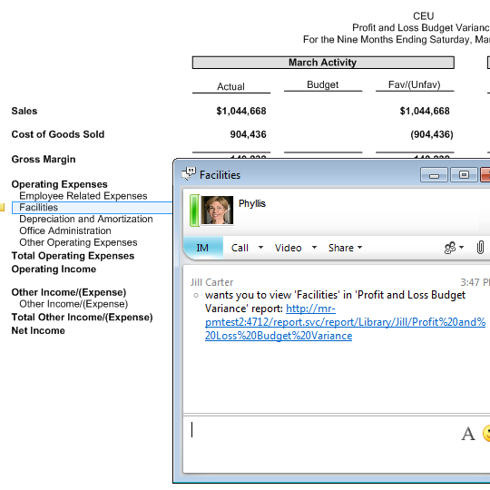
Interactive Report Viewing
Collaborate on a report by providing a link to current report and selected row when launching instant messenger client from within a report
Instant message
Message contains context -- name of report, report row and link URL to open report
Support for Microsoft Lync™ 2010

Slide 9
Management Reporter 2012
Deeper Microsoft Dynamics® ERP Integration
Drill from account and budget balances on a report to related information in Microsoft Dynamics ERP
Microsoft Dynamics ERP companies integrated with Management Reporter
Interactive Report Viewing
Deeper Dynamics ERP Integration
Report Collaboration
Design Flexibility

Slide 10
Management Reporter 2012
Report Collaboration
Personalized and secured view of data for all output types
More secured report output options
Publish to a read-only (.xps) report format
Publish a personalized Microsoft® Excel® (.xlsx) file
More report distribution flexibility
Schedule reports to generate on a periodic basis
Publish reports to multiple Microsoft® SharePoint® or any network location
E-mail reports via SharePoint alerts
E-mail a link to a report from within Report Viewer
Interactive Report Viewing
Deeper Dynamics ERP Integration
Report Collaboration
Design Flexibility

Slide 11
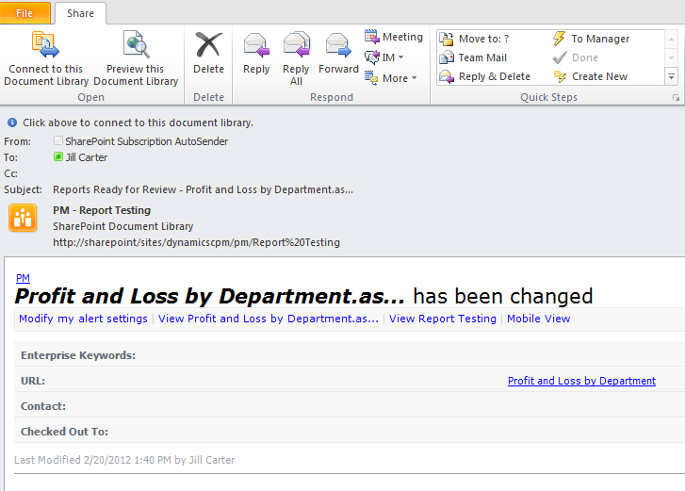
Report Collaboration
E-mail reports via SharePoint alerts
E-mail a link to a report from within Report Viewer

Slide 12
Management Reporter 2012
Design Flexibility
Quickly identify accounts/dimensions that have been omitted from report building blocks
Control how account descriptions are formatted
Easily save and reuse dimension combinations when designing reports
Format headers for rolling forecasts
Interactive Report Viewing
Deeper Dynamics ERP Integration
Report Collaboration
Design Flexibility

Slide 13
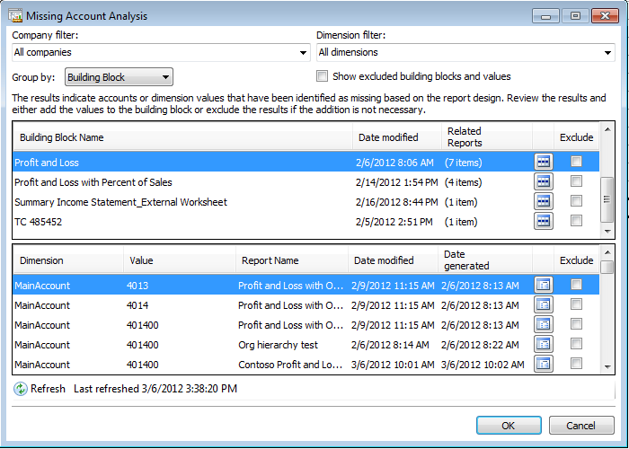
Design Flexibility
Quickly identify accounts/ dimensions omitted from building blocks
Notes:
Changed screen shot since Excel was cut from missing account analysis.

Slide 14
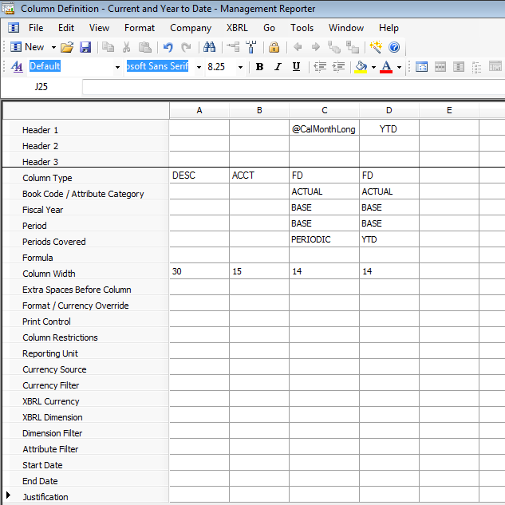
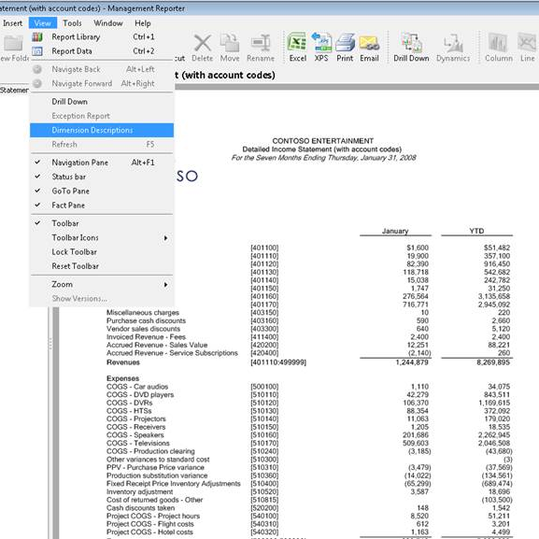
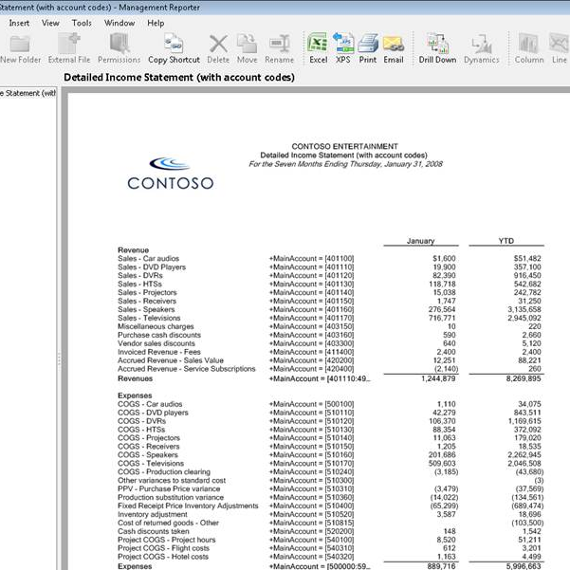
Design Flexibility
Control how account descriptions are formatted
Provide users with additional dimension information in Account column
Users choose how they want to view accounts -- with or without dimension descriptions

Slide 15
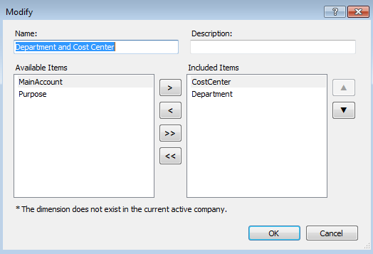
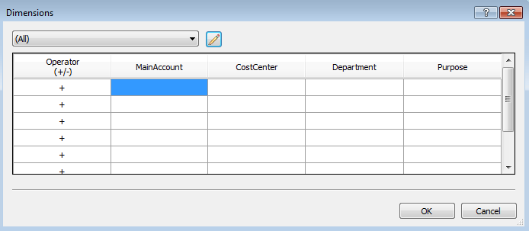
Design Flexibility
Easily save and reuse dimension combinations when designing reports
Design Flexibility

Slide 16
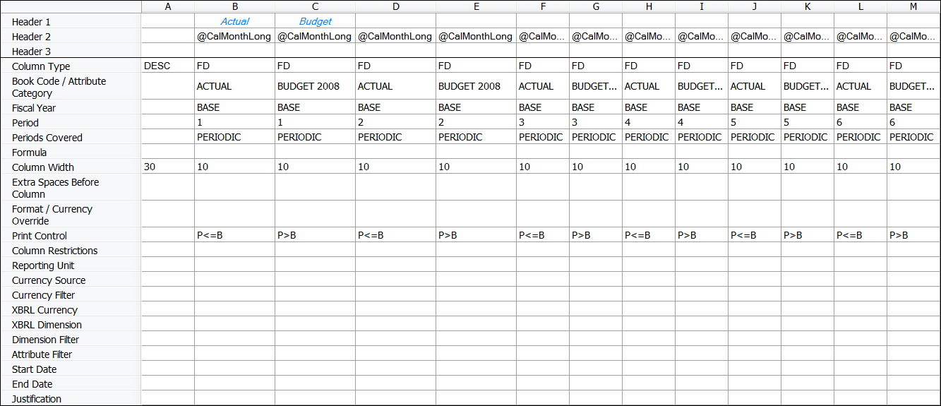
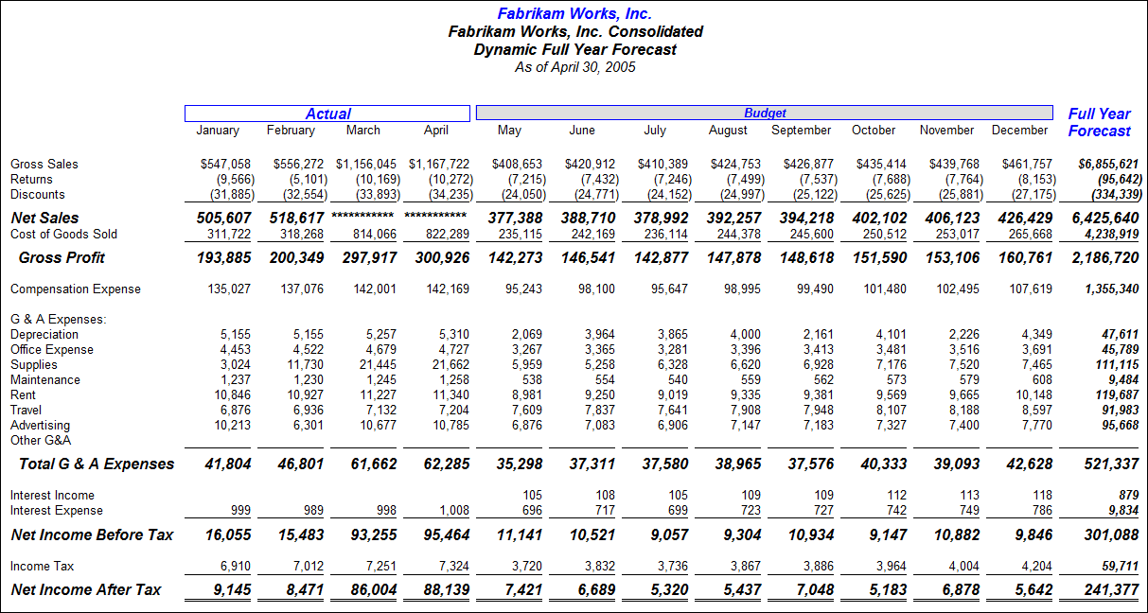
Design Flexibility
Format headers for rolling forecasts
Provides ability to create a rolling forecast with correct headers using Base concept
Autotext works with WKS columns, when period and year defined
Can use Base and Base+x and Base-x in Spread From and Spread To

Slide 17
Management Reporter 2012
Design Flexibility
Quickly identify accounts/dimensions that have been omitted from report building blocks
Control how account descriptions are formatted
Easily save and reuse dimension combinations when designing reports
Format headers for rolling forecasts
Interactive Report Viewing
Deeper Dynamics ERP Integration
Report Collaboration
Design Flexibility

Slide 18
Migrating to Management Reporter 2012
Tools to help the migration from FRx to MR
Migration
Validation
FRx to MR
Preparation
Migration
Success!
Notes:
New code base and architecture
64-bit support
Many companies are upgrading their systems to 64-bit. Management Reporter was built using in 64-bit environments. The IT department won’t need to maintain a separate machine just for Management Reporter as they may need to do for FRx.
More stable
FRx code base was close to 20 years old and the design experience was closely tied to generating. Fixing bugs was risky because it resulted in breaking things in other areas. Management Reporter is much more stable. Each area of the application (designing, processing, viewing) is isolated which makes it easier to identify exactly where issues are.
Improved performance
Processing takes place on the server, not the client. This frees up the client to continue designing reports instead of locking it up until the report has finished generating.
SQL Server
No more Microsoft Access databases! This means no more corrupted spec files, no need to rebuild indexes to ensure new accounts are picked up. This results in less calls to IT or the partner to “fix” the issue. End users are much more productive.
Improved multi-user environment
With the switch to IIS and SQL Server, there is no need create shares for the sysdata and io_data. All of the building block, company information and generated reports are in a SQL database. Administrators can see all reports that are being generated at any given time since all processing is done on the server.
Active directory
Once users are added to Management Reporter, any changes made to passwords, etc by users are automatically rolled forward. There is no need to “manage” users in Management Reporter unless a user needs to be disabled or given a new security role. This also means the only login screen users see is the company login which logs them into GP.

Slide 19
Preparation for Migration
Install Management Reporter
Test Connection
Delete Un-Needed Elements in FRx
Companies
Specification Sets
Building Blocks
Delete index files (*.g32)
Set all companies to default
Compact FRx databases
FRx to MR
Preparation
Migration
Success!
Notes:
New code base and architecture
64-bit support
Many companies are upgrading their systems to 64-bit. Management Reporter was built using in 64-bit environments. The IT department won’t need to maintain a separate machine just for Management Reporter as they may need to do for FRx.
More stable
FRx code base was close to 20 years old and the design experience was closely tied to generating. Fixing bugs was risky because it resulted in breaking things in other areas. Management Reporter is much more stable. Each area of the application (designing, processing, viewing) is isolated which makes it easier to identify exactly where issues are.
Improved performance
Processing takes place on the server, not the client. This frees up the client to continue designing reports instead of locking it up until the report has finished generating.
SQL Server
No more Microsoft Access databases! This means no more corrupted spec files, no need to rebuild indexes to ensure new accounts are picked up. This results in less calls to IT or the partner to “fix” the issue. End users are much more productive.
Improved multi-user environment
With the switch to IIS and SQL Server, there is no need create shares for the sysdata and io_data. All of the building block, company information and generated reports are in a SQL database. Administrators can see all reports that are being generated at any given time since all processing is done on the server.
Active directory
Once users are added to Management Reporter, any changes made to passwords, etc by users are automatically rolled forward. There is no need to “manage” users in Management Reporter unless a user needs to be disabled or given a new security role. This also means the only login screen users see is the company login which logs them into GP.

Slide 20
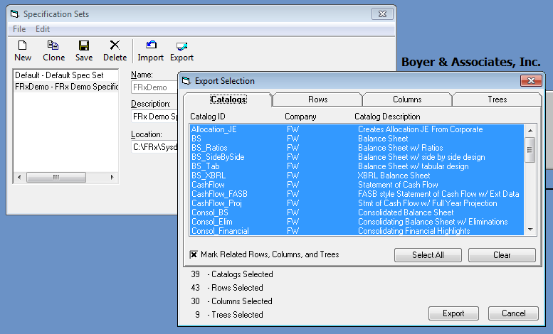
Preparation for Migration
Deleting Un-Needed Building Blocks
Delete unused Catalogs
Company>Specification Sets
Export Button
Select All
Review Building Blocks
Notes:
New code base and architecture
64-bit support
Many companies are upgrading their systems to 64-bit. Management Reporter was built using in 64-bit environments. The IT department won’t need to maintain a separate machine just for Management Reporter as they may need to do for FRx.
More stable
FRx code base was close to 20 years old and the design experience was closely tied to generating. Fixing bugs was risky because it resulted in breaking things in other areas. Management Reporter is much more stable. Each area of the application (designing, processing, viewing) is isolated which makes it easier to identify exactly where issues are.
Improved performance
Processing takes place on the server, not the client. This frees up the client to continue designing reports instead of locking it up until the report has finished generating.
SQL Server
No more Microsoft Access databases! This means no more corrupted spec files, no need to rebuild indexes to ensure new accounts are picked up. This results in less calls to IT or the partner to “fix” the issue. End users are much more productive.
Improved multi-user environment
With the switch to IIS and SQL Server, there is no need create shares for the sysdata and io_data. All of the building block, company information and generated reports are in a SQL database. Administrators can see all reports that are being generated at any given time since all processing is done on the server.
Active directory
Once users are added to Management Reporter, any changes made to passwords, etc by users are automatically rolled forward. There is no need to “manage” users in Management Reporter unless a user needs to be disabled or given a new security role. This also means the only login screen users see is the company login which logs them into GP.

Slide 21
Preparation for Migration
Install Management Reporter
Test Connection
Delete un-needed elements in FRx
Companies
Specification Sets
Building Blocks
Delete index files (*.g32)
Set all companies to default
Compact FRx databases
FRx to MR
Preparation
Migration
Success!
Notes:
New code base and architecture
64-bit support
Many companies are upgrading their systems to 64-bit. Management Reporter was built using in 64-bit environments. The IT department won’t need to maintain a separate machine just for Management Reporter as they may need to do for FRx.
More stable
FRx code base was close to 20 years old and the design experience was closely tied to generating. Fixing bugs was risky because it resulted in breaking things in other areas. Management Reporter is much more stable. Each area of the application (designing, processing, viewing) is isolated which makes it easier to identify exactly where issues are.
Improved performance
Processing takes place on the server, not the client. This frees up the client to continue designing reports instead of locking it up until the report has finished generating.
SQL Server
No more Microsoft Access databases! This means no more corrupted spec files, no need to rebuild indexes to ensure new accounts are picked up. This results in less calls to IT or the partner to “fix” the issue. End users are much more productive.
Improved multi-user environment
With the switch to IIS and SQL Server, there is no need create shares for the sysdata and io_data. All of the building block, company information and generated reports are in a SQL database. Administrators can see all reports that are being generated at any given time since all processing is done on the server.
Active directory
Once users are added to Management Reporter, any changes made to passwords, etc by users are automatically rolled forward. There is no need to “manage” users in Management Reporter unless a user needs to be disabled or given a new security role. This also means the only login screen users see is the company login which logs them into GP.

Slide 22
What Does/Doesn’t Migrate
What Does Migrate from FRx to MR
Rows
Columns
Trees
Reports (Catalogs)
Fonts
What Doesn’t Migrate from FRx to MR
Security
Company Connection Information
Report Chains
Email Settings
FRx to MR
Preparation
Migration
Success!
Notes:
New code base and architecture
64-bit support
Many companies are upgrading their systems to 64-bit. Management Reporter was built using in 64-bit environments. The IT department won’t need to maintain a separate machine just for Management Reporter as they may need to do for FRx.
More stable
FRx code base was close to 20 years old and the design experience was closely tied to generating. Fixing bugs was risky because it resulted in breaking things in other areas. Management Reporter is much more stable. Each area of the application (designing, processing, viewing) is isolated which makes it easier to identify exactly where issues are.
Improved performance
Processing takes place on the server, not the client. This frees up the client to continue designing reports instead of locking it up until the report has finished generating.
SQL Server
No more Microsoft Access databases! This means no more corrupted spec files, no need to rebuild indexes to ensure new accounts are picked up. This results in less calls to IT or the partner to “fix” the issue. End users are much more productive.
Improved multi-user environment
With the switch to IIS and SQL Server, there is no need create shares for the sysdata and io_data. All of the building block, company information and generated reports are in a SQL database. Administrators can see all reports that are being generated at any given time since all processing is done on the server.
Active directory
Once users are added to Management Reporter, any changes made to passwords, etc by users are automatically rolled forward. There is no need to “manage” users in Management Reporter unless a user needs to be disabled or given a new security role. This also means the only login screen users see is the company login which logs them into GP.

Slide 23
What Does/Doesn’t Migrate
“Before anything else, preparation is the key to success.” -Alexander Graham Bell
Validation
QA Review
Boyer & Associates is here to help with your Success!
FRx to MR
Preparation
Migration
Success!
Notes:
New code base and architecture
64-bit support
Many companies are upgrading their systems to 64-bit. Management Reporter was built using in 64-bit environments. The IT department won’t need to maintain a separate machine just for Management Reporter as they may need to do for FRx.
More stable
FRx code base was close to 20 years old and the design experience was closely tied to generating. Fixing bugs was risky because it resulted in breaking things in other areas. Management Reporter is much more stable. Each area of the application (designing, processing, viewing) is isolated which makes it easier to identify exactly where issues are.
Improved performance
Processing takes place on the server, not the client. This frees up the client to continue designing reports instead of locking it up until the report has finished generating.
SQL Server
No more Microsoft Access databases! This means no more corrupted spec files, no need to rebuild indexes to ensure new accounts are picked up. This results in less calls to IT or the partner to “fix” the issue. End users are much more productive.
Improved multi-user environment
With the switch to IIS and SQL Server, there is no need create shares for the sysdata and io_data. All of the building block, company information and generated reports are in a SQL database. Administrators can see all reports that are being generated at any given time since all processing is done on the server.
Active directory
Once users are added to Management Reporter, any changes made to passwords, etc by users are automatically rolled forward. There is no need to “manage” users in Management Reporter unless a user needs to be disabled or given a new security role. This also means the only login screen users see is the company login which logs them into GP.

Slide 24
© 2012 Microsoft Corporation. All rights reserved. Microsoft, Windows, Windows Vista and other product names are or may be registered trademarks and/or trademarks in the U.S. and/or other countries.
The information herein is for informational purposes only and represents the current view of Microsoft Corporation as of the date of this presentation. Because Microsoft must respond to changing market conditions, it should not be interpreted to be a commitment on the part of Microsoft, and Microsoft cannot guarantee the accuracy of any information provided after the date of this presentation. MICROSOFT MAKES NO WARRANTIES, EXPRESS, IMPLIED OR STATUTORY, AS TO THE INFORMATION IN THIS PRESENTATION.

