Slide 1
GP Tips & Tricks
Presented by Ron Pederson and Renee McLain

Slide 2
GP Tips & Tricks
System
Learn new things
Leverage Investment Maximizer

Slide 3
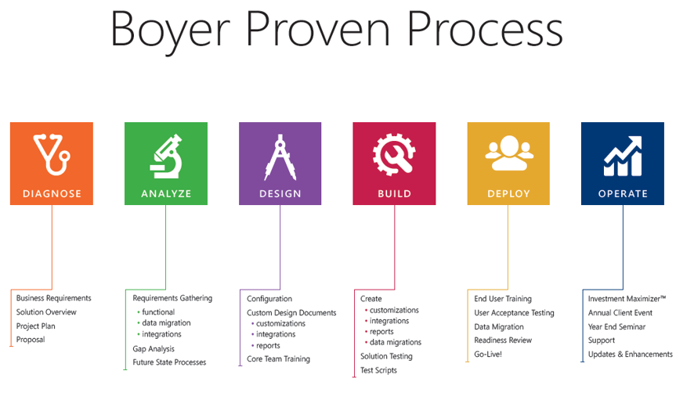
GP Tips & Tricks

Slide 4
GP Tips & Tricks

Slide 5
GP Tips & Tricks

Slide 6
GP Tips & Tricks

Slide 7
GP Tips & Tricks

Slide 8
GP Tips & Tricks

Slide 9
GP Tips & Tricks

Slide 10
GP Tips & Tricks
System
Learn new things
Leverage Investment Maximizer
Discover new features
Use new modules
Learn new Tips & Tricks

Slide 11
GP Tips & Tricks
System
Is your Esc key worn out?
Manage Posting Reports

Slide 12
GP Tips & Tricks
System
Trim down search lists
Exclude inactive accounts in lookups
Define and save default views for lookups
Save sort order in default lookups

Slide 13
GP Tips & Tricks
General Ledger
Look in the tool box
Reconcile sub-ledgers to GL
Accounts Receivable
Accounts Payable
Inventory
Bank Reconciliation

Slide 14
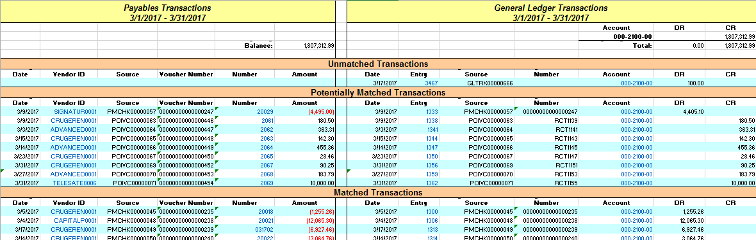
GP Tips & Tricks

Slide 15
GP Tips & Tricks
General Ledger
Cheater GL Import
Paste from Excel
Paste from text

Slide 16
GP Tips & Tricks
General Ledger
Find Money
Use Cashflow Tools
Add expected items for better analysis

Slide 17
GP Tips & Tricks
Sales
Don’t ignore the warning signs
Visual indicator for Customer Over Credit Limit

Slide 18
GP Tips & Tricks
Purchasing
Keep accounts in sync
Combine or modify Vendor IDs
Can also be used for Customer IDs

Slide 19
GP Tips & Tricks
Sales
Would you like Fries with that order?
Suggested sales items in GP

Slide 20
GP Tips & Tricks
Sales
Efficient Printing
Use Quick Print

Slide 21
GP Tips & Tricks
Purchasing
Quick snapshot
All-in-One document viewer

Slide 22
GP Tips & Tricks
Inventory
Why was this changed?
Use Inventory Adjustment Reason Codes

Slide 23
GP Tips & Tricks
Purchasing
Prevent double payments
PO check during AP entry

Slide 24
GP Tips & Tricks
Purchasing
You need a deposit?
PO Prepayments

Slide 25
GP Tips & Tricks
Fixed Assets
Please take a ticket
Automatically generate the next asset ID

Slide 26
GP Tips & Tricks
General
Use short cuts
Add toolbars

Slide 27
GP Tips & Tricks
Reporting
See what you are doing
Increase/Decrease width of Favorites Pane
Auto Hide Option

Slide 28
GP Tips & Tricks
Purchasing
Trouble inactivating a vendor
Move POs to history to inactivate Vendors

Slide 29
GP Tips & Tricks
General Ledger
To journal entry or not journal entry
Allow entry on account
Turn off for sub-ledger accounts

Slide 30
GP Tips & Tricks
System
Get your posting work done
Understanding ‘Post To’ vs. ‘Post Through’
Understanding ‘Post Through’ & Transaction Posting
Understanding Series Posting

Slide 31
GP Tips & Tricks
General
Be a control freak
Use MS Connect
http://connect.microsoft.com

Slide 32
GP Tips & Tricks

Slide 33
GP Tips & Tricks
Sales
Secure Sales Transactions
Hide Costs

Slide 34
GP Tips & Tricks
Sales
Clean up after yourself
Removed paid transactions

Slide 35
GP Tips & Tricks
Inventory
Can lettuce go in the freezer?
Assign items to sites

Slide 36
GP Tips & Tricks
General Ledger
Same entry, different amounts
Clear recurring batch amounts

Slide 37
GP Tips & Tricks
Sales
Auto numbering customer, vendors, items
Free tool! - Auto numbering customer, vendors, items
http://mohdaoud.blogspot.com/2013/10/cards-auto-numbering-for-vendors.html

