Slide 1
Corporate Performance Management (CPM)
Business Intelligence (BI)
Notes:
Katie do admin: thanks for coming, get started in a couple minutes; hit record, welcome

Slide 2
What is Corporate Performance Management?
Wikipedia: Corporate Performance Management (CPM) is a set of performance management and analytic processes that enables the management of an organization's performance to achieve one or more pre-selected goals.
What is Business Intelligence?
Wikipedia: Business Intelligence (BI) comprises the strategies and technologies used for the data analysis of business information.
Notes:
On to today’s topic …

Slide 3
Components of CPM
Goals, budgets, or other desired results
Consolidation of information to measure against #1 (BI)
Decisions and insights made from #2 to achieve #1 and more thoughtful planning for the next or revised #1, starting the process over again
Notes:
On to today’s topic …

Slide 4
Example of Issues without #2 (BI)
Financial
Manual Excel files with distribution
One person consolidating budgets
Customers
Custom programs not linked to ERP (CRM, Salesforce, etc.)
Missing important information regarding customers
Products or Services
Custom programs not linked to ERP or customers
Difficult to find correlations between customers and sales in a financial view
Without a developed BI solution #3 of the CPM is difficult to achieve which may result in failure to meet goals and budgets, #1.
Notes:
On to today’s topic …

Slide 5
How Can BI Help?
The following is based on a true story, the names and details have been altered for privacy.
Background:
Medical device company with 10% month over month continued increase in sales
Gross margin was not following sales growth
Using a Dynamics ERP system with custom inventory program linked to the ERP with summary data only. CRM data not linked at all.
5 year goal 25% net income
Notes:
On to today’s topic …

Slide 6
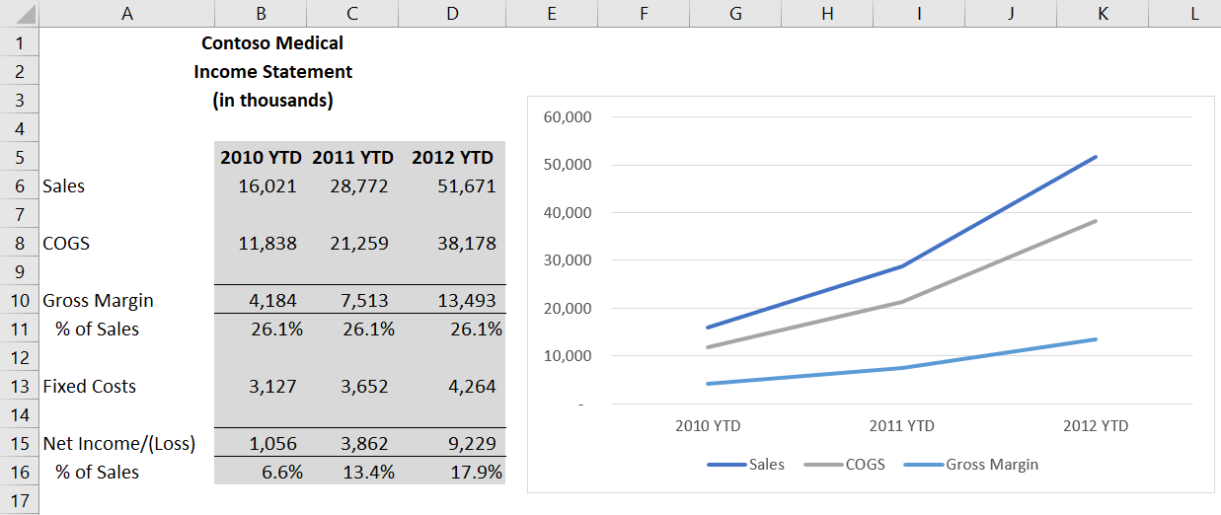
Good yearly growth, could it be better?
Notes:
On to today’s topic …

Slide 7
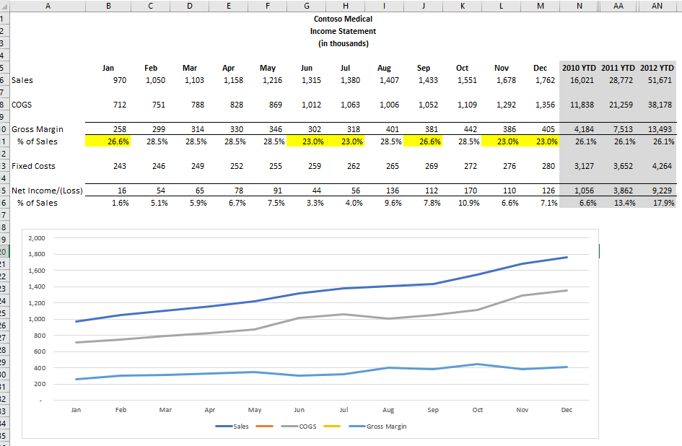
Growth could be better! What is causing margin % to dip?
Notes:
On to today’s topic …

Slide 8
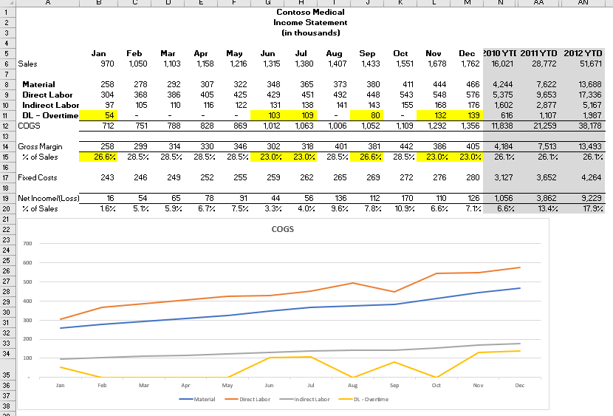
Possibly one more level down to Department for where OT occurred, but that's the limit of the current system. WHY has yet to be answered!
Notes:
On to today’s topic …

Slide 9
Need to combine data to answer WHY Need a BI tool!
Data Warehouse
Direct Connect
Financial
GL Group
Sales
COGS
GL Acct
Sales
Material
Direct Labor
Indirect Labor
DL – Overtime
Inventory
Inv Group
Invasive
Non-Invasive
Supplies
Inv Category
Elective
Non-Elective
CRM or other database
Notes:
On to today’s topic …

Slide 10
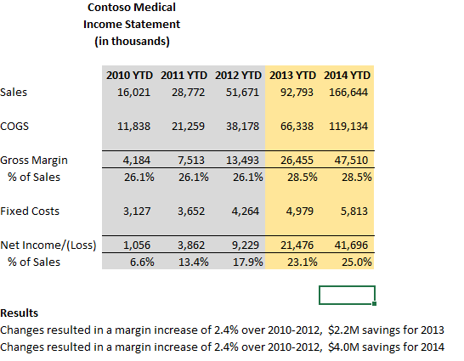
Result
Notes:
On to today’s topic …

Slide 11
BI Tools
Management Reporter
SSRS (SQL Server Reporting Services)
Excel - Power Pivot
Power BI
Jet Reports
BI-360
Notes:
On to today’s topic …

Slide 12
Power BI is a suite of business analytics tools that deliver insights throughout your organization. Connect to hundreds of data sources, simplify data prep, and drive ad hoc analysis. Produce beautiful reports, then publish them for your organization to consume on the web and across mobile devices. Everyone can create personalized dashboards with a unique, 360-degree view of their business. And scale across the enterprise, with governance and security built-in.
https://powerbi.microsoft.com/en-us/
Notes:
On to today’s topic …

Slide 13
Business Intelligence for Microsoft Dynamics. Fast, Flexible Dashboards and Financial Reports in Excel and Online.
https://www.jetreports.com/
Notes:
On to today’s topic …

Slide 14
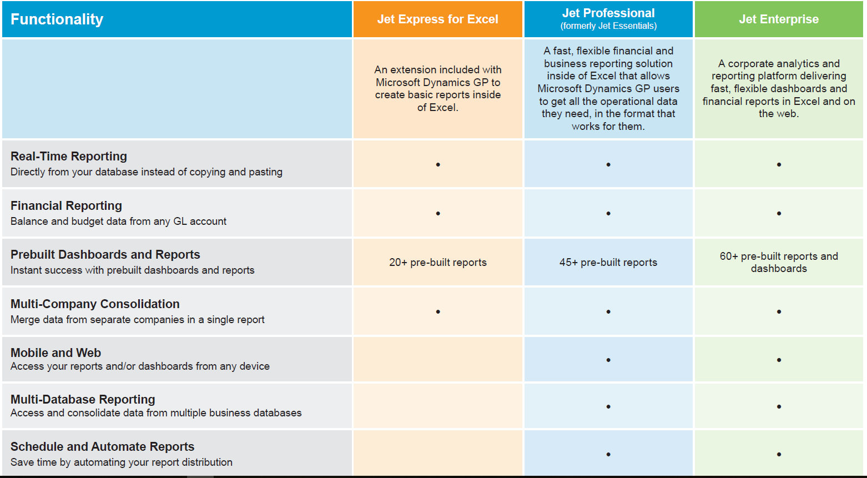
Notes:
On to today’s topic …

Slide 15
Notes:
On to today’s topic …

Slide 16
For a more in depth review contact us or join us on the upcoming webinars. June 12th - Power BI June 26th – Jet Reports July 10th – Solver BI360
Notes:
Who moderate?

Slide 17
Any questions?
Notes:
Who moderate?

Slide 18
Thank you
Paul James
763-412-4336
pjames@boyerassoc.com
www.boyerassoc.com
Notes:
I can put you in contact with our presenters also.

