Slide 1
What’s New in Dynamics NAV 2018

Slide 2
Dynamics NAV / 365 Business Central Roadmap
Q1
2016
Q4
2016
Q4
2017
Q2
2018
Q4
2018
Dynamics NAV 2016
Dynamics NAV 2017
Dynamics NAV 2018
Dynamics 365 Business Central On Premises
Dynamics 365 for Financials, Business Edition
Dynamics 365 for Finance and Operations, Business Edition
Dynamics 365 Business Central
Dynamics 365 Business Central
Cloud

Slide 3
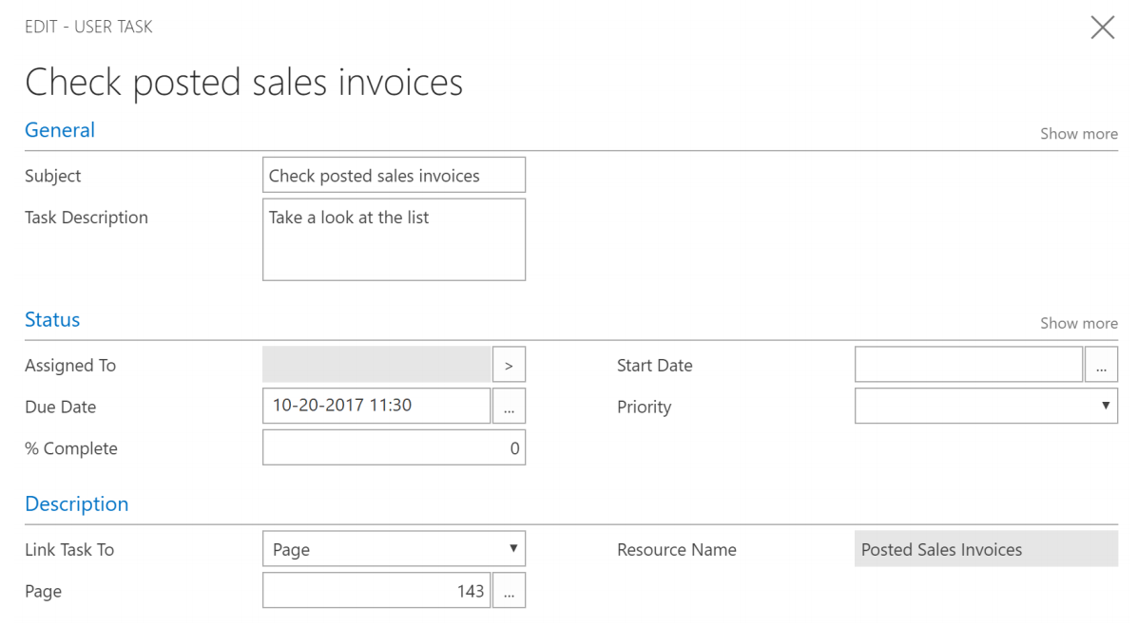
User Tasks

Slide 4
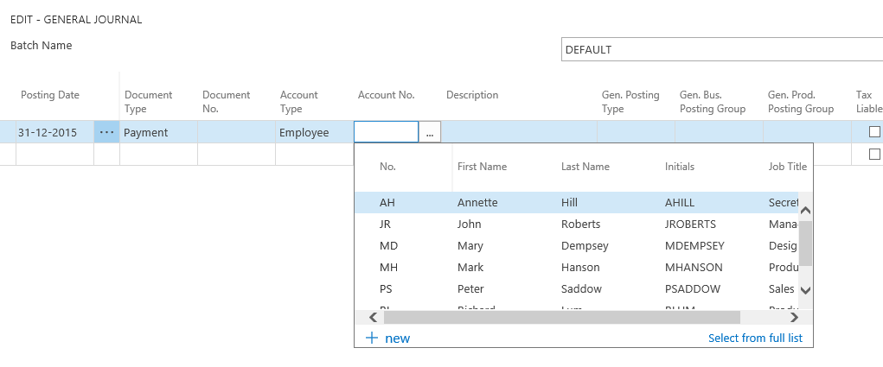
Employee Ledger Entries

Slide 5
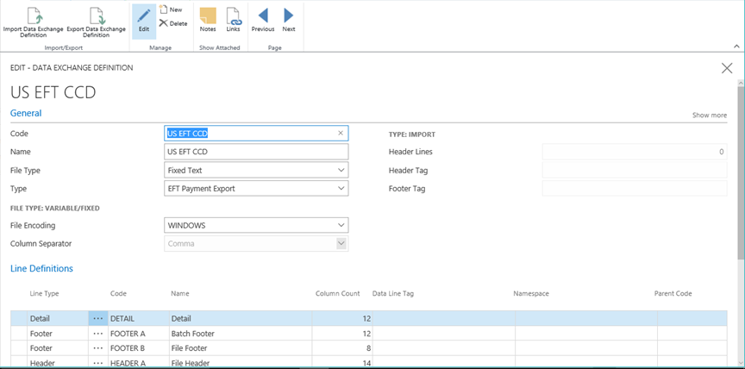
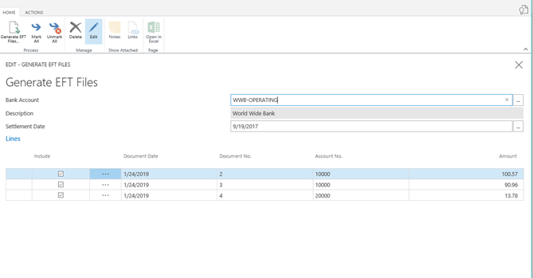
Bank Account EFT Enhancements

Slide 6
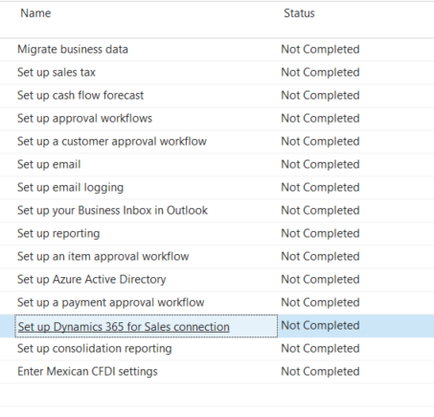
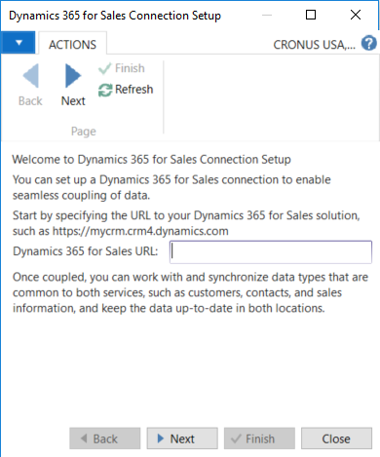
Assisted Setup

Slide 7
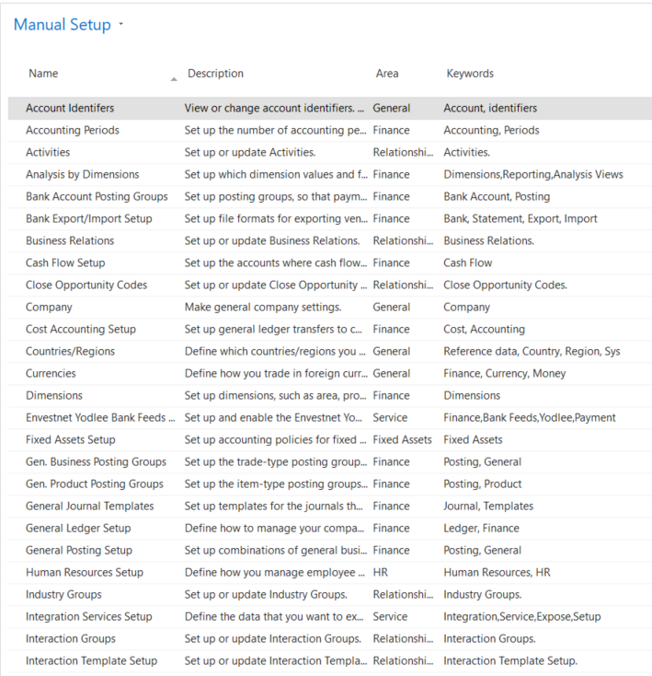
Manual Setup

Slide 8
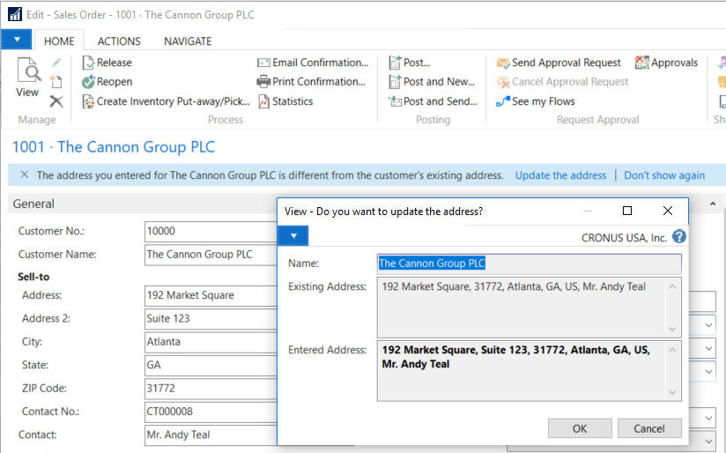
Update Customer/Vendor from Order

Slide 9
Dynamics 365 Business Central

Slide 10
What is “the cloud”?
Computer hardware and
software services, connected
using the Internet.

Slide 11
SaaS
Software as a service.
Azure
Microsoft’s network of cloud computing services.
365
Software and services offered by Microsoft as an ongoing subscription.

Slide 12
Cloud Computing is a Growing Market
153.5 B
221.1 B
302.5 B
2017
2019
2021
Worldwide Public Cloud Service Revenue Forecast
April 2018 Gartner

Slide 13
Cloud Computing Benefits
Lower upfront investment
High availability
Flexible costs
Improved mobility
Continuous upgrades
Reduced IT overhead

Slide 14
Ongoing Software Expenses
Server hardware and software
Software maintenance renewals
IT support
System repairs and maintenance
Data backup storage
Software upgrades

Slide 15
Introducing Dynamics 365 Business Central
Cloud service provided by Microsoft
Monthly per-user subscription
Complete Dynamics NAV functionality
Accessed using web browser or mobile/tablet app

Slide 16
On-Premises NAV is Not Going Away
Planned major releases each year for both products.
Shared codebase between cloud and on-premises products.
Cloud hosted software is not an option for every organization.
Boyer’s goal is to provide you with the solution that best suits your business needs.

